Slide 1
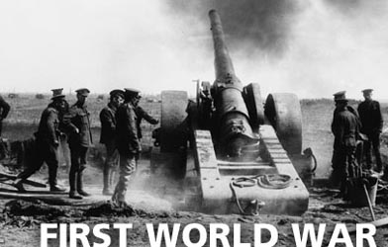
First World War

Slide 2

First world war at a glance
Started in 28th July 1914 & finished 10th Nov 1918.
Two force Central force & Allied force.
Central force: Germany , Austria & Hungary.
Allied force: United Kingdom, France & Russian
Empire.
Bitter nationalism & militarism of Germany uprooted
the war.
2/3 people of the world were under the war.
Civil people killed more than military people.
Weapons like tank, big gun, submarine, poisonous gases
used for the first time.
Central force defeated in the war
Deaths were twice in number in first world war than all wars of Europe till 1790-1913.
Industries expanded for industrial revolution used in war.

Slide 3
The First world war- causes
Raise of Germany & leadership of Bismarck
Mutual defense alliance
Rough Nationalism
Military competition
Social Darwinism

Slide 4
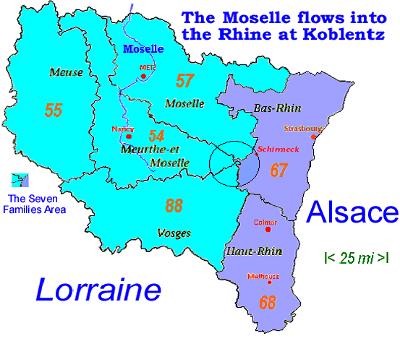
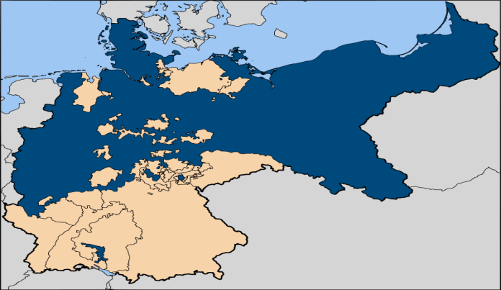
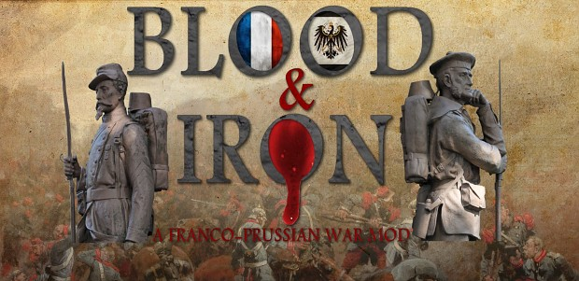
Raise of Germany & leadership of Bismarck
In Franco Prussian war Germany won & seized Alsace & Lorraine province from France.
A large empire through Prussian’s
leadership.
Blood & iron policy of
Bismarck
Germany

Slide 5
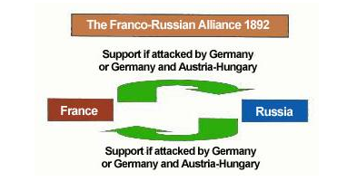
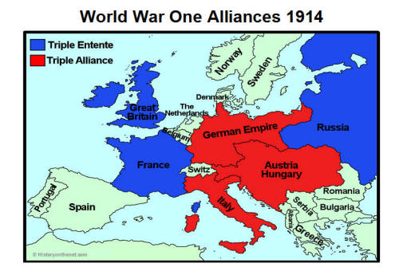
Mutual defense alliances
Triple alliance
Germany made alliance with Austria & Italy to make France alliance less country.
Dual alliance
Miserable condition of France.
Russia broke ‘Reinsurance’ treaty with Germany & France
made ‘Dual Alliance’ with Russia.
Triple entente
England was panic & opposed the expansion of Russia in the
east & favored Germany.
Expansion of German colonies in Africa, railway line from
Berlin to Parossho Upasagar,
Expansion of German empire, priorities over sea forced
England thought that Indian British empire might at stake.
Leaving it’s neutral position England joined hand
with dual alliance because of it’s security & formed ‘Entente Cordiale’ with France.

Slide 6
Rough Nationalism
Competition between German & Britain encouraged by intense navy & armed forces.
Arrogant nationalism derived to get imperial power in Asia, Africa & Balkan regions.
Jealousy, power, domination lead to start war.
Uses of Newspapers.
Armed peace or Pacism.

Slide 7

Military competition
German arms became 8,70,000
In 1913
Compulsory 3 years army jobs in France
Compulsory Arm training in Russia
Britain enriched navy

Slide 8

Social Darwinism
Emphasized on social competition of different nations, minorities, races & colors at social level.
Adopted by political elites of Europe.
Survival of the fittest.
Encouraged competition on establishing colonies & naval arms race.

Slide 9
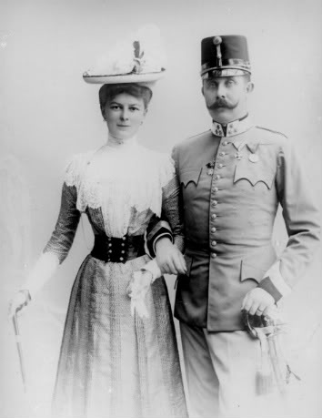
Immediate cause
Assassination of Archduke Franz Ferdinand in Sarajevo.
Ultimatum letter of Austria intended by Germany.
Declaration of war by Austria.

Slide 10
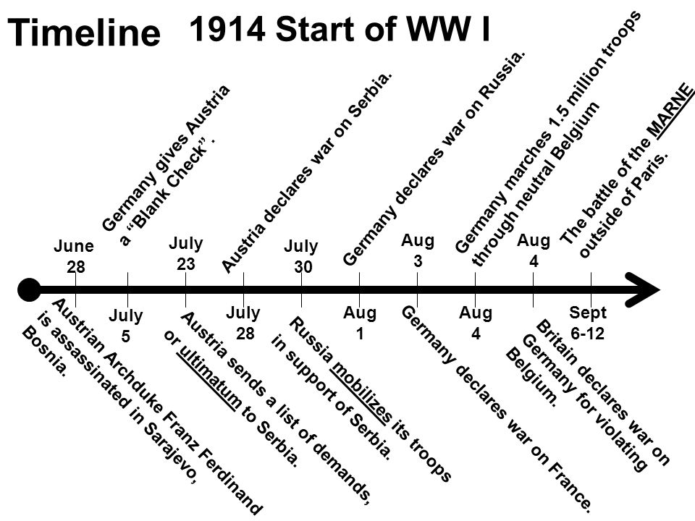
Cont.

Slide 11
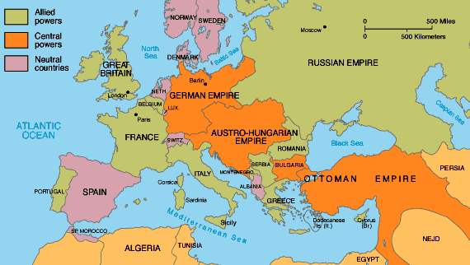
Central Power & Allies
Central powers Allied powers
Austria-Hungary Serbia
Germany France
Ottoman Empire Britain
Bulgaria Belgium
Italy
Russia
Japan
Greece
Romania
America
Indian sub continent

Slide 12
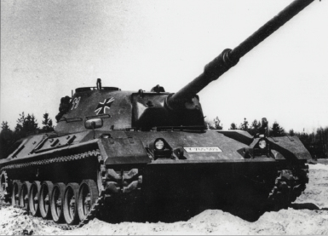
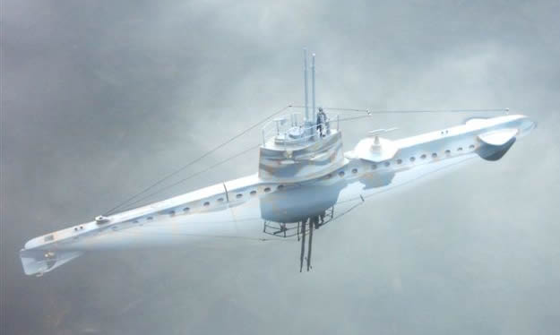
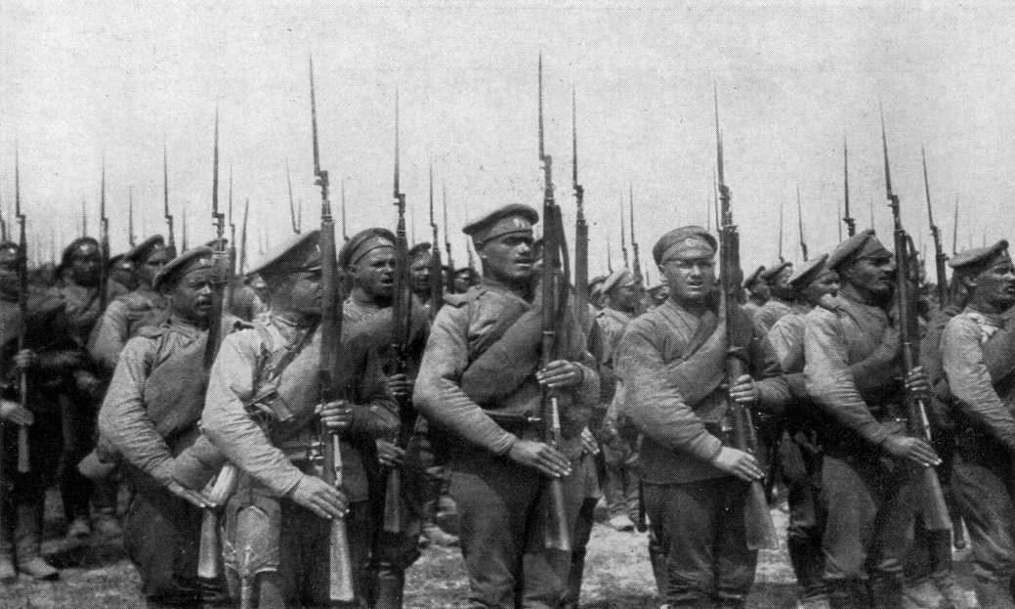
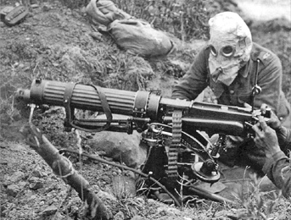
artillery of first world war

Slide 13
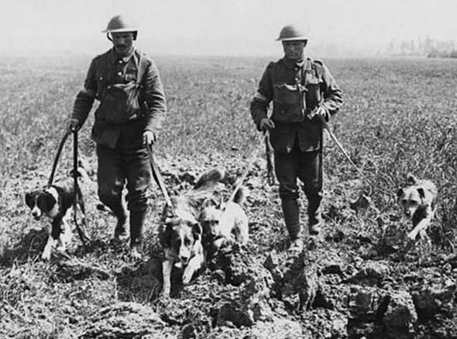
Use of canines in world war 1
A watchdog never barks; at the most he will use a low growl to indicate the presence or approach of a hostile force – quote from the article of Mr. Richardson

Slide 14
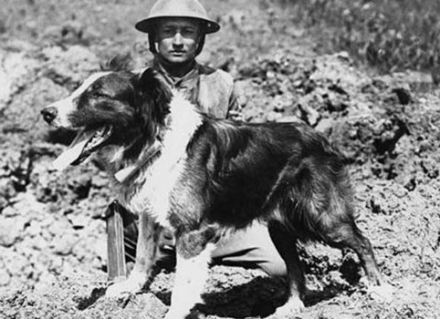
20,000 dogs helped frontline soldiers used by allied troops.
carried aid to the wounded, delivered messages, pulled along vital equipment and sniffed out enemy soldiers.
War Dog School of Instruction in Hampshire were established by war office.

Slide 15
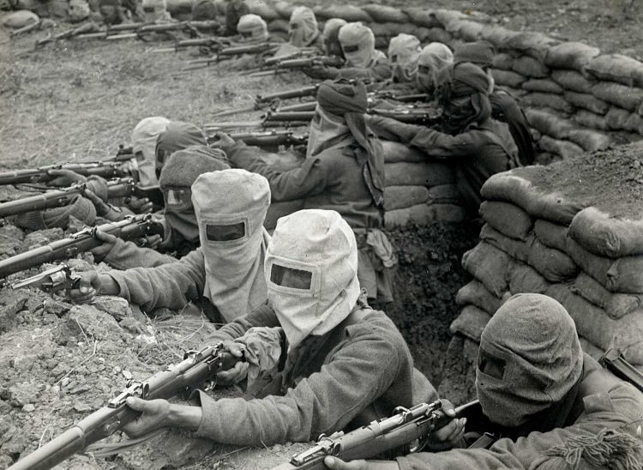
Stages of the war

Slide 16
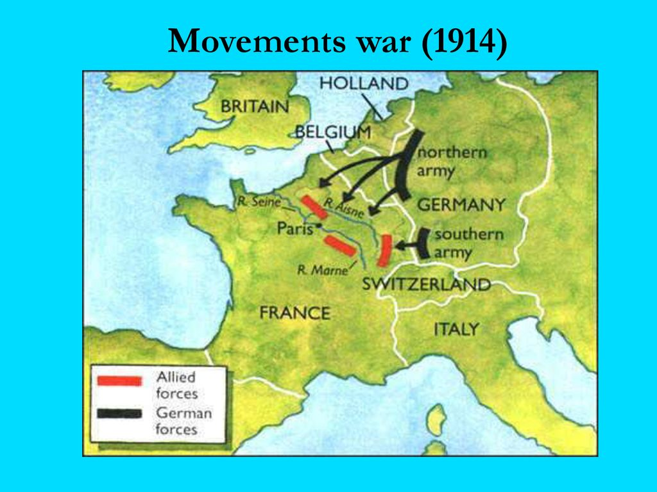
The war of movement
The war started with a movement of troops on both fronts trying to have a quick victory. Germany attacked France through Belgium – a neutral country – expecting the French surrender in six weeks. However, France stopped the German advance at the First Battle of Marne.
In the Eastern Front, Russia was defeated by Germany at the Battle of Tannenberg. Then Russia attacked the Austro-Hungarian Empire while Serbia stopped the Austrian advance.

Slide 17
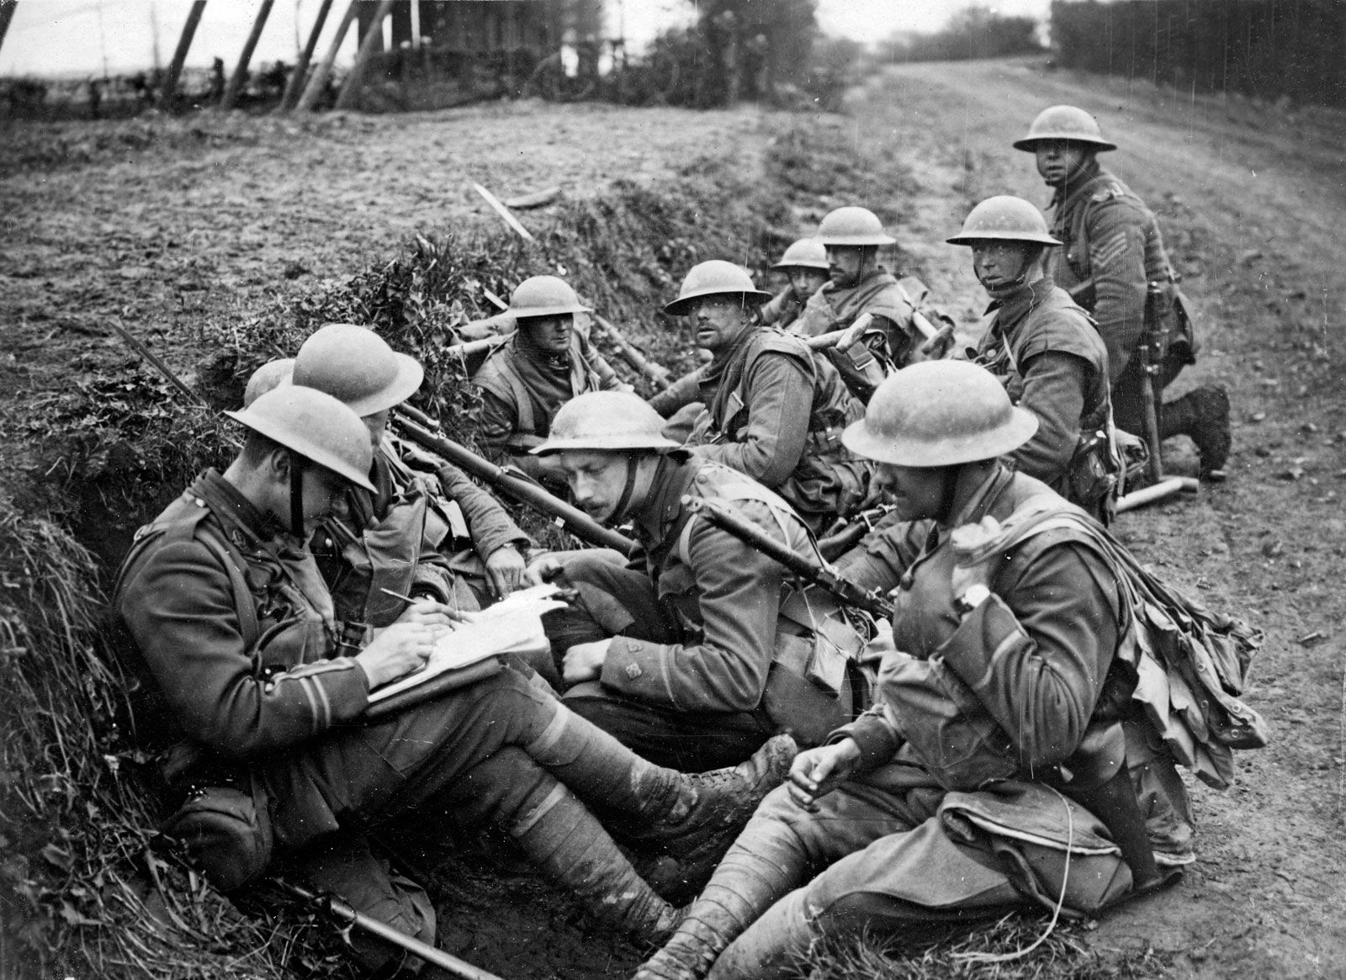
Trench warfare (1915-1916)
After the Battle of Marne, the advance on the front slowed down.
Trenches were built to prevent enemy advance. In addition, new countries entered the war: Turkey, Italy, Bulgaria, and Romania.
In 1916, Germany launched an offensive in the Western front that was stopped by the French army at the Battle of Verdun. France and Great Britain attacked Germany at the Battle of Somme but were unsuccessful.

Slide 18
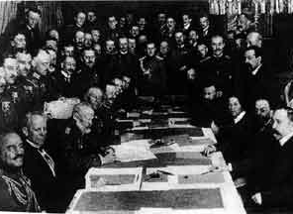
The crisis of 1917 and the end of the war
The most decisive year in the First World War was 1917. Russia withdrew from war due to the Revolution while United States entered the war when a British cruiser with American passengers was sunk by a German torpedo. The United States contributed two million soldiers and its industrial potential to the Allies , changing the course of the war. The allies defeated the Austro-Hungary Empire and its allies on the Eastern front. The Austro -Hungarians and the Ottoman Empire asked for an armistice, so the war ended on the Eastern front.
On the Western front, the Germans were defeated at the Second Battle of the Marne. There were revolts in the German army and navy. Then Germany signed the armistice on November 11, 1918.

Slide 19
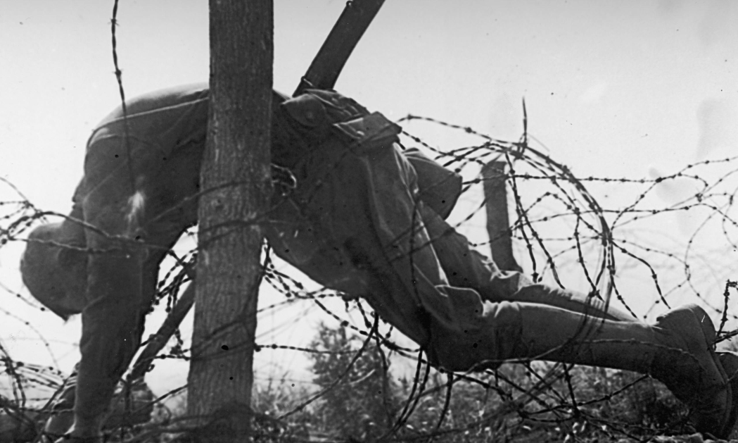
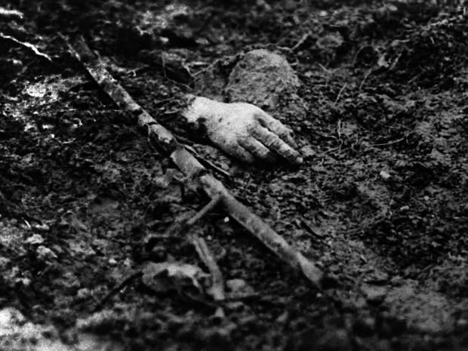
Devastation in First World war
Total deaths: 17 million
Wounded: 20 million
Military : 10 million
Civilian : 7 million
Deaths of military personnel
The entente powers : 6 million
Central powers : 4 million

Slide 20
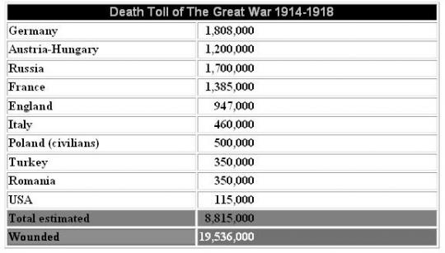
Cont.

Slide 21
Consequence of 1st world war
Economic consequence
Terrible loss of human life and increased property.
Different diseases and famine.
Financial cost estimated about 400 billion dollars.
Large scale of unemployment.
Germany was particularly badly effected.
Economic collapse in Germany’s business went bankrupt.

Slide 22
Consequence of 1st world war
Political consequences
The maps of Europe was reconstructed.
Different treaties.
The treaty of Versailles made Germany stand fully unarmed before the fully armed allied power.
The all kinds of tanks, armed cars, Military Aero planes, submarines were forbidden in Germany.
Creation of League of Nation at the Paris peace conference.
Democratic culture in Germany through ‘VI mar republic’
European countries reformed on the basis of nationalism.

Slide 23
Consequence of 1st world war
Colonial consequence
Deprivation of Germany’s colonies & was totally disarmed by the Versailles treaty.
Emergence of great power in Europe, USA, far East and Great Britain.
Great Britain proved to be leading maritime & colonial power on the Earth.
New nations were established on the ruins of old ones.
Nationalist independence protest will lead to the process of colonial emancipation.

Slide 24
Consequence of 1st world war
Emergence of new power
France came to be the regarded as a great military power in Europe.
Japan enhanced it’s power & prestige in the far East.
USA emerged from 1st world war as a great world power.
Autocratic leadership of Adolph Hitler.
Victorious countries emerged as the strong world power.

Slide 25
The Peace Treaties
Paris Peace treaty (1919)
Treaty of Versailles
-between Germany & Versailles
Treaty of Saint Germain
-between Austria & Saint Germain
Treaty of Trianon
-between Hungary & Trianon
Treaty of Neville
-between Bulgeria & Neville
Treaty of Sevres
-between Turkey & Sevres

Slide 26
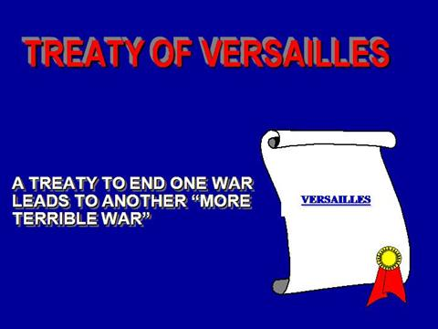
Treaty of Versailles
For establishing peace in Europe
Germany unwillingly signed it in 28th June, 1919
Returned Alsace & Lorraine to France.
Austria & Hungary termed as two new state.
Reduce German’s power in navy, arm & forced to surrender.
Reduce German’s power in trade & gave trade ports to France.
Determined to take compensation of war from Germany.
Seized arms, weapons & destroyed Heligoland army station.
France got right of coal & mine regions for 15years.
Initiate defensive measures.

Slide 27

The League of Nations
Established in 28th June 1919 for reducing risks of further war
& to control international relations.
For establishing peace & reduce sufferings of
countries defeated in war.
The League home was in Geneva & Primary
member was 42
Succeeded in mediating conflicts between two small regions of Balkan.
Failed in 1946
Recognized voting right of women.
Nazism developed in Germany & socialism in Russia.

