Slide 1
Hitler’s Rise to Power

Slide 2
A little background
Wanted to be an artist – father wanted him in public service
After father died – he dropped out of high school tried to get into an art academy – denied
WWI veteran
Was a victim of mustard gas

Slide 3
Origins of the Nazi Party
Bitter after WWI, he joins a German workers’ party
This becomes known as the National Socialist German Workers’ Party = NAZIS
Hitler gave many speeches that spelled out the Nazi programs
It was a very small political group at the beginning
He was a brilliant public speaker

Slide 4
Nazi Beliefs
German people had been separated into warring social classes for too long.
By eliminating the differences between the rich and poor, Germany could be strong and united.
The defeat in WWI and all other issues were blamed on the Jews and Communists – not on the German people.

Slide 5
Nazi Beliefs
All those who were not blond, blue-eyed members of the Aryan or German race were at fault.

Slide 6
The Third Reich
Depression 1929
6 million Germans unemployed
He promised the people he could rebuild the economy
Denounced the Treaty of Versailles
By 1932, Nazi party was most powerful political party in Germany
Became Chancellor in 1933

Slide 7
The Third Reich
Persuaded German President Paul von Hindenburg to suspend all German civil rights
Using false promised and violence, he get the Reichstag (parliament) to give him the power to make all laws without their consent
June 1934, all members of the military must swear personal allegiance to Hilter
After Hindenburg dies in August 1934, Hitler abolishes the office of President
Declare himself Fuhrer – supreme leader – of the German Empire – The Third Reich

Slide 8
The Third Reich
He becomes a totalitarian dictator
He begins to invade nearby lands
1st – the Rhineland – eastern boarder with France
France and England did not do anything
Formed an alliance with Italy in 1936 – Axis Powers
Both sent troops and supplies to the civil war in Spain

Slide 9
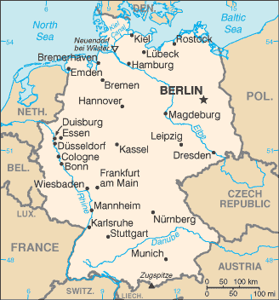

Slide 10
Review time!
How did the Nazi party begin?
What were their beliefs?
How did Hitler gain control in Germany?

Slide 11
Activity
With a partner, read the Appeasement handout and answer the questions on the back of the reading IN YOUR NOTES.

Slide 12
Appeasement
March 1938, Hitler claimed Austria as part of Germany
6 months later, he occupied the Sudetenland region of Czechoslovakia
Hitler said the Germans living there wanted to become part of Germany
Britain and France adopted a policy of appeasement – gave in to his demands to in an attempt to keep the peace

Slide 13
Munich Conference
Britain and France not happy
Hitler promised not to take over any more territory
September 1938
Winston Churchill, British Prime Minister said, “Britain and France had to choose between war and dishonor. They chose dishonor. They will have war.”

Slide 14
Road to War
5 ½ months later, Hitler takes over Czechoslovakia
August 1939, Germany signs a nonaggression pact with the Soviet Union
The agreed that they would not attack each other and secretly agreed to divide Poland between the two countries

Slide 15
Road to War
September 1, 1939 Hitler invaded Poland by land (tanks) and by air
This was called a blitzkrieg – all out style of attack
2 days later, Great Britain and France, who had pledged to protect Poland, declared war on Germany
WWII had begun
(Video clip Days that Shook the World)

Slide 16
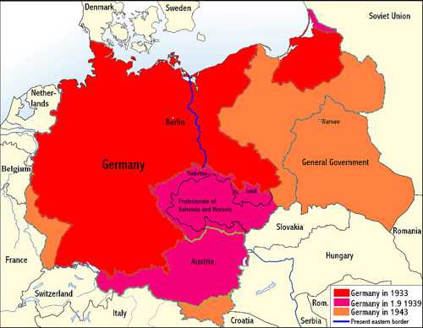

Slide 17
Review time…again
What does appeasement mean?
What happened at the Munich Conference?
Why were Great Britain and France so mad at Germany?
What caused them to declare war?

