Slide 1
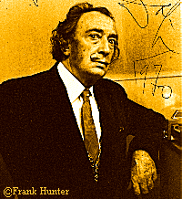
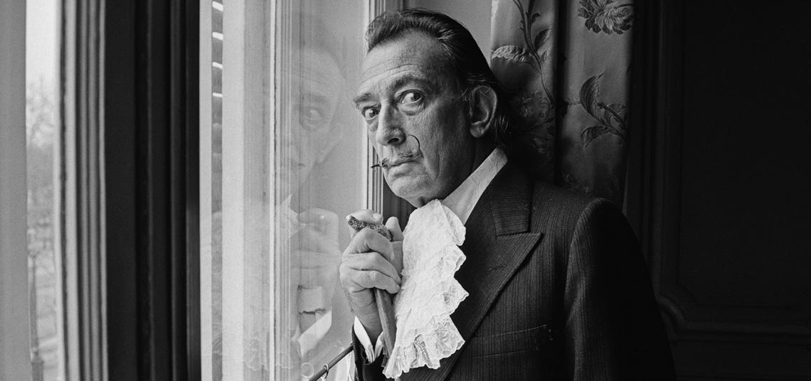

MARÍA SANZ

Slide 2
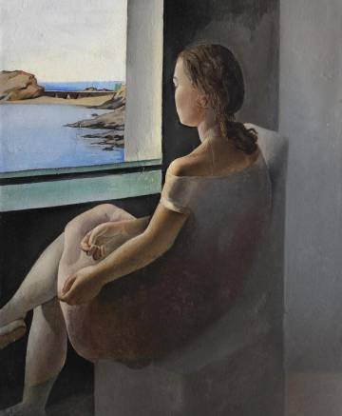
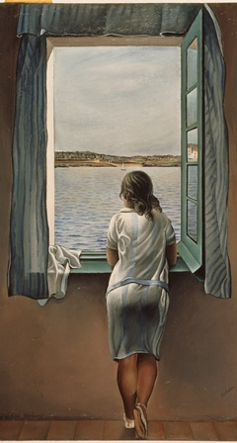
Biography
Salvador Felipe Jacinto Dali i Domenech was born on May 11, 1904, in the small agricultural town of Figueres, Spain, in the foothills of the Pyrenees.(his older brother with the same name died 9 months prior to his birth)
Is it me or is that just weird? Wait it gets weirder…

Slide 3
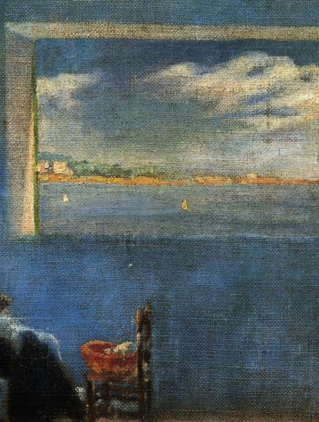
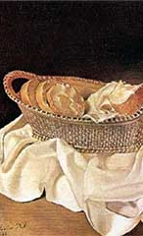
When he was 5 Dali was taken to his brother’s grave and told by his parents that he was the reincarnation of his brother. A concept which he came to believe.

Slide 4
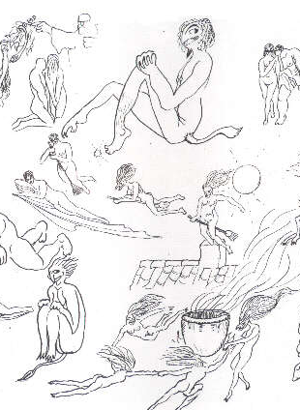
Early entries in Dali’s sketchbook

Slide 5
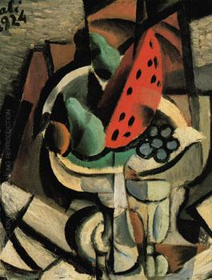
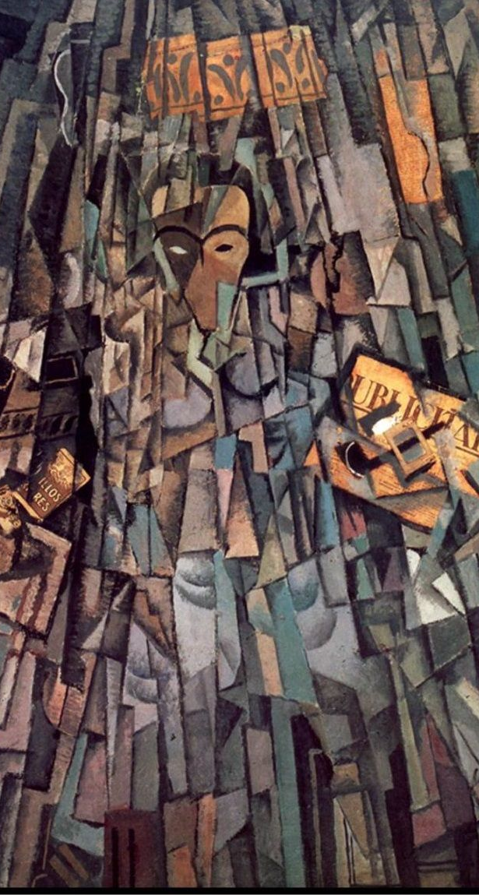
Attends drawing school at age 12.
Has his first public exhibition at age 15.
At age 17 he attends the Royal Academy of the Arts (a kind of Nueva in Madrid).
There he met the Spanish filmmaker Luis Buñuel and poet Federico García Lorca

Slide 6
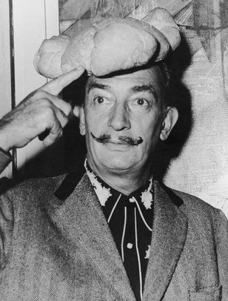
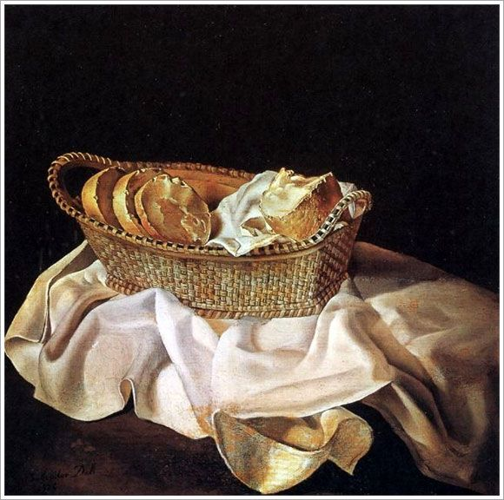
Is expelled from the Academy the same year he paints Basket of Bread which is shown in the Carnegie International Exhibition in Pittsburgh in 1928.

Slide 7
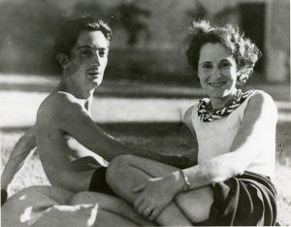
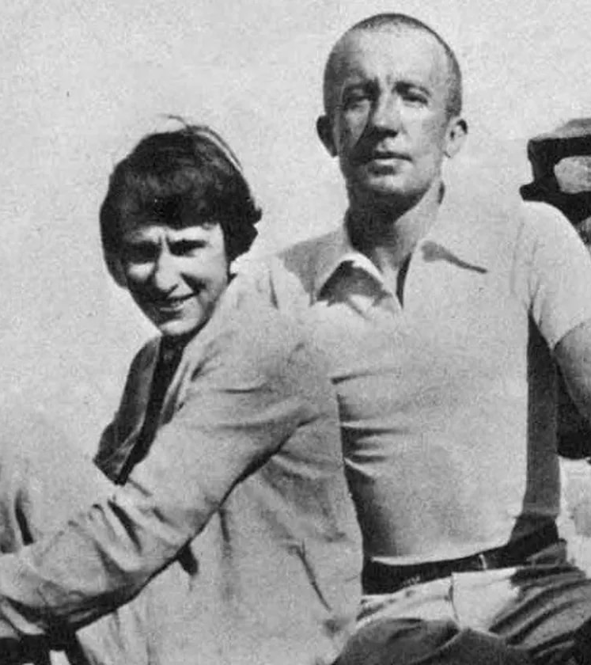
That year Dali met Gala Eluard when she visited him in Cadaques with her husband, poet Paul Eluard. She became Dali's lover, muse, business manager, and chief inspiration.
He devours many styles of art during the 1920s ranging from the most academically classic to the most avant garde.

Slide 8
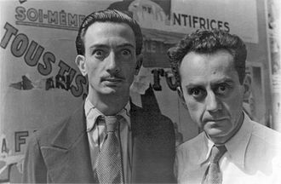
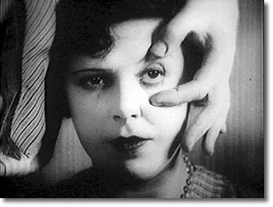
Dali collaborates on script with Bunuel. He later claims to have played a significant role in its creation.

Slide 9
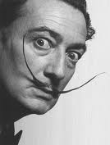
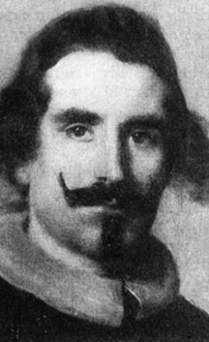
Dali grew a flamboyant moustache, influenced by 17th century Spanish master Diego Velazquez. The moustache became an iconic tramark of his appearance for the rest of his life.

Slide 10
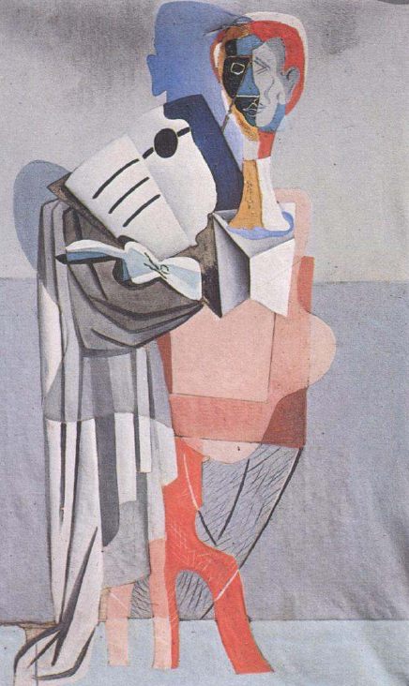
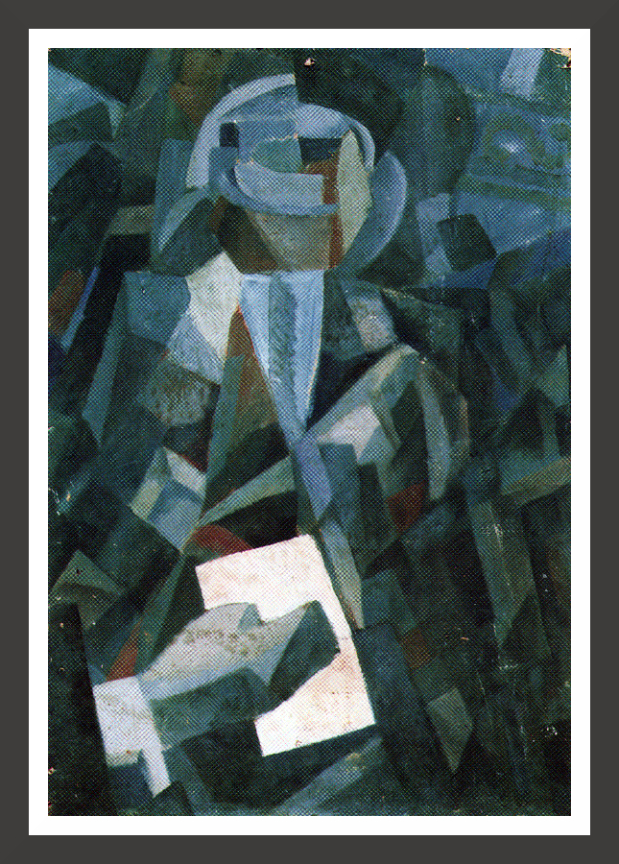
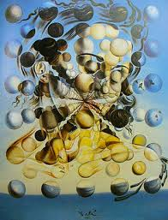
INFLUENCES
Dalí went to Paris in 1926, where he met Picasso, for whom he had a great deal of respect.
Picasso’s influence is seen in many of Dalí’s paintings.
In 1929 Dalí joined a group of surrealists living in Paris.

Slide 11
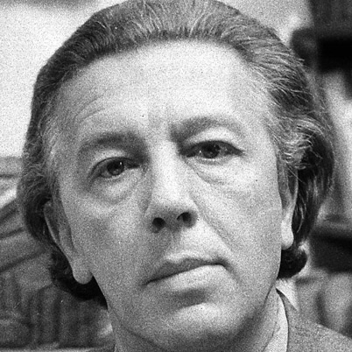
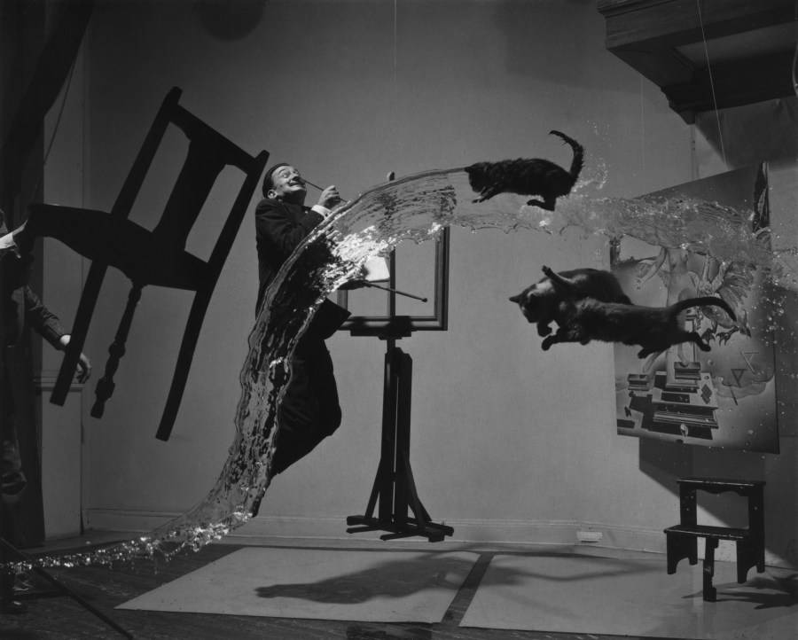
SURREALISM
The founder of surrealism was Andre Breton.
Breton thought that all the world’s problems were caused by rational thinking.
In Breton’s opinion, rational thinking is what led to World War I.

Slide 12
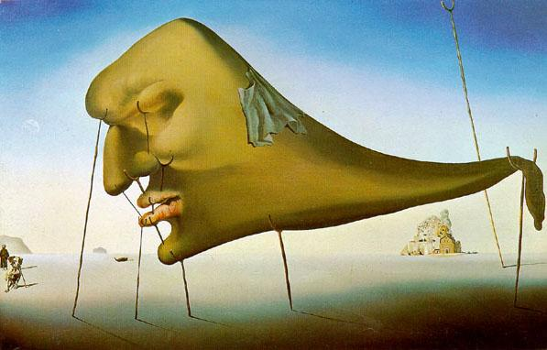
Instead of rational thinking, surrealism focuses on the subcon-scious mind.
According to Breton, dreams and fantasy should be expressed without editing.
Sleep, 1937

Slide 13
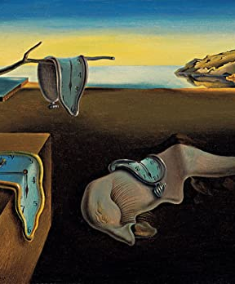
Dali soon became a leader of the Surrealist Movement. His painting, Persistence of Memory (1931), is still one of the best known surrealist works. But, as war approached, the apolitical Dali clashed with the Surrealists and was expelled from the Surrealist movement during a "trial" in 1934. He did, however, exhibit works in international surrealist exhibitions throughout the decade.

Slide 14
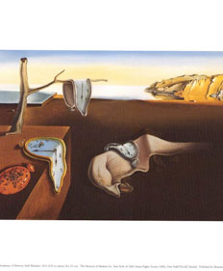
Persistence of Memory 1931

Slide 15
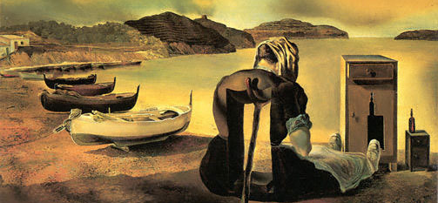
The Weaning of Furniture- Nutrition
1934

Slide 16
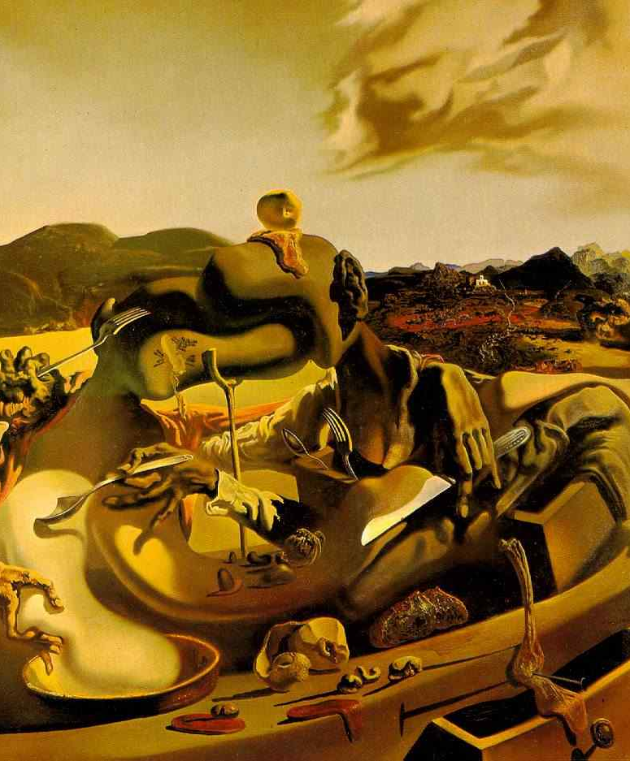
Cannibalism In Autumn
1937

Slide 17
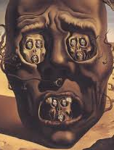
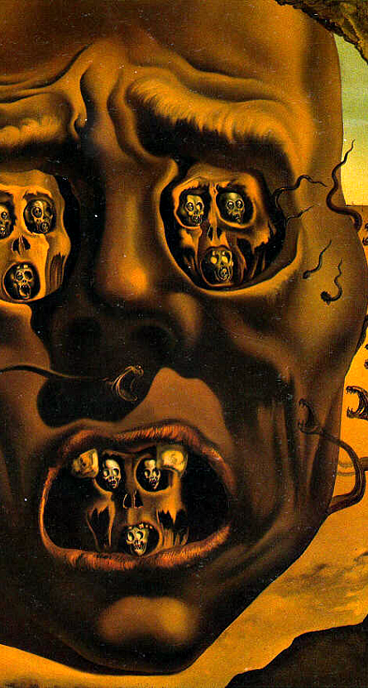
Face of War 1940
By 1940 Dali was moving into a new style which eventually became known as his "classic" period, demonstrating a preoccupation with science and religion.

Slide 18
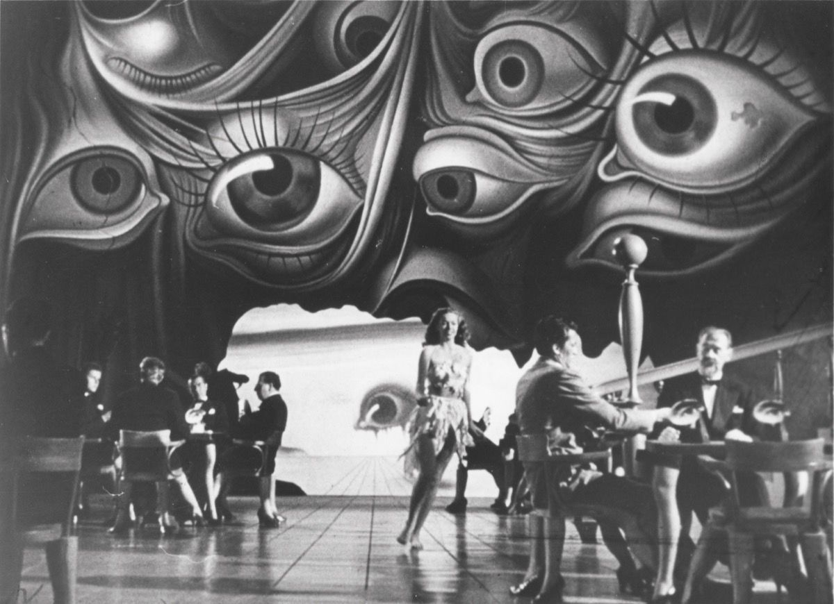
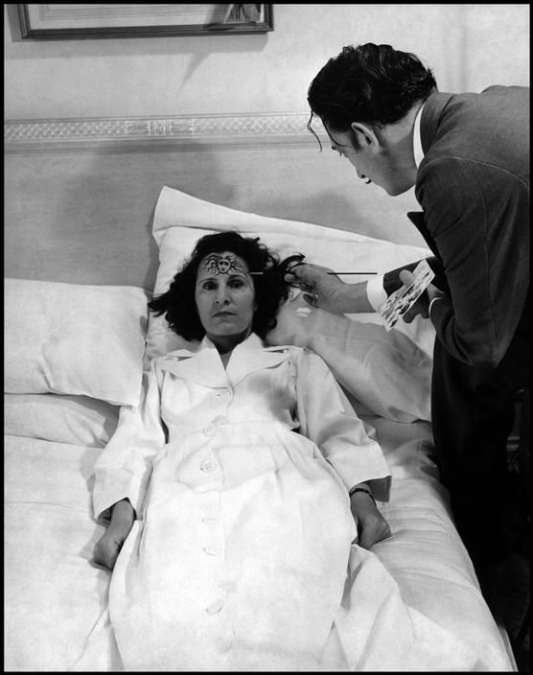
Dali and Gala escaped from Europe during World War II, spending 1940-48 in the United States. These were very important years for the artist. The Museum of Modern Art in New York gave Dali his first major retrospective exhibit in 1941. This was followed in 1942 by the publication of Dali's autobiography, The Secret Life of Salvador Dali.

Slide 19
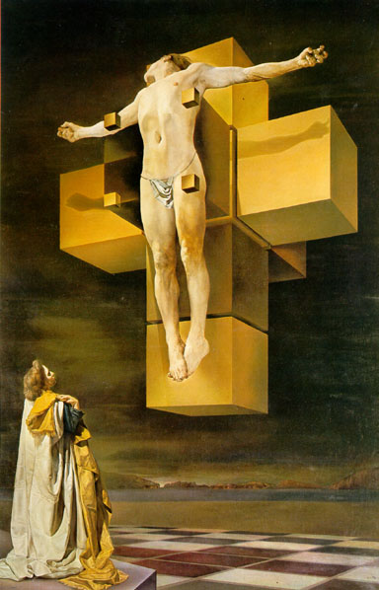
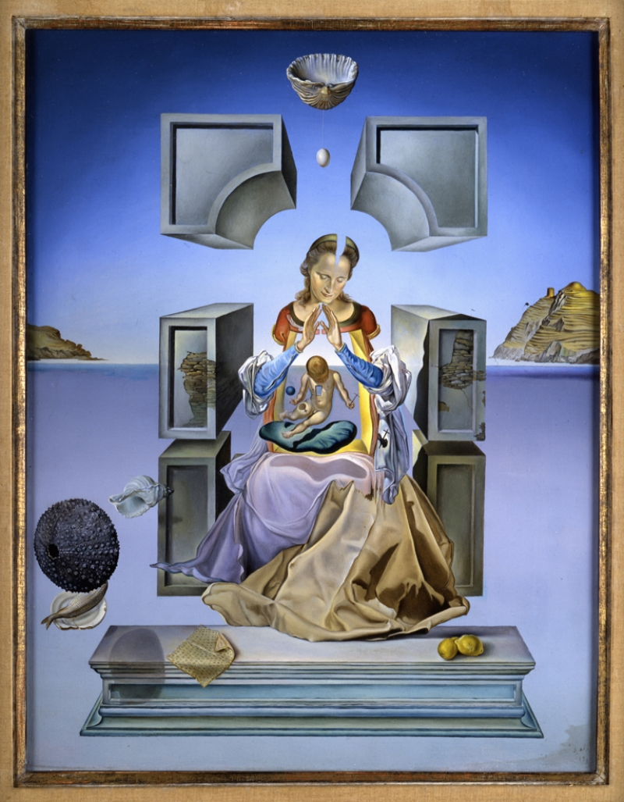
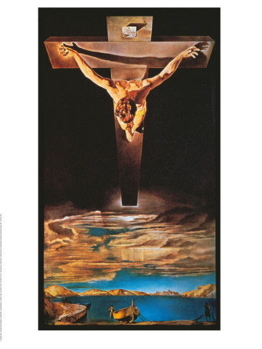
1950-1970
Dalí began to paint religious themes.
Crucifixion, 1954

Slide 20
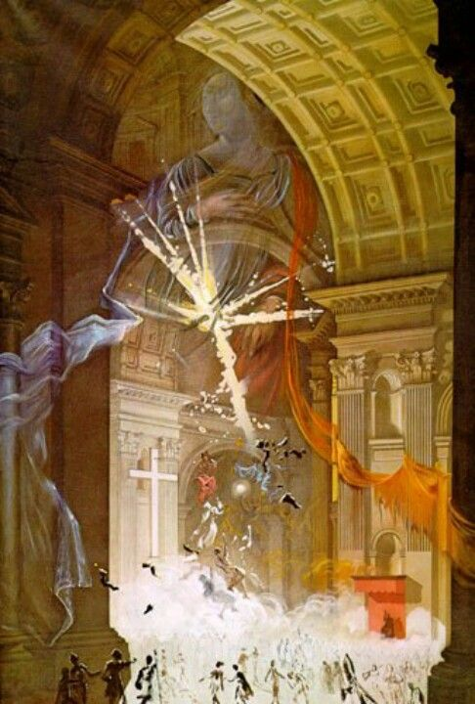
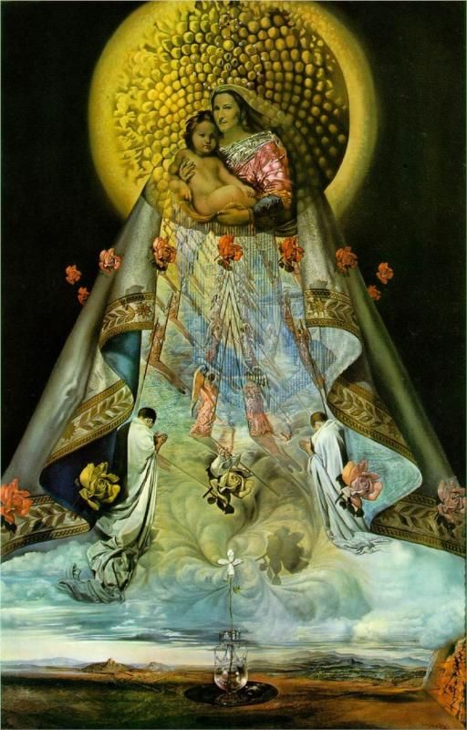
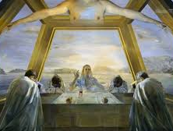
RELIGIOUS
AND
MYSTICAL
INSPIRATION

Slide 21
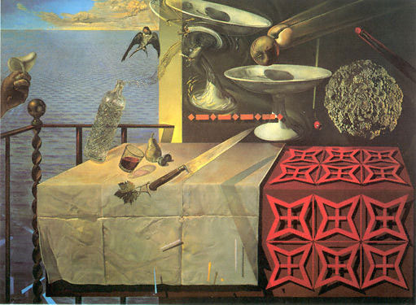
Still-life Fast moving 1956

Slide 22
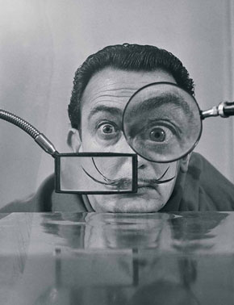
“There is only one difference between a madman and me. I am not mad.” --Salvador Dalí

Slide 23
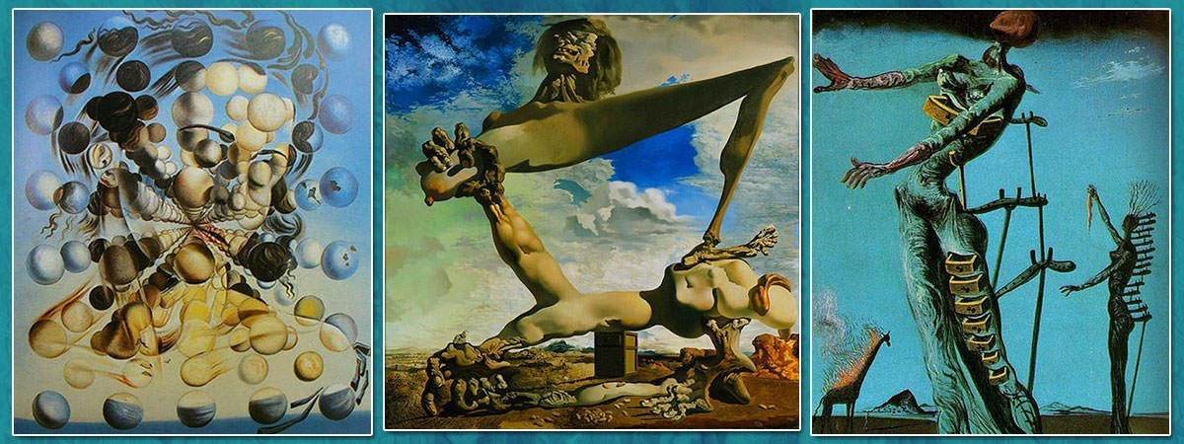
In 1974, Dali opened the Teatro Museo Dali in Figueres, Spain.
After the death of his wife, Gala, in 1982, Dali's health began to fail. It deteriorated further after he was burned in a fire in his home in Pubol in 1984.
Two years later, a pacemaker was implanted. Much of this part of his life was spent in seclusion, first in Pubol and later in his apartments at the Torre Galatea, adjacent to the Teatro Museo.
Dali died January 23, 1989 in Figueres-

Slide 24
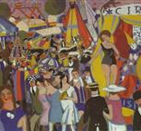
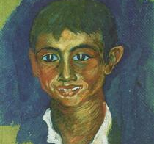
DALI´S WORKS - EXPRESSIONISM

Slide 25
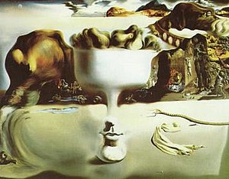
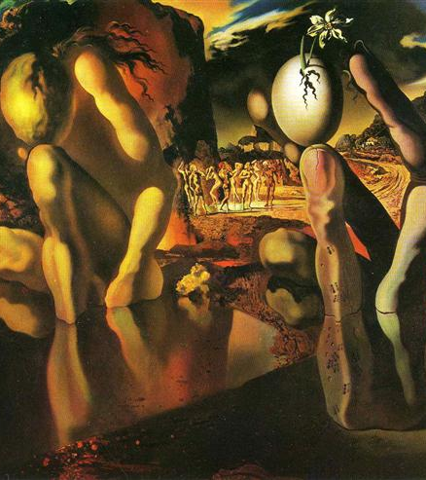

DALI´S WORKS: SURREALISM

Slide 26

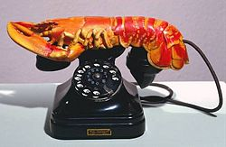
DALI´S WORKS: SURREALISM

Slide 27
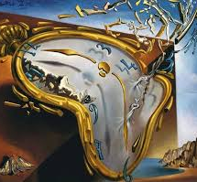
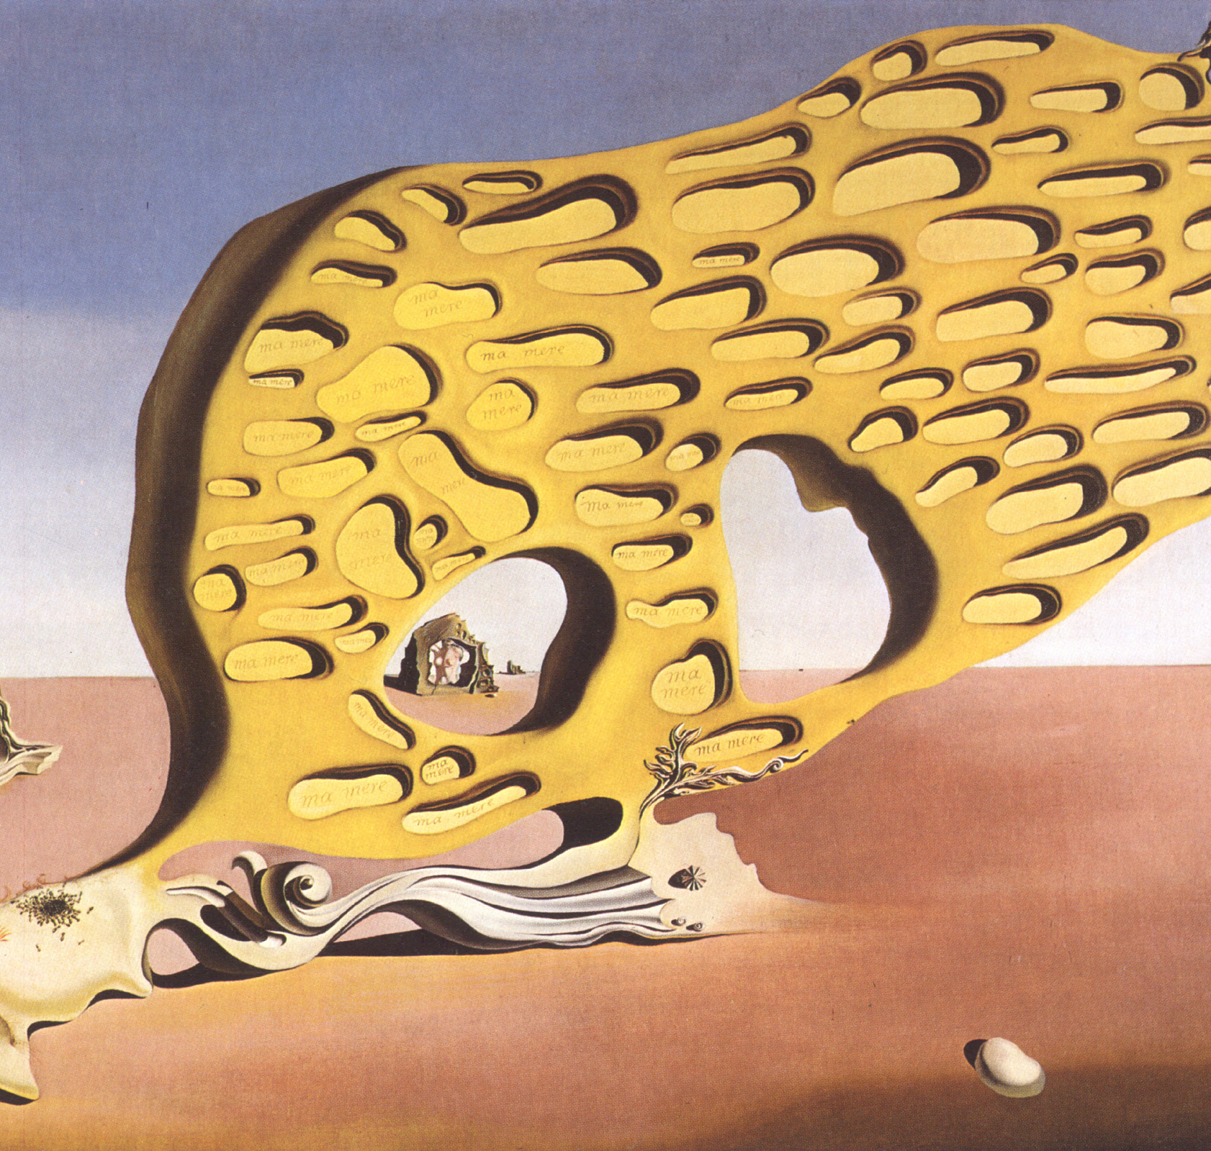
DALI´S WORKS: SURREALISM

Slide 28
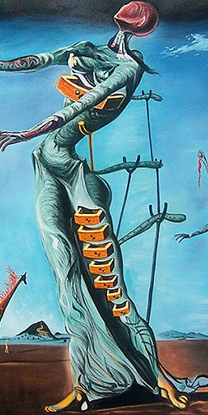
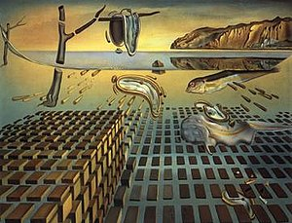
DALI´S WORKS: SURREALISM

