Slide 1
POST - IMPRESSIONISM
MARÍA SANZ

Slide 2
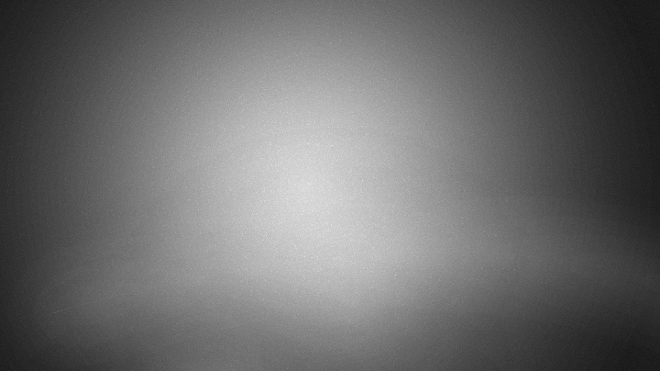
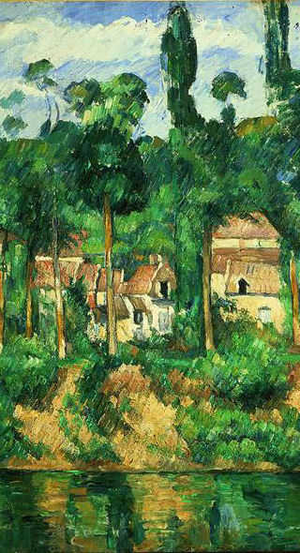
Post Impressionism
At the end of the 19th century / beginning of the 20th century, artists began to develop more personal styles
The main Post Impressionist artists were Paul Cezanne, Vincent Van Gogh and Paul Gauguin
These artists would be highly influential to the Cubist, Expressionist and Fauve movements of the 20th century

Slide 3
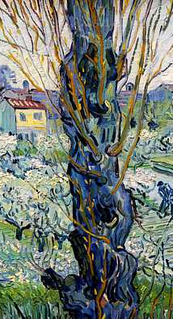
Post Impressionism
Characteristics of the Post Impressionist Style:
Painting Compositions describing form in terms of its underlying geometric structure - eg sphere, cone, cube, cylinder etc (Cezanne)
Use of colour contrasts for defining surfaces and forms (Cezanne/ Van Gogh/ Gauguin)
Use of Advancing and Receding colours to create depth in painting (Cezanne/ Van Gogh)
Less emphasis on accuracy in drawing (Van Gogh)
Use of parallel and Expressive brushstrokes (Cezanne/ Van Gogh)

Slide 4
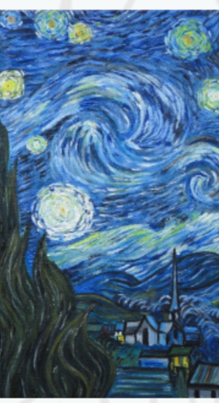
Post Impressionism
Characteristics of the Post Impressionist Style:
Use of pure colour with a great emotive charge (Van Gogh)
Paintings with extreme diagonals and curved brushstrokes that tend to express anguish and depression (Van Gogh)
Creation of simplified, flat painting compositions based on shapes (Gauguin)
Harmonious and bright colour use (Van Gogh/ Gauguin)

Slide 5
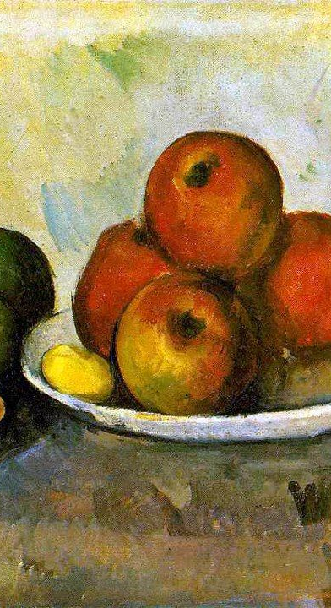
Paul Cezanne
  His paintings covered the use of structure and volume through the use of geometric shape, and definition of
  the forms through painted parallel brushstrokes
  He tended to use primary and secondary and tertiary colours
  He used contrasts and tones to build 3D form
  He used advancing and receding colour to create
  depth, and he sometimes used multiple viewpoints
  His belief that “Everything in Nature adheres to the
  sphere, cylinder, cone and cube” was a main basis
  for his paintings of all subject matter
  He influenced the 20th century Cubist movement

Slide 6
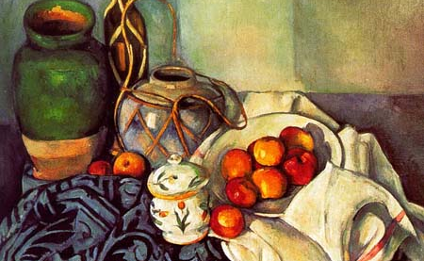
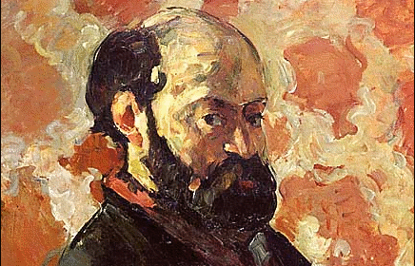
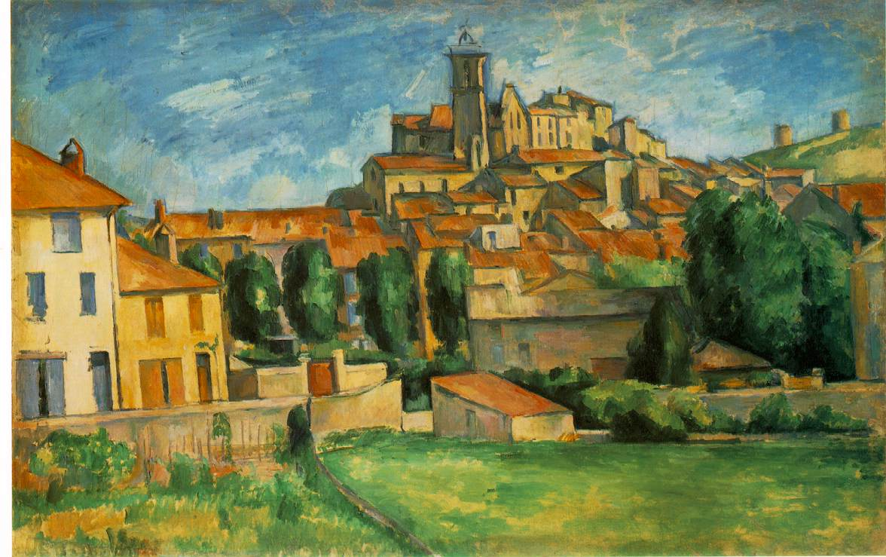
Paul Cezanne
Cezanne best known for his :
Still Life
Portraits
Landscapes

Slide 7
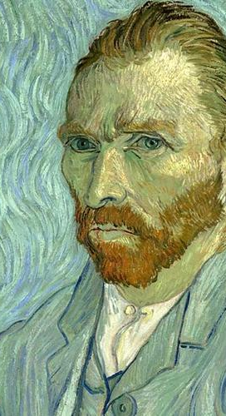
Vincent Van Gogh
  He painted curved, wavy brush marks in his landscapes
  His brushstroke is very characteristic -wavy, sinuous, or diagonal and thick
  Colours used are often aggressive with use of opposite colours and contrasts (blue next to orange)
  His use of colour is highly emotive and expressive
  He was to influence the movement Expressionism in the 20th century

Slide 8
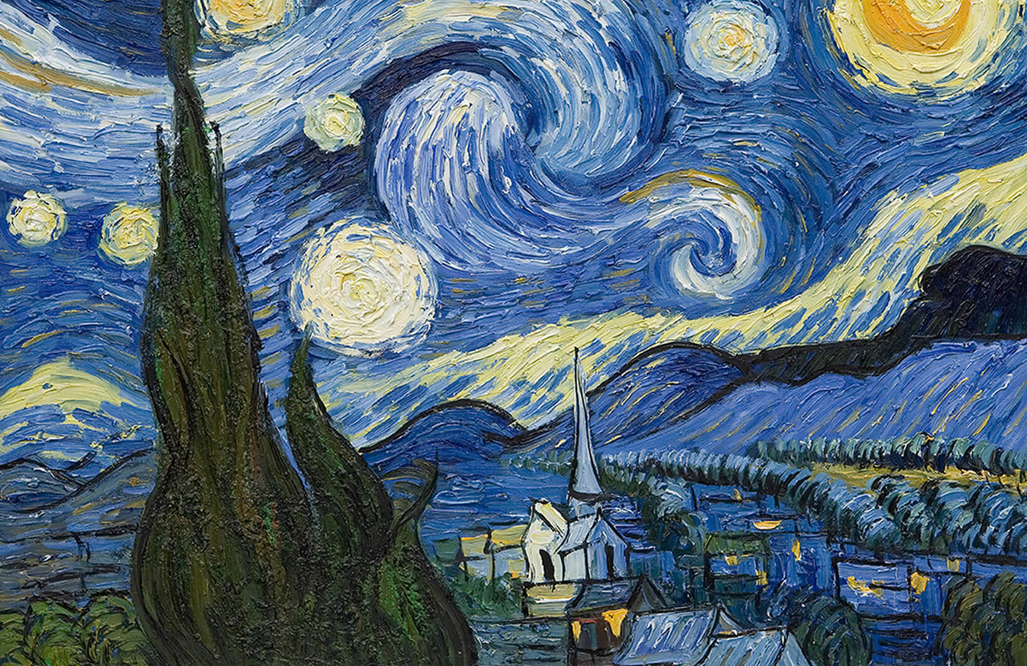
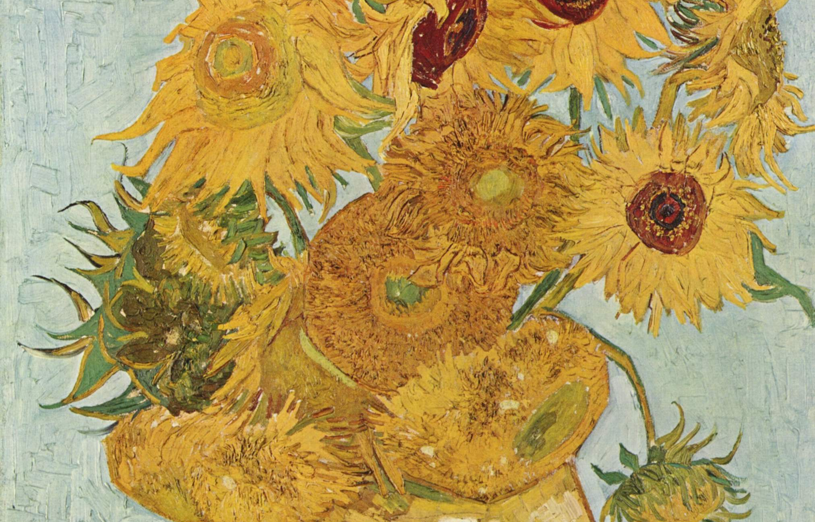
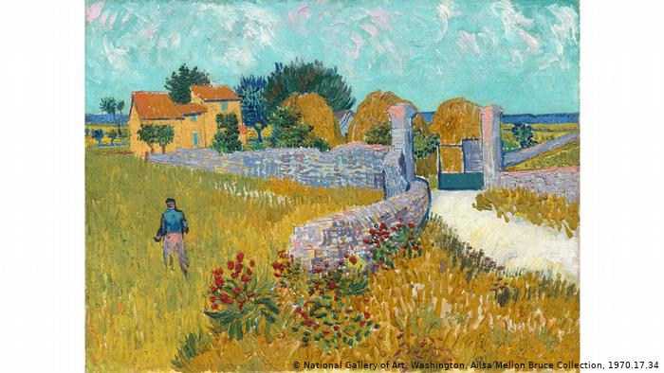
Vincent Van Gogh
Van Gogh
- best known for his
Still Life
Portraits
Landscapes

Slide 9
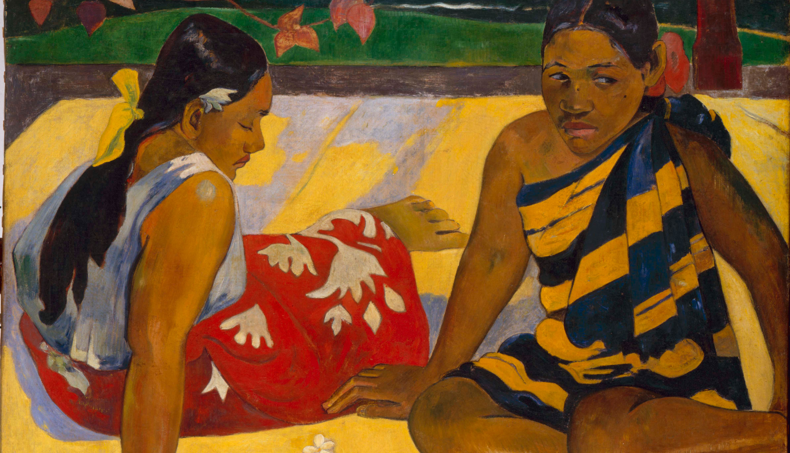
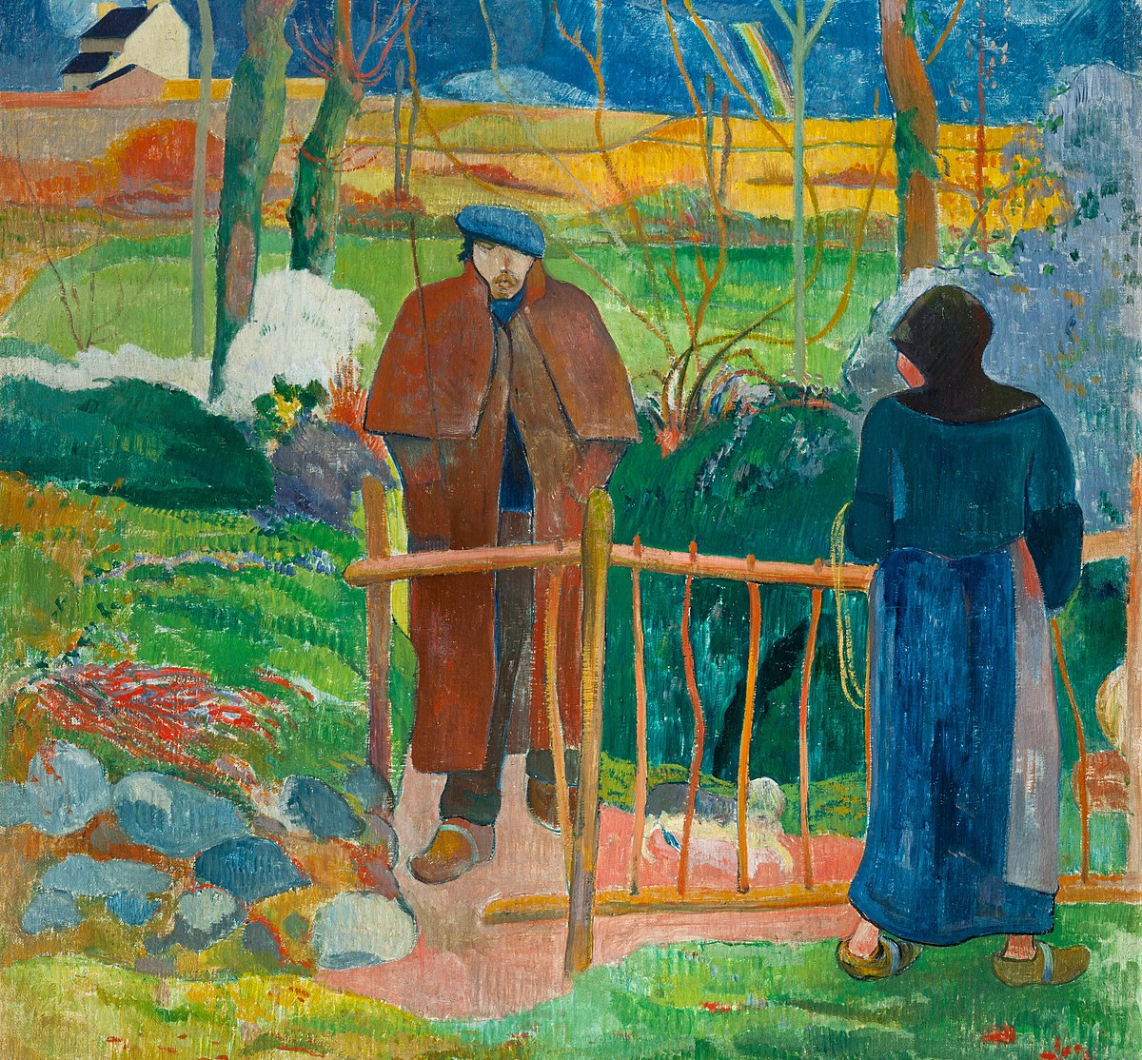
Paul Gauguin
  His work has elements of symbolism in it
  Flat shapes and bold colours are used
  Little or no use of perspective
  Colours used are often vivid with use of opposite colours and contrasts
  His use of colour is highly expressive
  He lived in Tahiti for most of his later life
  He was to influence the movement Fauvism in the 20th century

Slide 10
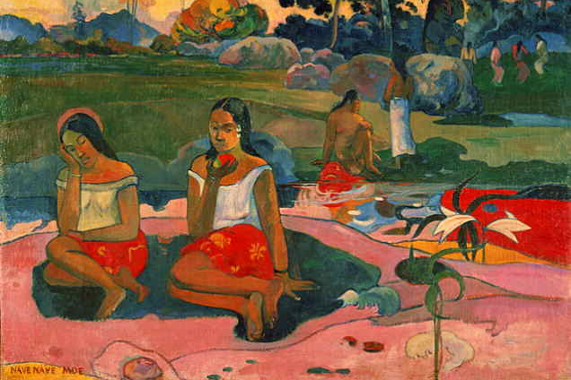
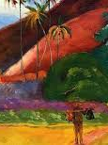
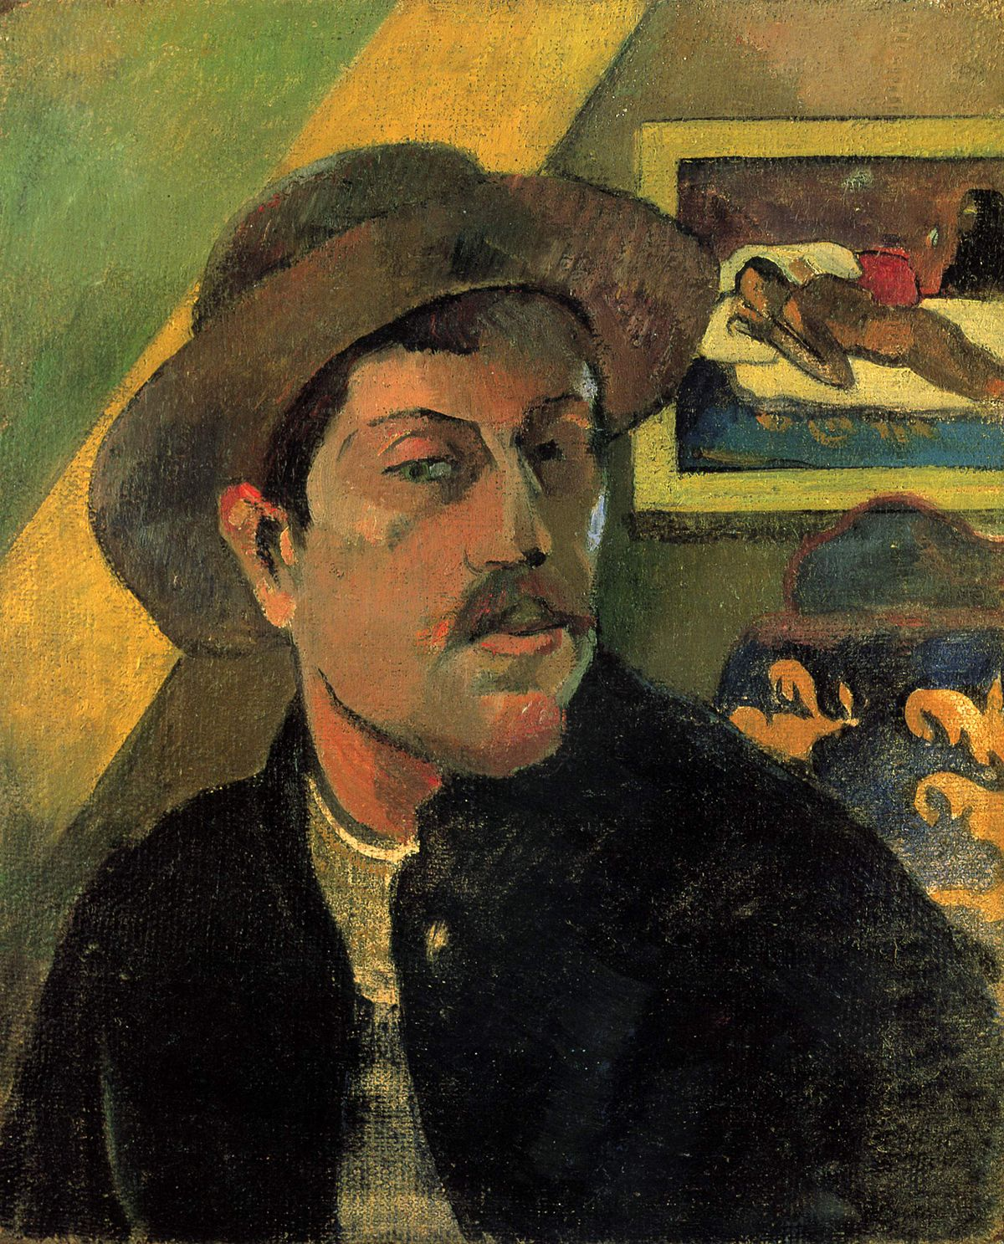
Paul Gauguin
Gauguin
- best known for his
Portraits
Landscapes with figure
Tahitian women/nudes

Slide 11
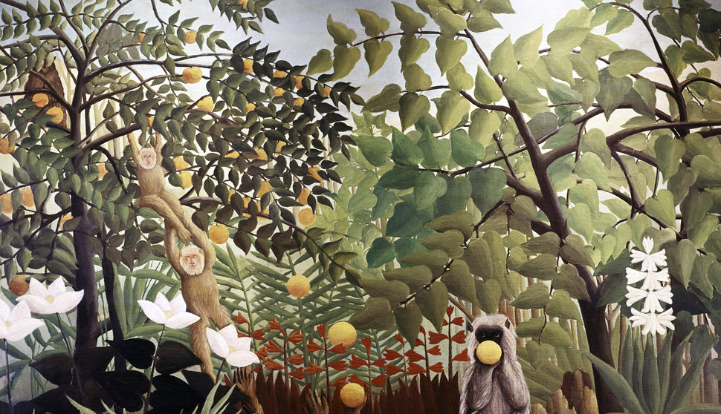
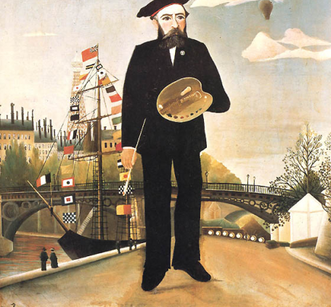
HENRY ROUSSEAU
He is well-known for his colorful jungle scenes and meticulous brush strokes.
His style is known as primitivism.
He painted some portraits but most of his works come from his imagination and are like dreams.
He was a self-taught painter, so his paintings look like child -like and the artists that use this style are called naïve.

Slide 12
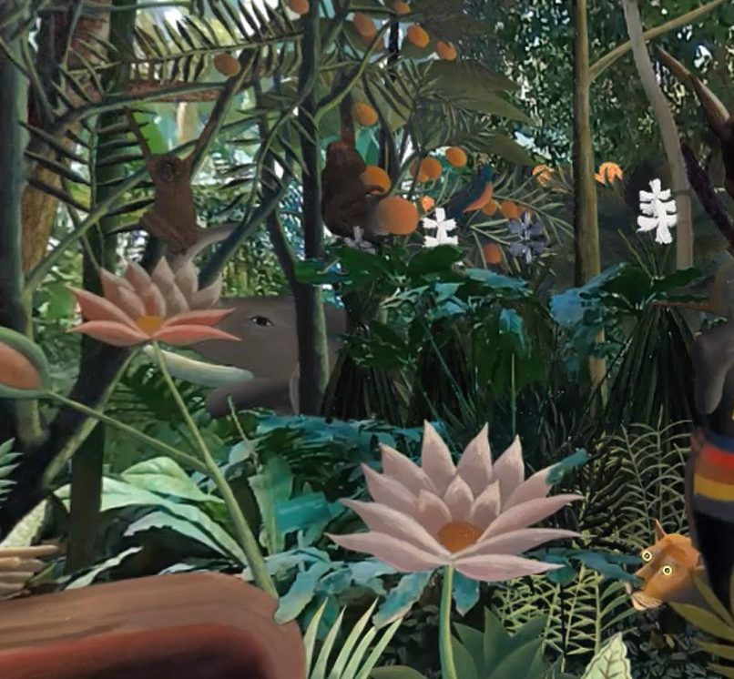
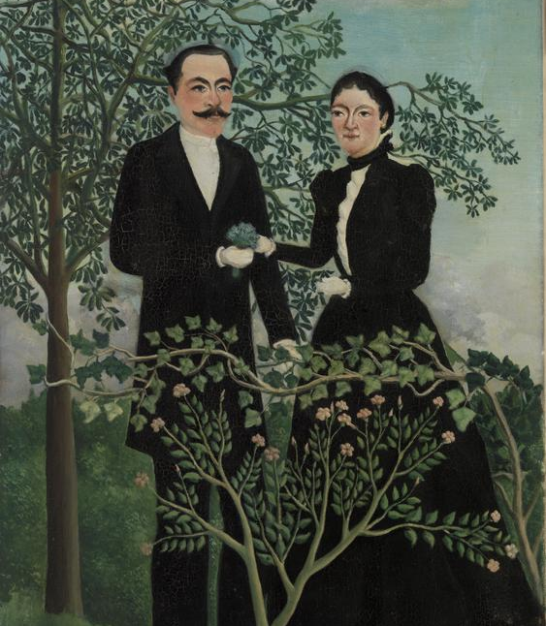
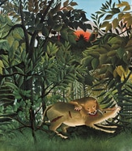
HENRY ROUSSEAU
Famous for:
Portraits
Jungle scenes
Imaginative landscapes.

Slide 13
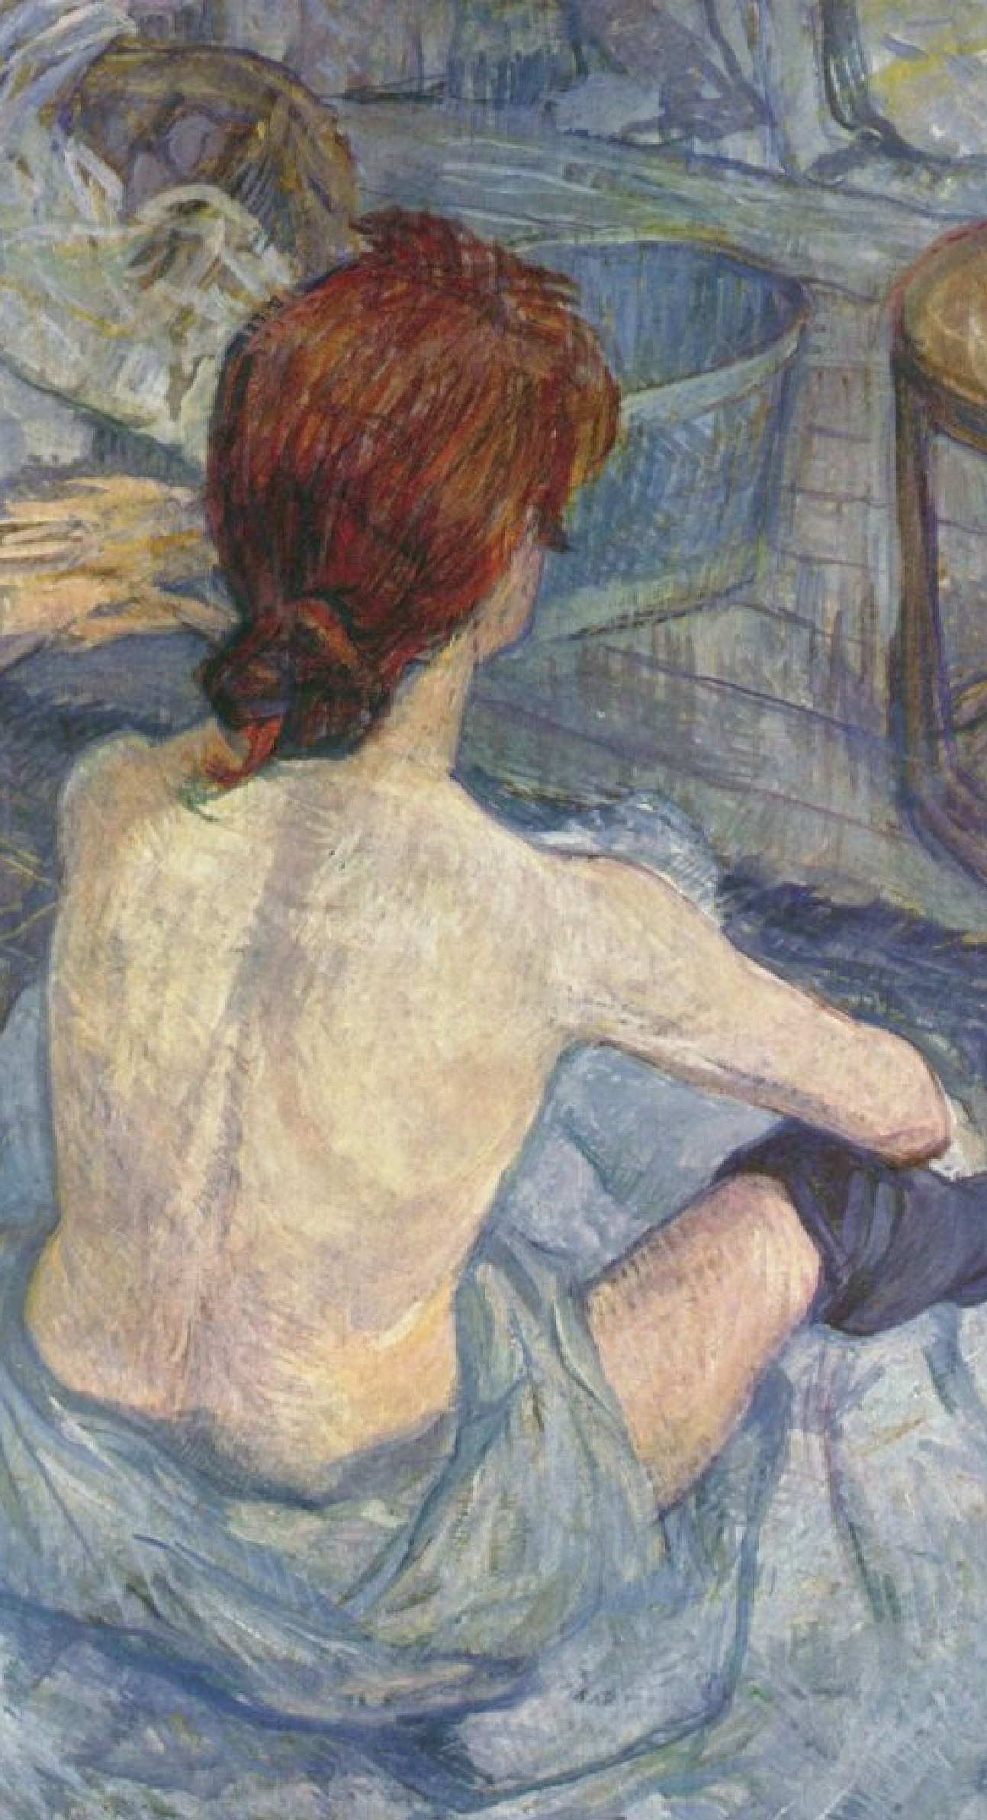
HENRY TOULOUSE-LAUTREC
Henri Toulouse-Lautrec was rich but disabled.
He lived in Paris and portrayed the nightlife of Paris, especially the Moulin Rouge, a popular cabaret at the time.
He was good at drawings in paint and sometimes he used pastel colors for his drawings.
Toulouse-Lautrec also designed posters to advertise entertainments and theatres.

Slide 14
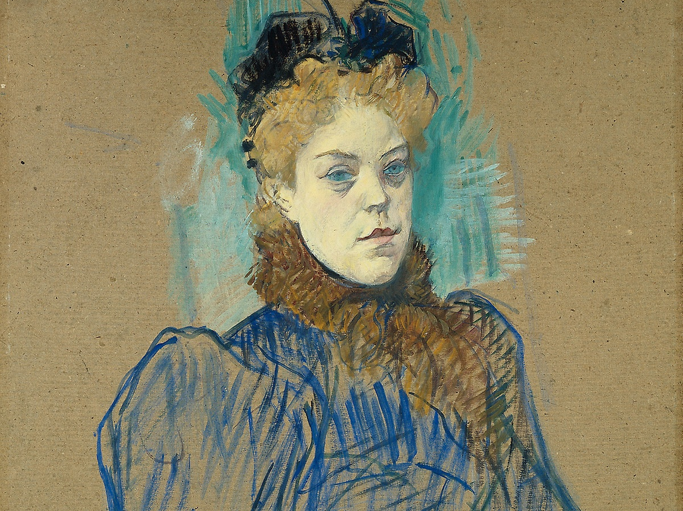
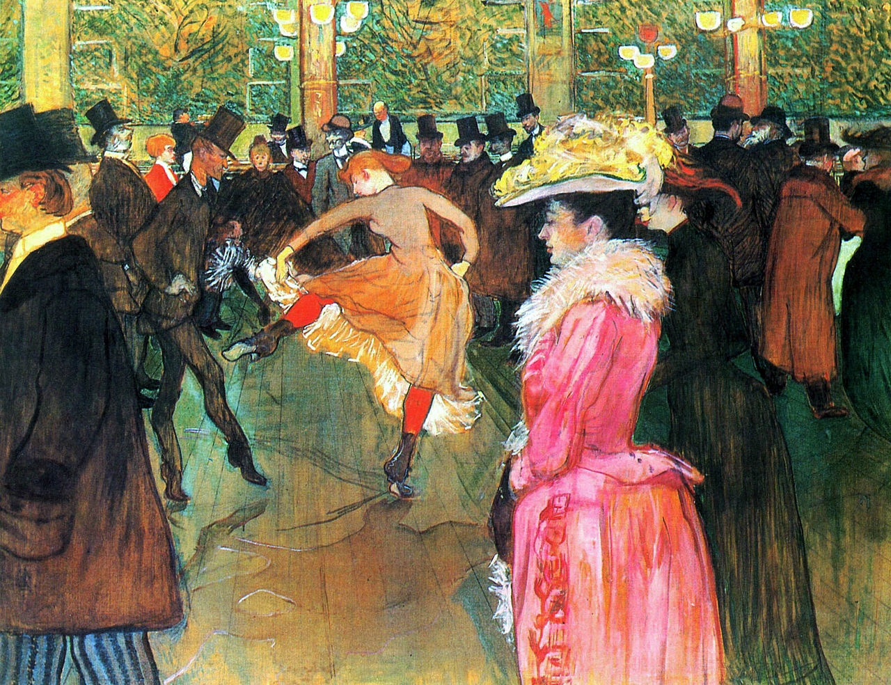
HENRY TOULOUSE-LAUTREC
Famous for:
Portraits
Popular threatre and cabaret scenes
Posters advertising enterteiments
Pastel drawings

Slide 15
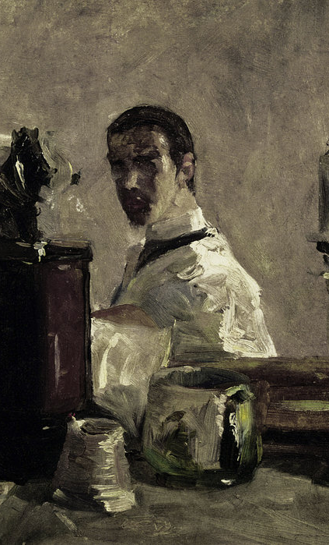
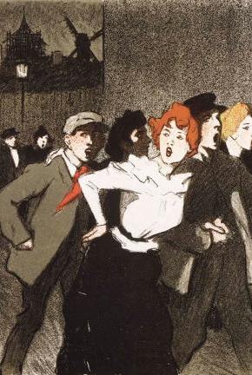
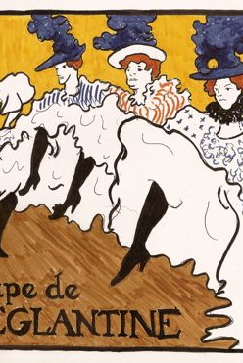




HENRY TOULOUSE -LAUTREC

Slide 16
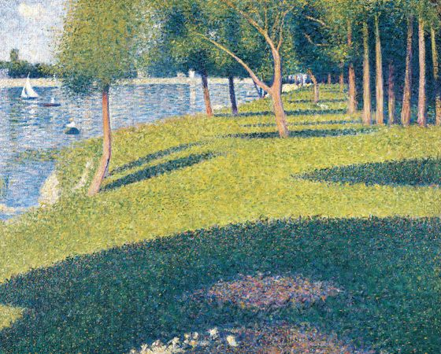
GEORGES SEURAT
Georges Seurat collaborated with the Impressionists.
He was interested in the effects of light on color.
Seurat studied the light and realized it was divided in multiple particles
He painted in hundreds of tiny dots of bright color.
This style is known as pointillism.

Slide 17
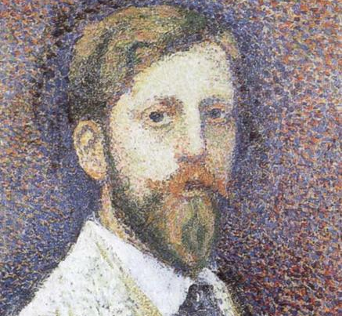
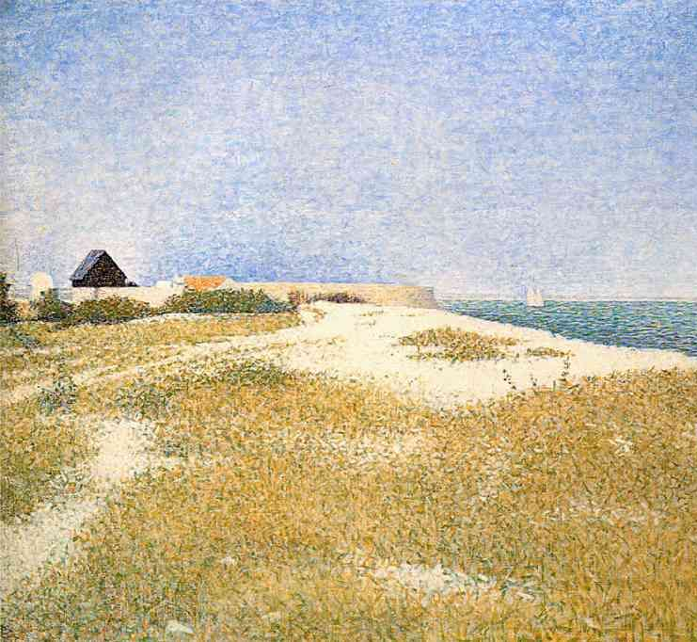
GEORGE SEURAT
Seurat is famous for:
Landscapes
Portraits
Pointillism
Use of bright colors
Plain surfaces

Slide 18
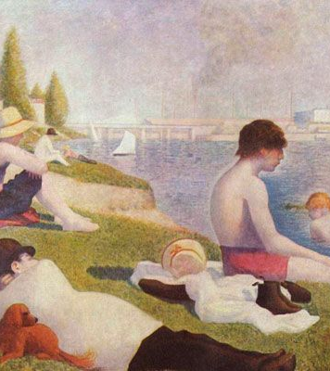
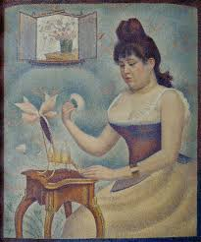
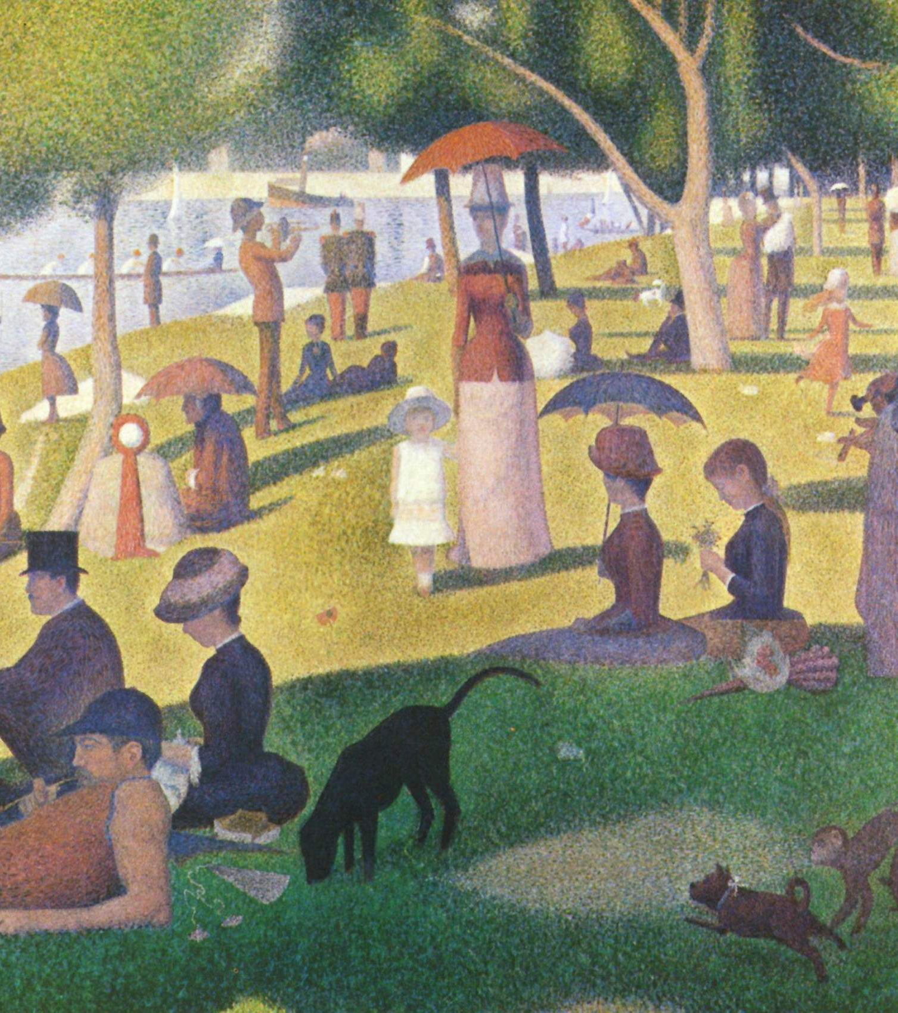
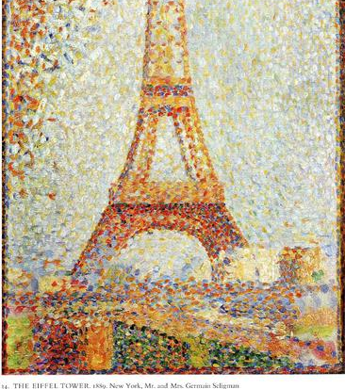
GEORGE SEURAT

