Slide 1
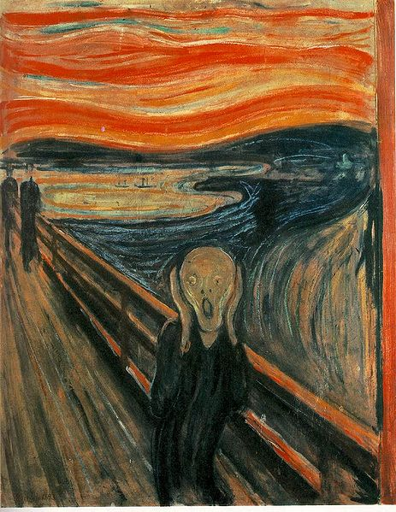
Expressionism (1905-1925)
MARÍA SANZ

Slide 2
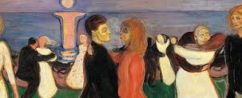
Origins
Expressionism was a cultural movement, initially in poetry and painting, originating in Germany at the start of the 20th Century.
Its typical goal is to present the world under a subjective perspective, violently distorting it to obtain an emotional effect and vividly transmit personal moods and ideas.
Expressionist artists sought to express the meaning of "being alive" and emotional experience rather than physical reality.
Expressionists would use their artwork to express their inner emotions, not necessarily to paint what they saw.
Expressionism is exhibited in many art forms, including: painting, literature, theatre, dance, film, architecture and music.

Slide 3
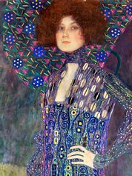
Influences
Expressionism emerged as an 'avant-garde movement' in poetry and painting before the First World War, being appreciated by a mass audience, having its popularity peak in Berlin, during the 1920s.
The Expressionist stress on the individual perspective was also a reaction to positivism and other artistic movements such as naturalism and impressionism.
In general the term expressionism refers to art that expresses emotion.
Treatment of colour by the Fauves

Slide 4
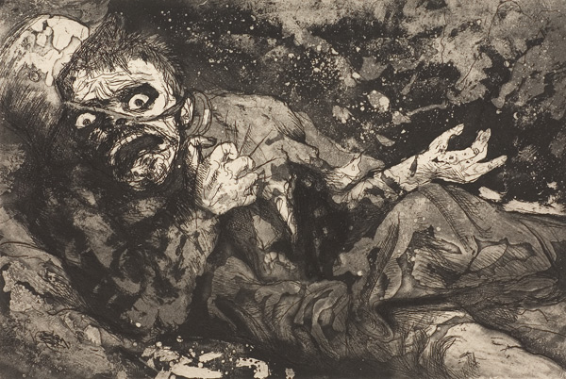
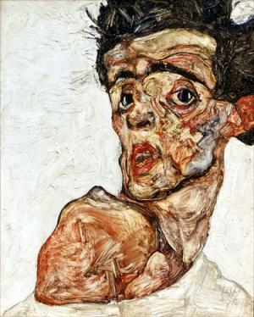
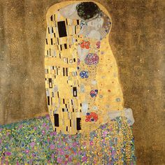

Slide 5
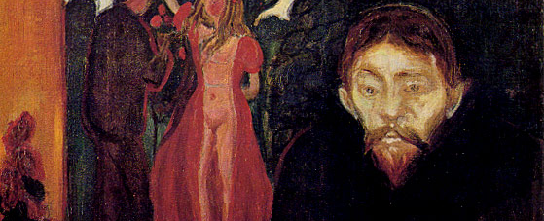
Expressionist Style
Intense colour
Agitated brushstrokes
Depicts emotions and responses to the world around the artist
Distortion, exaggeration, primitivism and fantasy

Slide 6
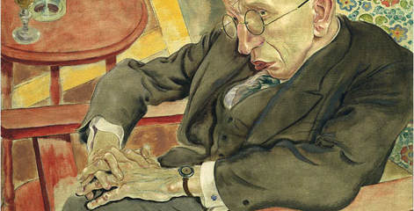
Expressionist Artists
Max Beckmann
Otto Dix
George Grosz
Paul Klee
Edvard Munch
Emil Nolde
Franz Marc
Wassily Kandinsky
Egon Schiele

Slide 7
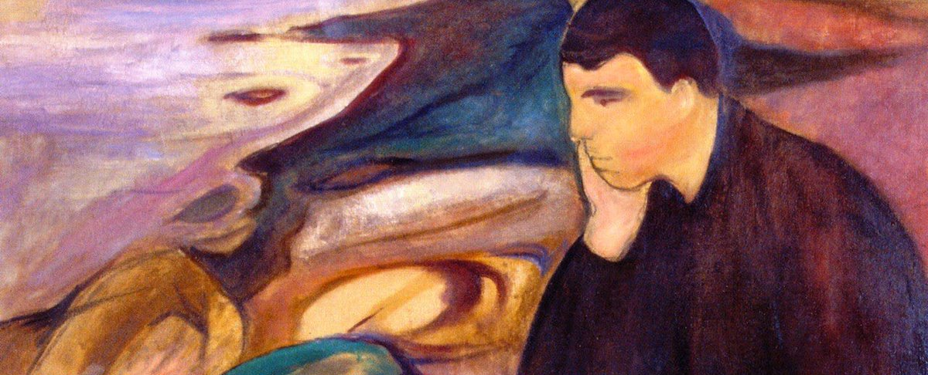
Edvard Munch
He was born on December 12, 1863 in Loten, Denmark.
When he was five his mother died. When he was 14 his sister died.
He decided to become a painter at the age of 17.
He had his first private exhibition in 1889, the same year his father died.

Slide 8
The Scream (1893)
Its central figure is a symbol of modern man, terrified of the state of the world.
The painting shows pain, isolation, and fear.
In a page in his diary headed Nice 22.01.1892, Munch described his inspiration for the image thus:
“ I was walking along a path with two friends — the sun was setting — suddenly the sky turned blood red — I paused, feeling exhausted, and leaned on the fence — there was blood and tongues of fire above the blue-black fjord and the city — my friends walked on, and I stood there trembling with anxiety — and I sensed an infinite scream passing through nature.

Slide 9
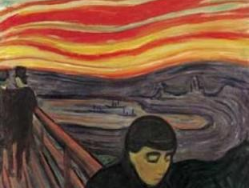

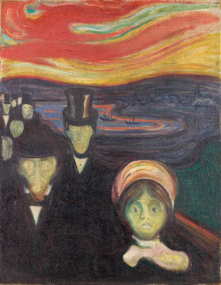
“Anxiety” “Despair”

Slide 10
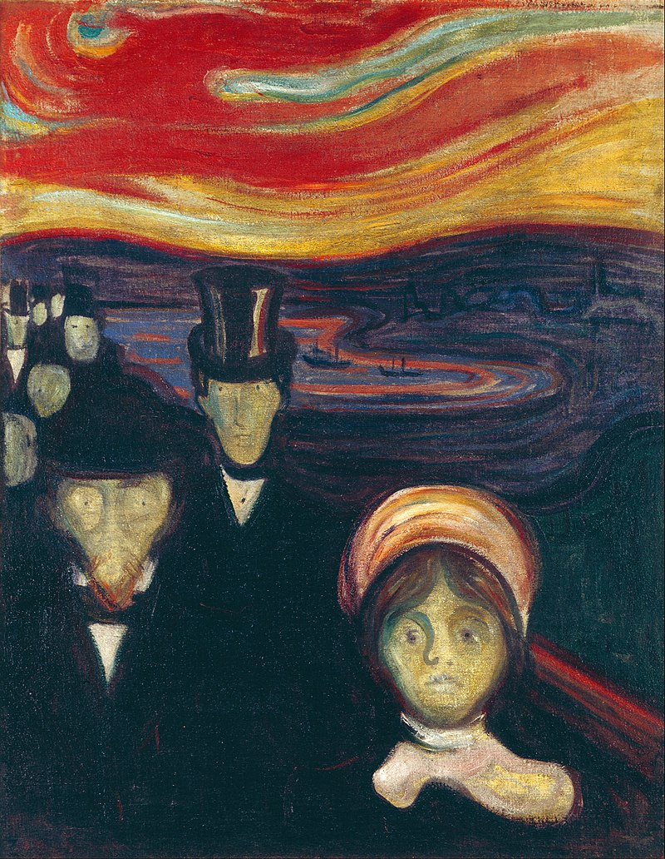
Munch- Later Years
In 1908, he suffered a nervous breakdown.
He moved back to Norway and continued to paint until his death in 1944.
Munch’s methods influenced many artists, even today, and his paintings remain portrayals of every person’s search for meaning in the world.

Slide 11
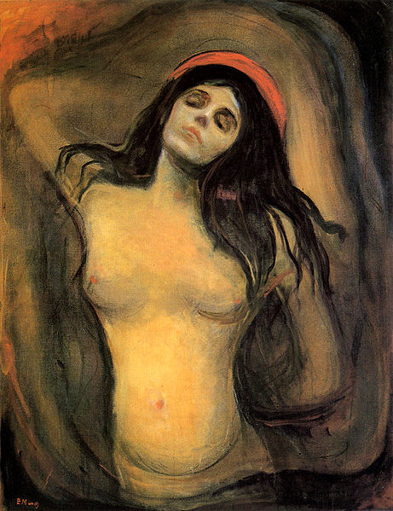
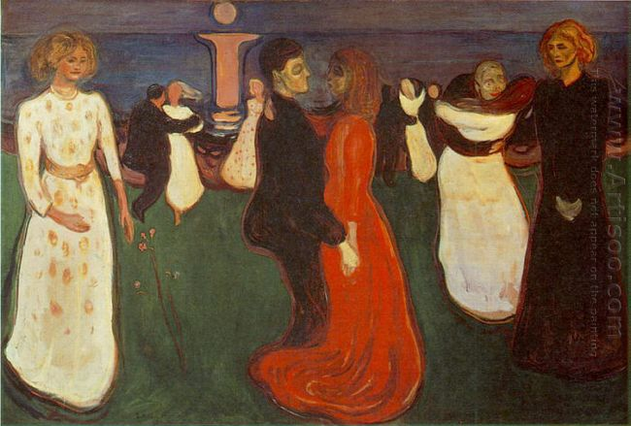
The Dance of Life
Madonna (1894-1895)

Slide 12
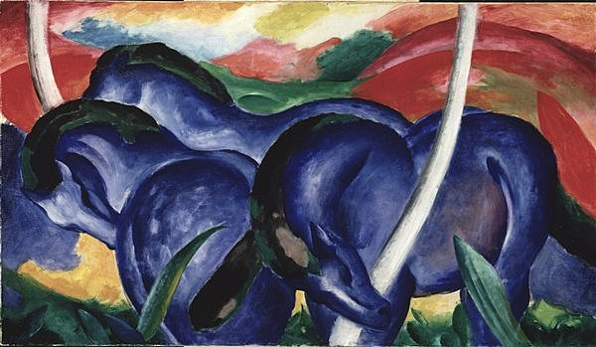
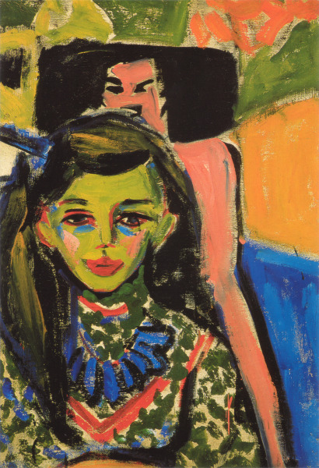
Expressionist Groups in Painting
There were a number of Expressionist groups in painting, including Der Blaue Reiter and Die Brucke.
The Expressionists focused on capturing vivid emotional reactions through powerful colors and dynamic compositions instead.
The leader of Der Blaue Reiter, Kandinsky, would take this a step further. He believed that with simple colours and shapes the spectator could perceive the moods and feelings in the paintings, therefore he made the move to abstraction.

Slide 13
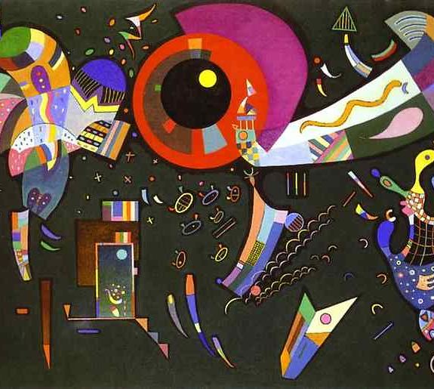
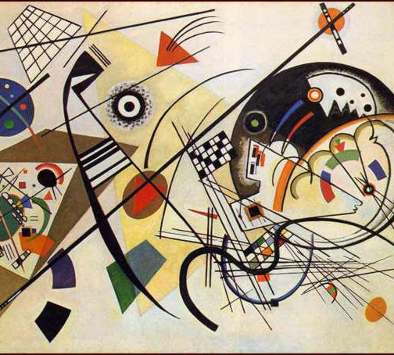
“Transverse Line” “Around the Circle”
Kandinsky

Slide 14
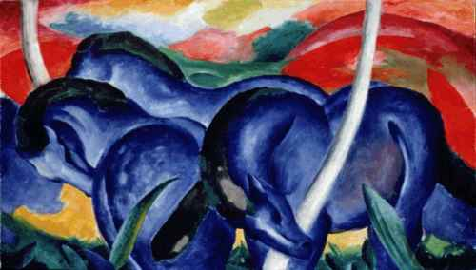
Large Blue Horses
Franz Marc

Slide 15
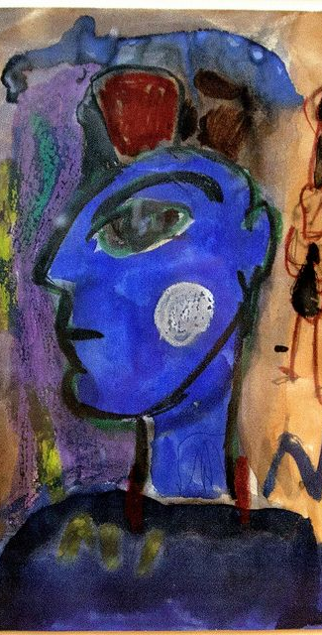
American Expressionism
Norris Embry (1921-1981) studied with Oskar Kokoschka in 1947 and over the next 43 years produced a large body of work grounded in the Expressionist tradition. Norris Embry has been called "the first American German Expressionist". Other American artists of the late 20th and early 21st century have developed distinct movements that are generally considered part of Expressionism.

Slide 16
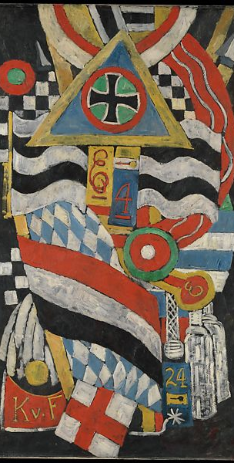
American Expressionism
The ideas of German expressionism influenced the work of American artist Marsden Hartley, who met Kandinsky in Germany in 1913. In late 1939, at the beginning of World War II, New York welcomed a great number of leading European artists.

