Slide 1

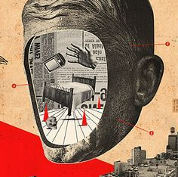
DADAISM
MARÍA SANZ

Slide 2
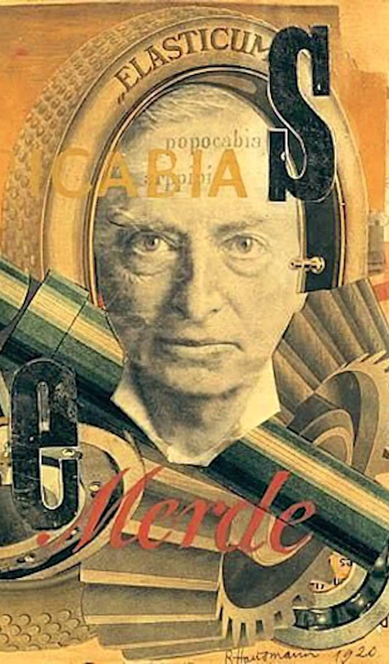

Zurich Dada (1916 – 1918 )
Why Dada?
to counter the logic that was used to justify the killing and mutilation of millions
to show disgust with bourgeois values
to create a better life after WWI through the irrational
What Is It?
international movement in art and literature that used ridicule and nonsense to reflect what was considered to be the meaninglessness of the modern world
anti-war, anti-art, and anti-bourgeois movement
anarchistic movement that challenged traditional perceptions of art as well as provoked a reexamination of social and moral values

Slide 3

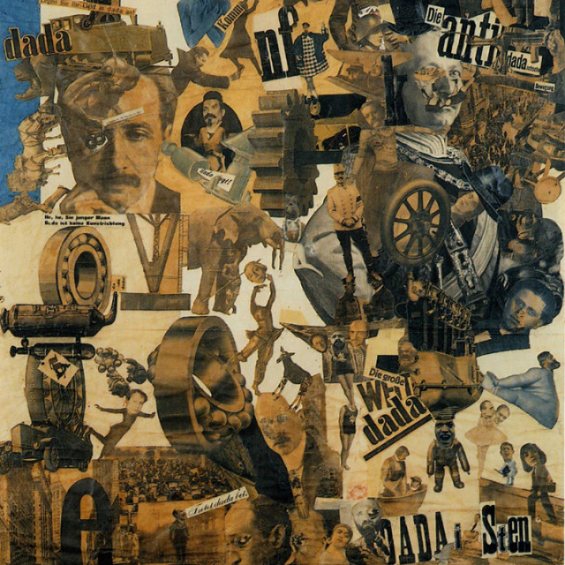
Founding of the Movement
originated in Zurich, Switzerland, in 1916
– Zurich was neutral territory, the place where many artists went to find refuge from World War I
– Lenin, James Joyce, and Carl Jung were also in residence here
founded by exiles
other Dada cells located in Paris, Barcelona and New York

Slide 4
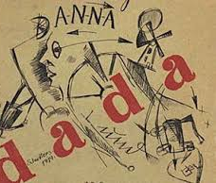
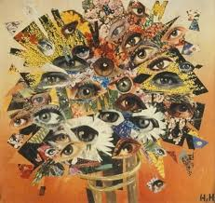
GOALS
originally, to express anger over the war
later, to attack the art establishment which was aligned with middle class society
to destroy those systems based on reason and logic and replace them with ones based on anarchy, the primitive, and the irrational

Slide 5
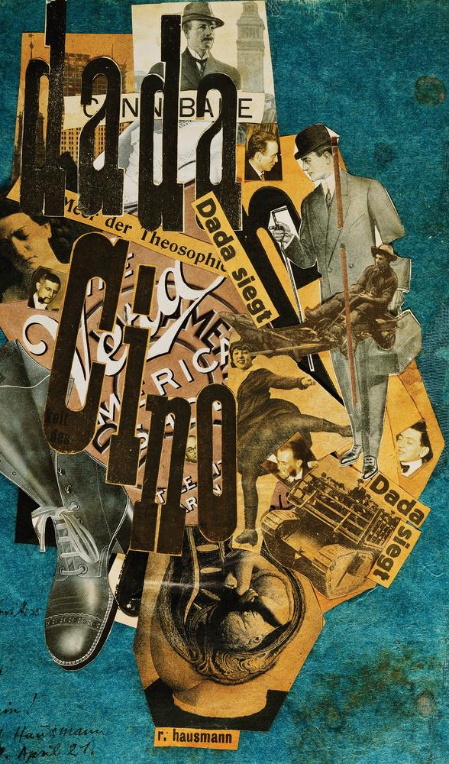
ANTI – ART IDEAS
used shock, provocation, and irrationality as a weapon against the Establishment
asked the question: what kind of culture would condone the industrialized murder of World War I?
made fun of the "seriousness" and sanctity of traditional art
believed that traditional art had to be purged and that this new movement was going to start culture from scratch
created in a "child-like" manner
believed that the value of art was located more in the act of making it than in the work produced

Slide 6
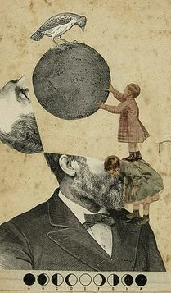
Characteristics of Dada Art
elementary
anonymous and collective
spontaneous, random, and provocative
toy-like
primitive
organic and biomorphic

Slide 7
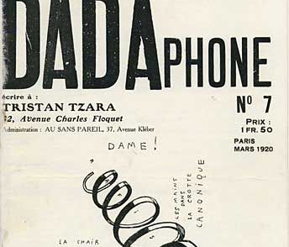
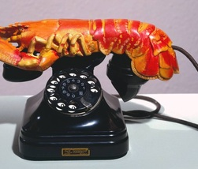
Origins of the Word Dada
first word a baby utters?
"yes, yes" in Russian?
"hobby-horse" in Rumanian?
word found at random in the dictionary?

Slide 8
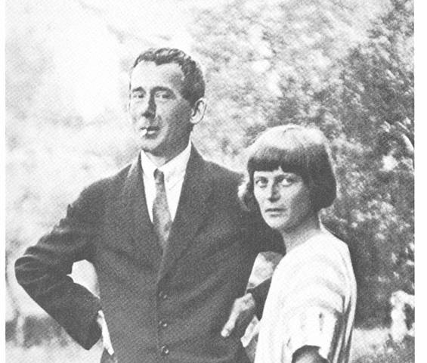
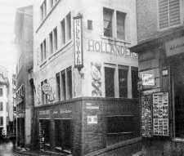
the Cabaret Voltaire
In 1915, Hugo Ball (writer and theatre director)and his female partnerEmmy Hennings (dancer and chanteuse) left Munich and moved to Zurich.
founded on February 1, 1916, as an international literary cabaret
located in a slightly disreputable neighborhood in Zurich, Switzerland, on the Speigelgasse
venue for selling beer, sausage, and rolls
Emmy Hennings sang songs while Hugo Ball played the piano; others recited non-sensical poetry and improvisefounded on February 1, 1916, as an international literary cabaret
located in a slightly disreputable neighborhood in Zurich, Switzerland, on the Speigelgasse
venue for selling beer, sausage, and rolls
Emmy Hennings sang songs while Hugo Ball played the piano; others recited non-sensical poetry and improvise

Slide 9
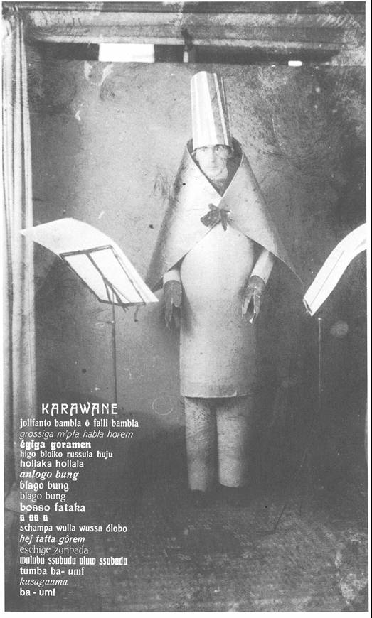
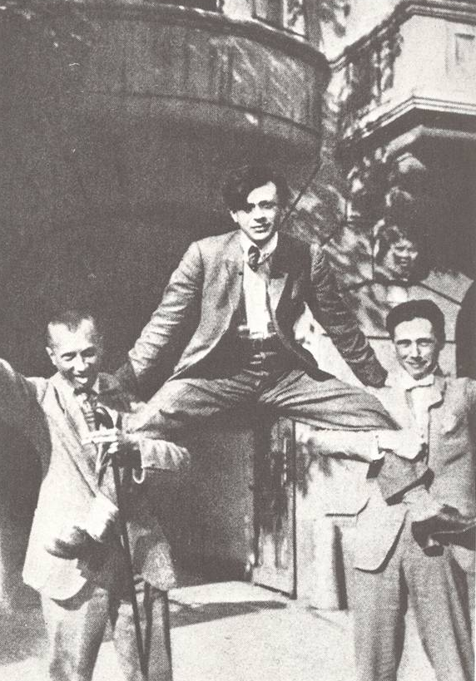
Hugo Ball in “cubist” costume reciting his poem “Caravan” at The Cabaret Voltaire, Zurich,
1916.
Hans Arp, Tristan Tzara, and Hans Richter in Zurich (1918).

Slide 10
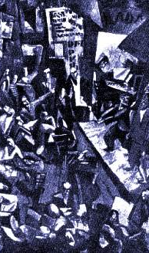
Marcel Janco.
Cabaret Voltaire (1916).
“Total pandemonium. Tzara
is wiggling his behind like
the belly of an Oriental dancer.
Janco is playing an invisible
violin and bowing and scraping.
Madame Hennings, with a
Madonna face, is doing the splits.
Huelsenbeck is banging away
nonstop on the great drum,
with Ball accompanying him
on the piano, pale as a chalky ghost." (Hans Arp, 1916)

Slide 11
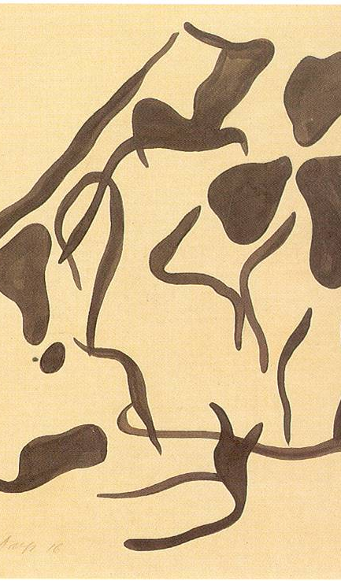
AUTOMATISM AS A TECHNIQUE
The starting point of creation is the notion of vitality, the movement of the creative hand.
There are no preconceived subjects.But as outlines contoured the surface, they provoked associations to plant, animal, and human life.
The important thing is ambiguity—to suggest rather than to define forms.
Hans (Jean) Arp. Automatic Drawing (1916).
Brush and ink on gray paper.

Slide 12
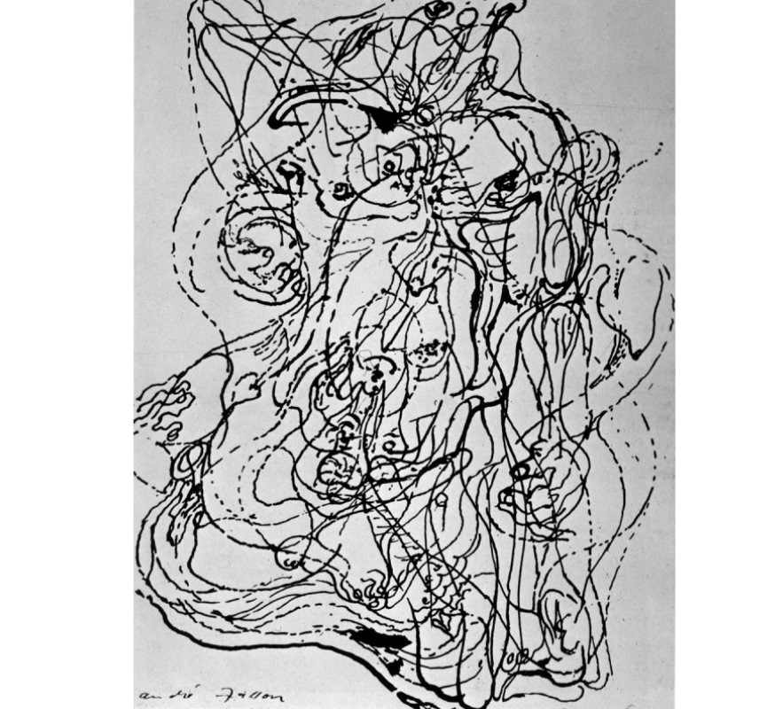
The Automatic Process
First, pencil outlines are drawn.
Second, contours are filled in with black ink.
Third, changing and adjusting these shapes.
Fourth, eliminating shapes as the drawing was near completion.

Slide 13
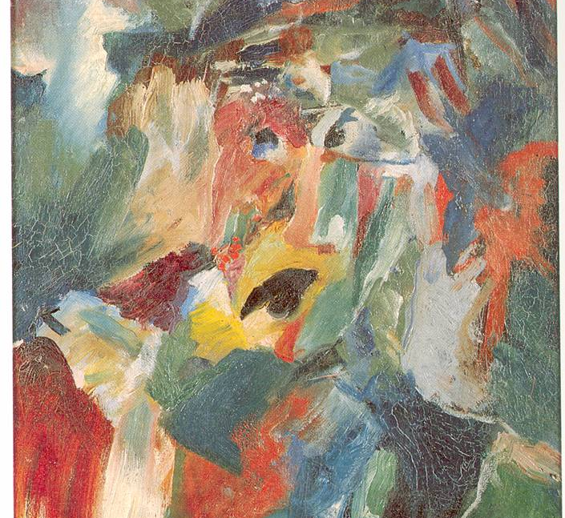
Hans Richter. Macabre
Portrait (1917).
Oil on canvas.

Slide 14
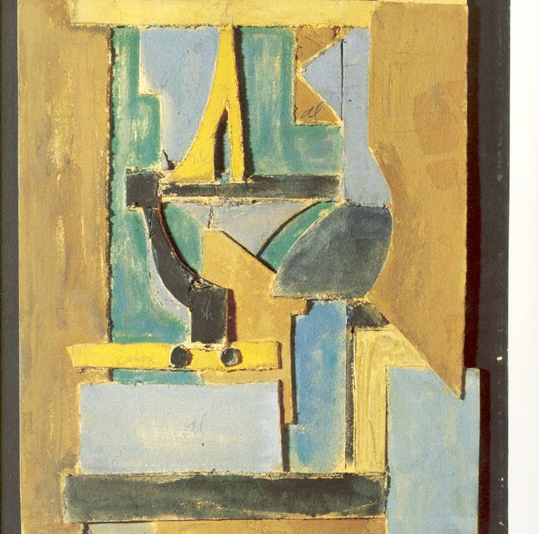
Marcel Janco.
Study for
Brilliant Empire Architecture
(1918). Painted plaster relief.

Slide 15
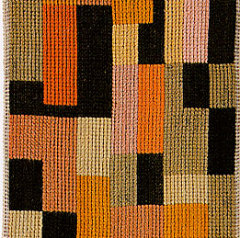
Hans Arp. Wool Rug
(executed by Sophie
Taueber-Arp), 1918.

Slide 16
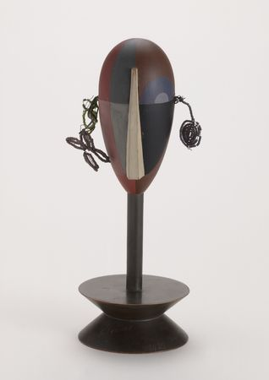
Sophie Taeuber-Arp.
Dada Head (1920).
Painted wood with glass beads on wire

Slide 17
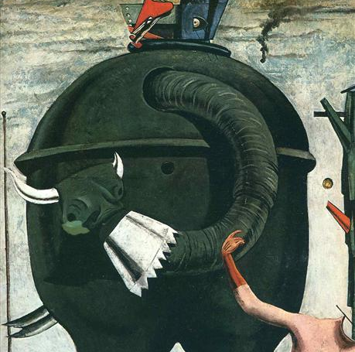
The Elephant Celebes (1921)
MAX ERNST

