Slide 1
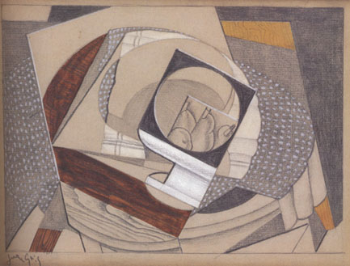
CUBISM

Slide 2
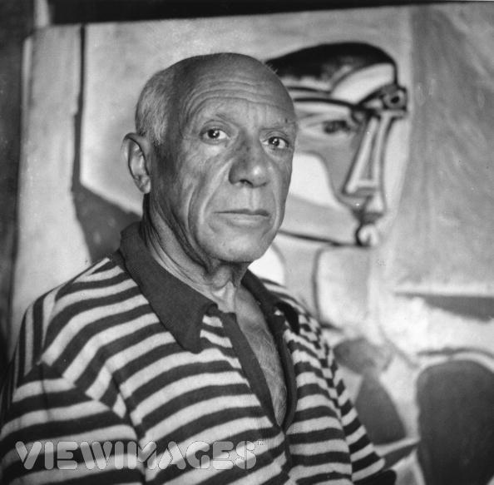
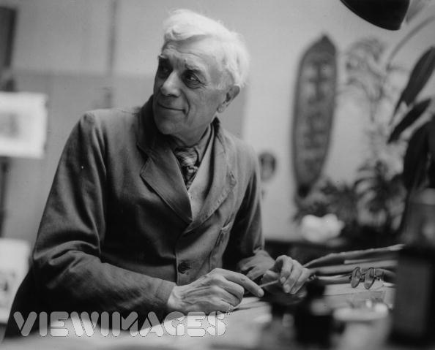
Georges Braque
01 Jan 1955
Pablo Picasso
30 Sep 1955
The Cubist movement in painting was developed by Picasso and Braque around 1907-1914, and became a major influence on Western art.

Slide 3
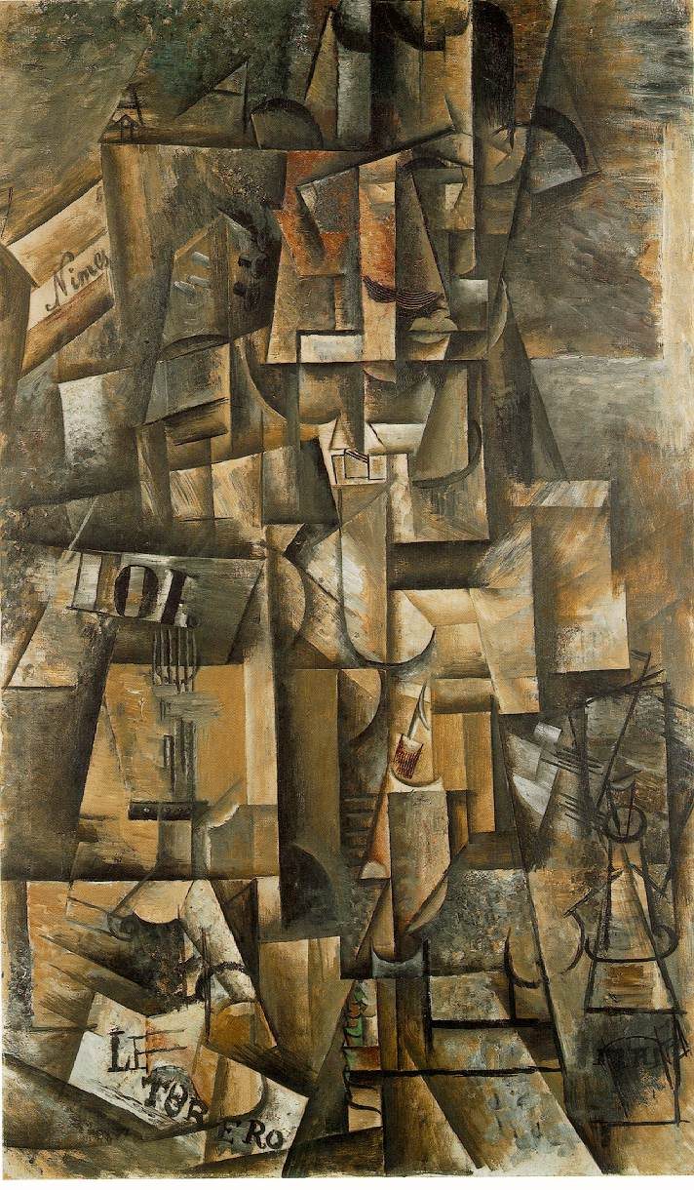
Abstracted form
The artists chose to break down the subjects, and re-assembled in an abstracted form — instead of depicting objects from one viewpoint, the artist depicts the subject from a multitude of viewpoints to represent the subject in a greater context.
Picasso, Aficionado (1912)

Slide 4
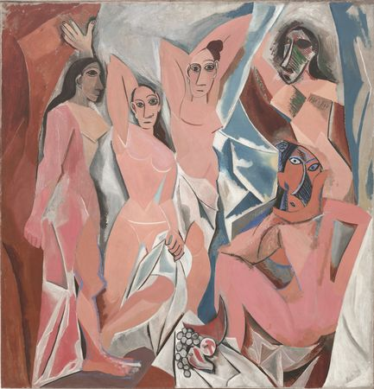
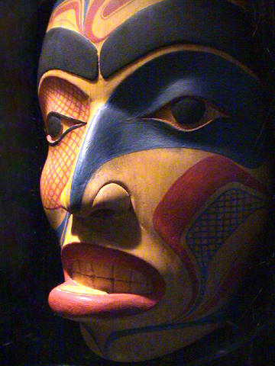
Inspirations…
They were greatly inspired by African sculpture, and by painters Paul Cézanne (French, 1839-1906) and Georges Seurat (French, 1859-1891),
Picasso, Les Demoiselles d'Avignon (1907)

Slide 5
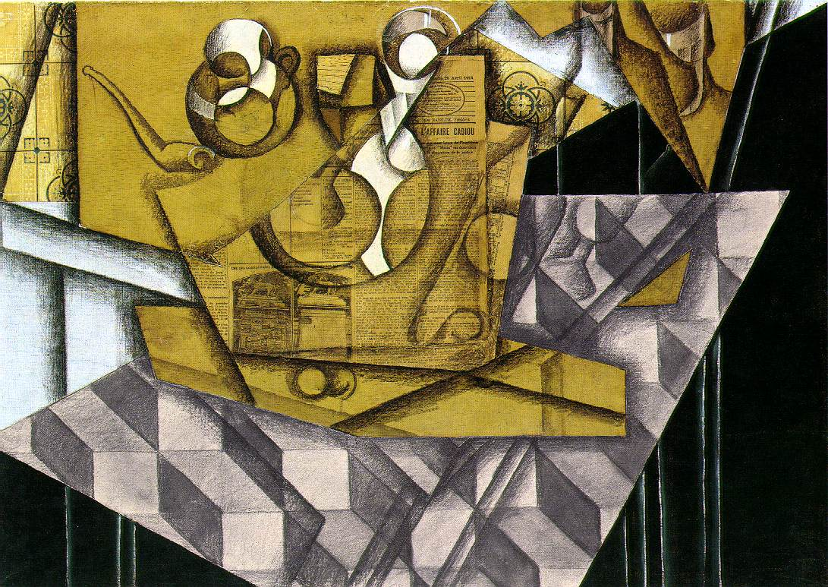
Broken up
Gris, Juan, Teacups,1914
In Cubism the subject matter is broken up, analyzed, and reassembled in an abstracted form. Picasso and Braque followed the advice of Paul Cézanne, who in 1904 said artists should treat nature "in terms of the cylinder, the sphere and the cone."

Slide 6
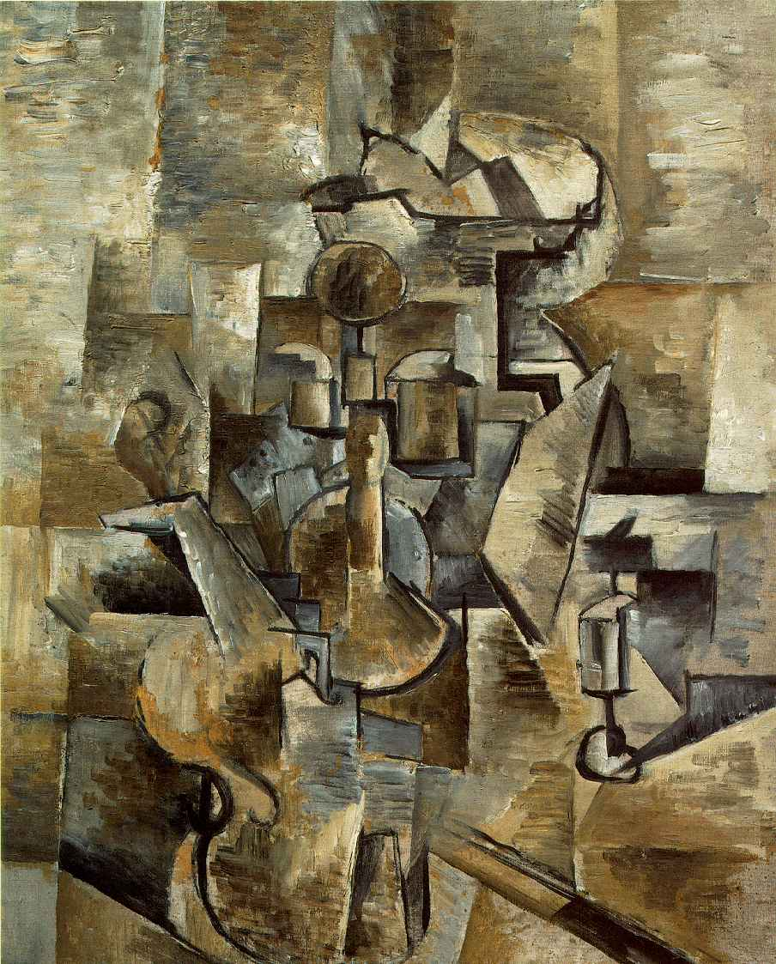
The Cubist style
emphasized the flat, two-dimensional surface of the picture plane, rejecting the traditional techniques of perspective, foreshortening, modelling.
Braque, Georges
Violin and Candlestick
Paris, [spring 1910]

Slide 7
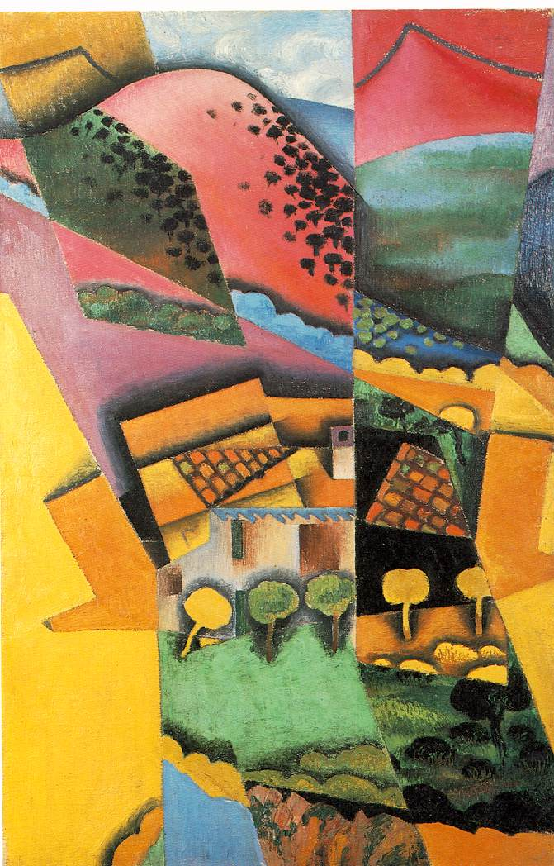
New realities
Cubist painters were not bound to copying form, texture, colour, and space; instead, they presented a new reality in paintings that depicted fragmented objects, whose several sides were seen simultaneously.
Gris, Juan
Landscape at Ceret, 1913
oil on canvas

Slide 8
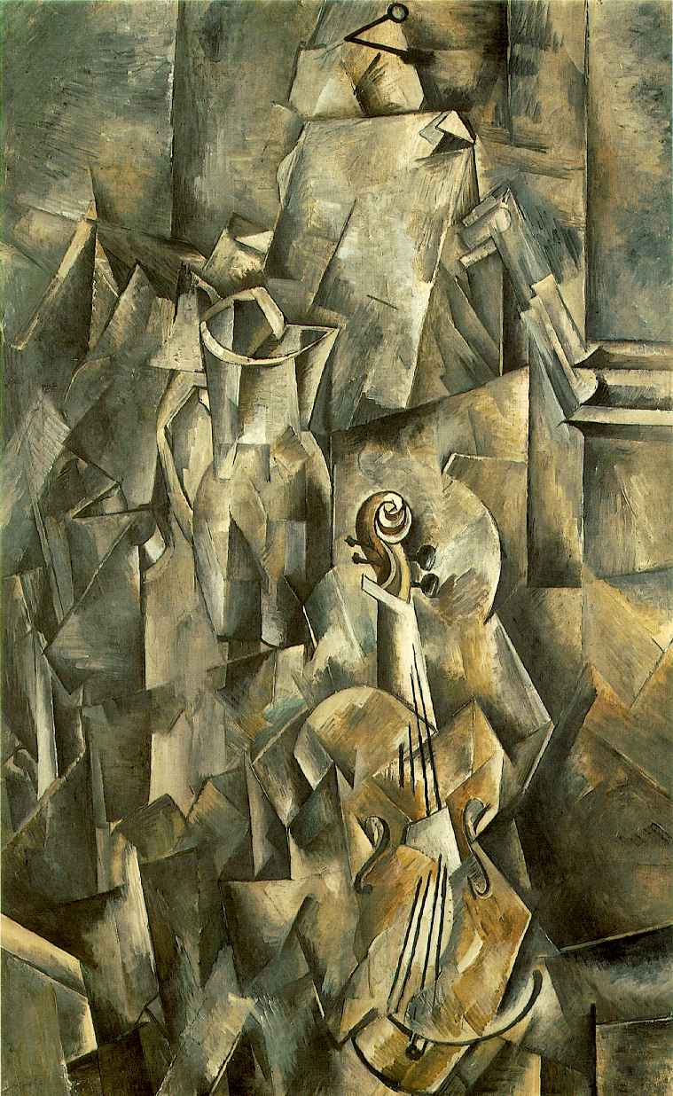
Types of Cubism
There are two main types of cubism, analytical cubism and synthetic cubism. The work up to 1912 is known as Analytical Cubism, concentrating on geometrical forms using subdued colours. Analytic cubism was mainly practiced by Braque, and is very simple, with dark, almost monochromatic colours.
Braque, Georges
Violin and Pitcher
Paris, [early 1910]
Oil on canvas

Slide 9
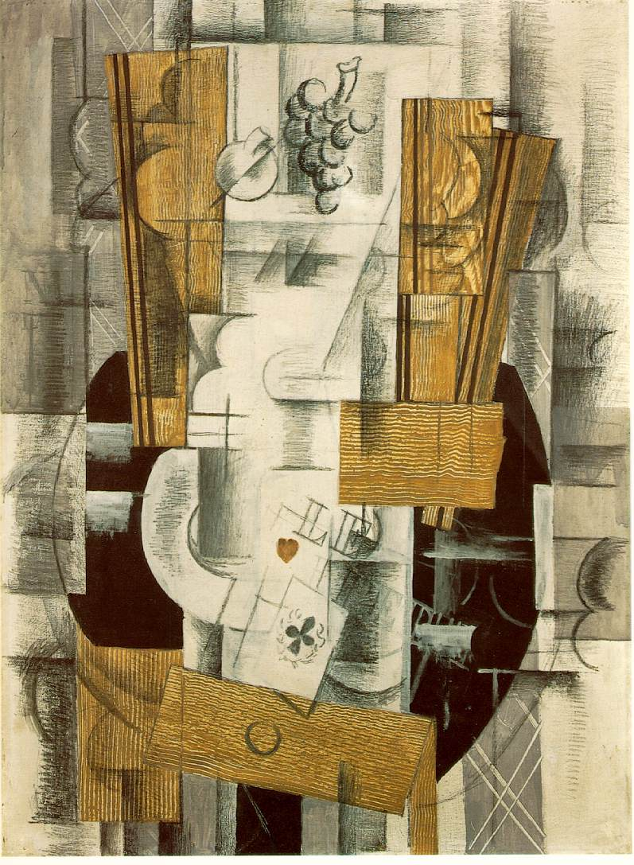
Synthetic Cubism
The second phase after 1912, known as Synthetic Cubism, used more decorative shapes, stencilling, collage, and brighter colours. It was then that artists such as Picasso and Braque started to use pieces of cut-up newspaper in their paintings.
Braque, Georges
Fruit Dish, Ace of Clubs, [Paris, early 1913]
Oil, gouache, and charcoal on canvas.

Slide 10
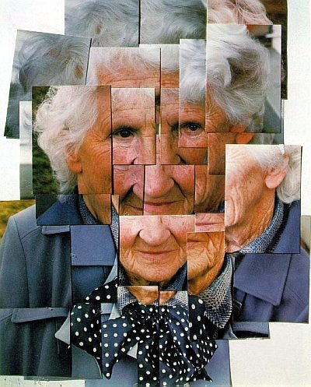
Cubism influences in Contemporary Art
David Hockney
Portrait of the Artist's Mother. 1985, photocollage.
This is called a photocollage rather than a photomontage, because it is more three-dimensional than a montage tends to be. Hockney reflected extensively on his process of collaging prints taken from a camera as connecting to the Cubist sense of multiple angles and especially of movement. These "multiples" (as he called them) convey a strong sense of movement,

Slide 11
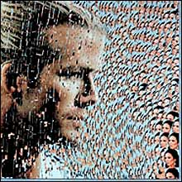
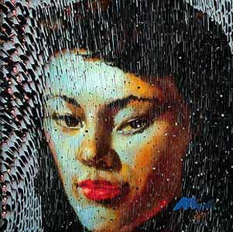
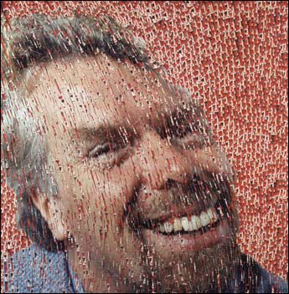
David Mach
Post Card Collage, made up of multiple images to build
A single portrait.

Slide 12
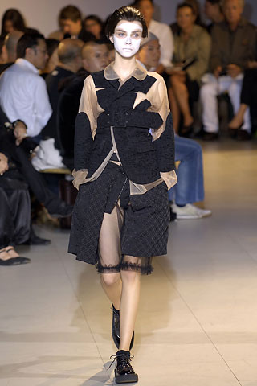
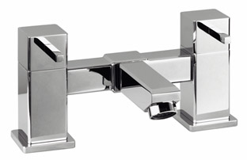
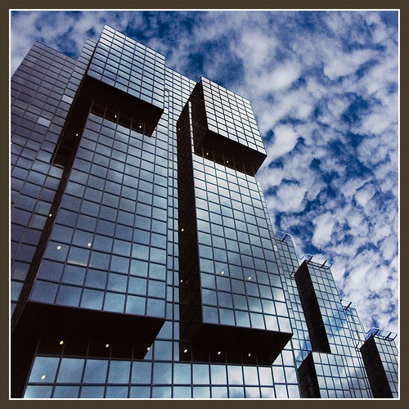
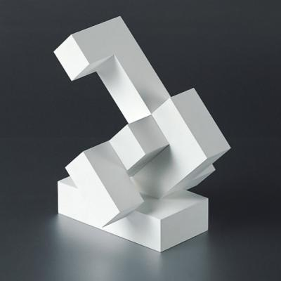
Cubism Influencing Design
Buildings
Household
Fashion
Toys

Slide 13
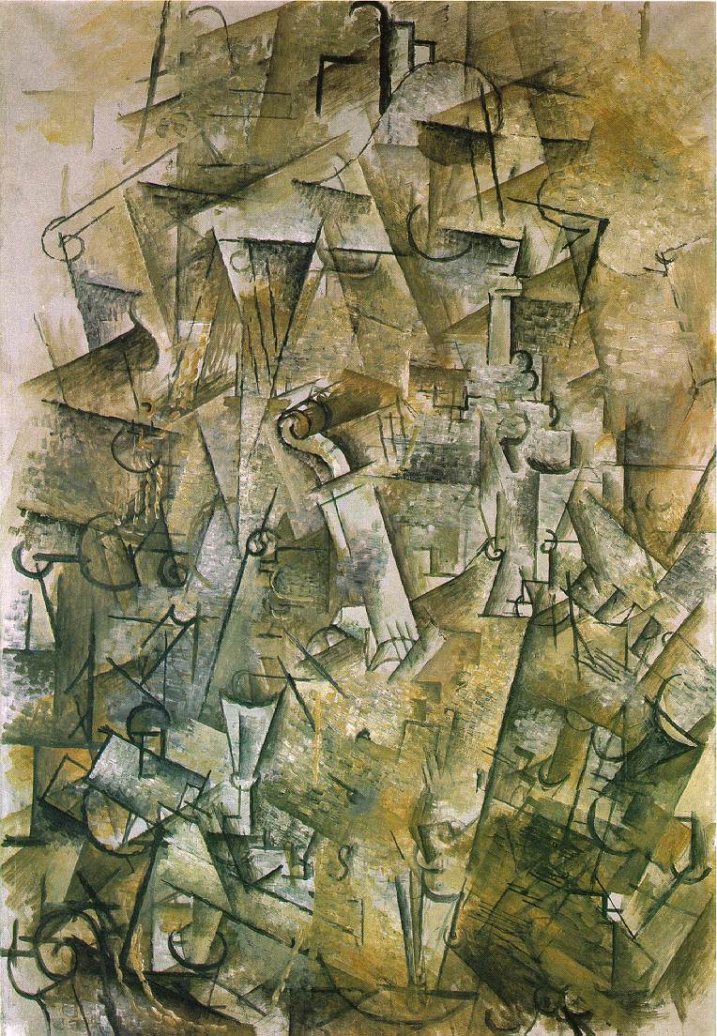
Can you identify the following?
Braque, Georges
Still Life with Harp and Violin
1912
Oil on canvas

Slide 14
Answer:
Analytical Cubism
Why?

Slide 15
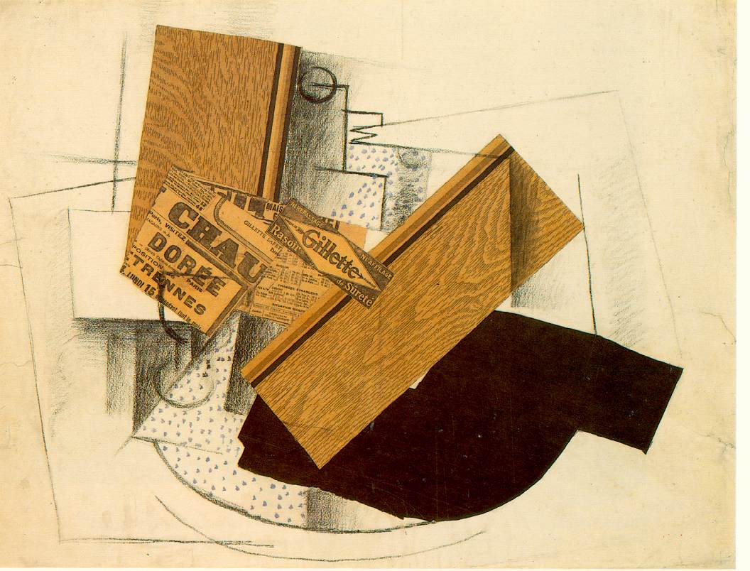
Braque, Georges
Still Life on a Table: "Gillette."
[Paris, early 1914]
Charcoal, pasted paper, and gouache

Slide 16
Answer:
Synthetic Cubism
Why?

Slide 17
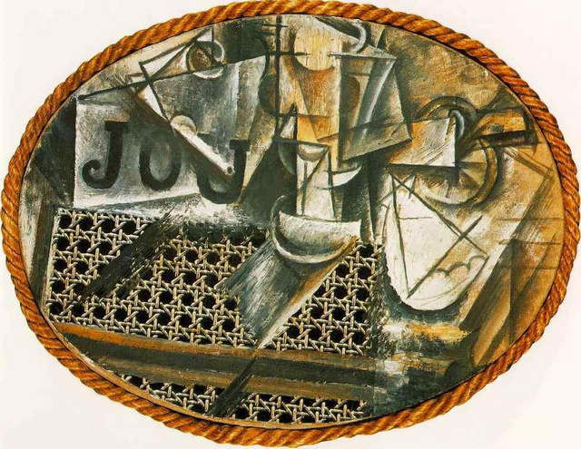
Picasso "Still Life with Chair Caning"
1912 Oil and oilcloth on canvas, with rope frame

Slide 18
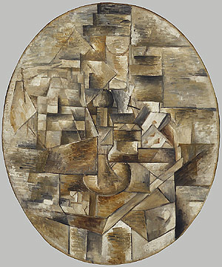
Georges Braque
Candlestick and Playing Cards on a Table
1910

Slide 19
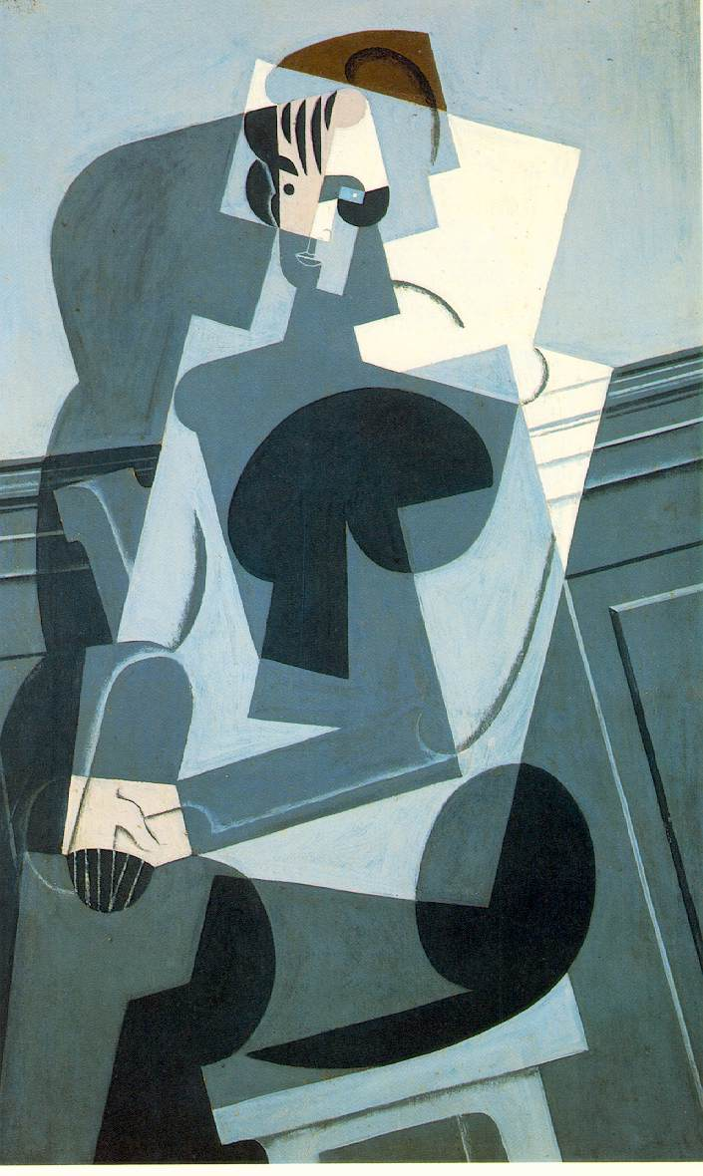
Juan Gris
Portrait of Josette Gris
1916, Oil on panel

Slide 20
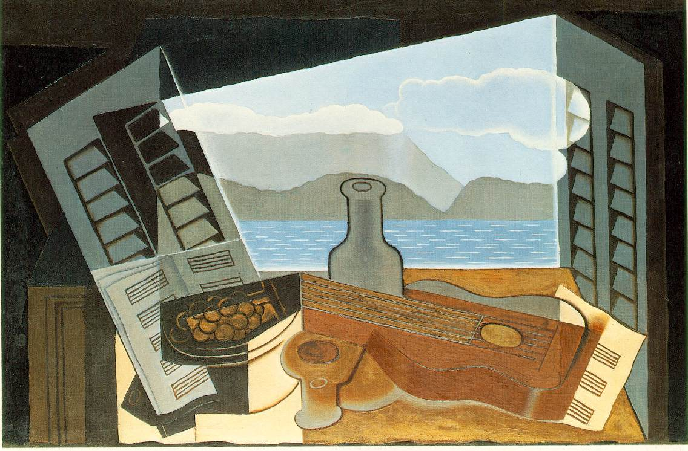
Create a mind map of all the words you would use to describe Cubism… Here are a few to get you started…
Abstract, Picasso, Braque, African Masks,
Cezanne, 1907-1914, Gris, re-assembled,
Viewpoint, broken , Cylinder , Sphere , David Mach, Cone
David Hockney, Basic Shapes, Still Life, Portraits, Collage,
Flat, two-dimensional, rejecting the traditional techniques ,
innovative, Photomontage, perspective, foreshortening, modelling,
form, texture, colour, space , Synthetic Analytical

