Slide 1
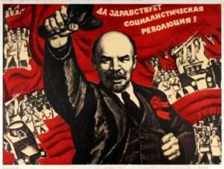
LENIN & THE USSR

Slide 2
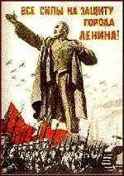
LENIN TAKES POWER
Provisional Gov’t was weak & kept Russia in WWI
  Workers go on strike & soldiers refuse to fight
People want: “Peace, Land, Bread”
  Peace=out of WWI
  Land=Peasants want land
  Bread=End to starvation

Slide 3
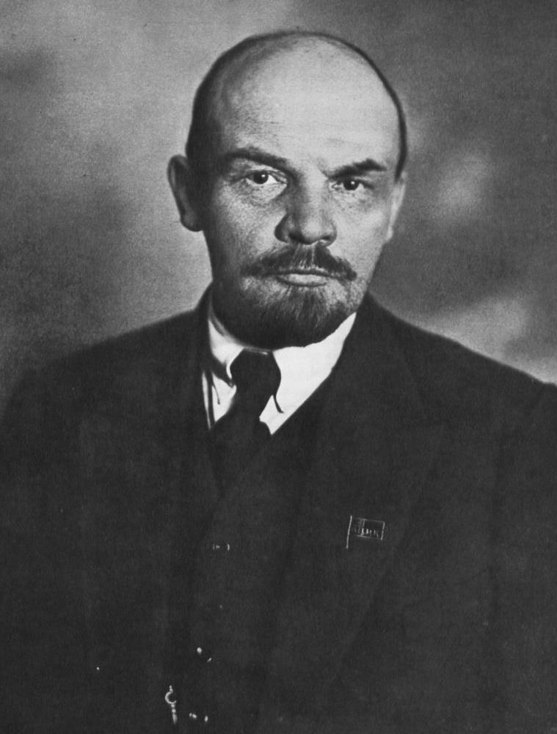
OCTOBER REVOLUTION
1917-Lenin gets Russia out of WWI through the Treaty of Brest-Litovsk
Civil War: 1917-1920
  “Reds” (communists) versus “Whites” (loyal to Czar)
  Murders Czar & family
Lenin wins (rules 1917-1924)
Creates the USSR (Union of Soviet Socialist Republics)
Censorship & secret police

Slide 4
RUSSIAN CIVIL WAR
War Communism: Communists nationalized banks, mines, & factories
  Peasants forced to give food to red army
Results: Communists win but complete breakdown of Russian economy and society
  Millions are starving & industrial production is low
  5 million dead of starvation
  Lenin must now deal with these issues……

Slide 5


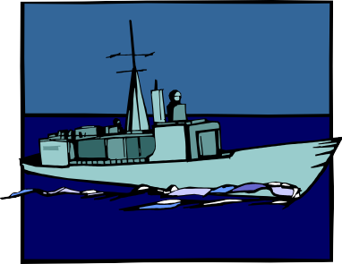



2-Sailors protested about their living conditions
3-Agricultural
Collapse – 5 million die of
starvation
Consequences of War Communism.
4-Currency collapse: Payment in food and fuel
1-Cities in chaos:
*orphaned children
*Social unrest

Slide 6
GOVERNMENT
1922- Communists produce a constitution (democratic and socialist)
  Elected legislature
  Gave all citizens over 18 the vote
  Political power, resources, & means of production now belonged to workers and peasants
Reality was different from theory
  Communist party were supreme (NOT the people)
  Party used army & secret police

Slide 7

SYMBOL OF SOVIET UNION
Hammer and Sickle
Symbolized union between peasants and workers

Slide 8
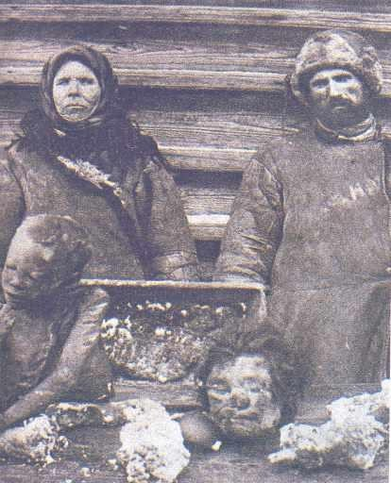
The famine affected both the countryside and the cities. There were reports of
cannibalism in some
districts. "Sometimes mothers and fathers feed their children human meat as a last resort. Sometimes a starving family eats the body of one of its
junior members.
Sometimes parents at night seize part of a body from a cemetery and feed it to their children”.
WHAT DO YOU THINK IS HAPPENING
IN THIS PICTURE?
What does this tell you about the conditions in Russia at this time?
Photograph used with the kind permission of the David King Collection, London

Slide 9

New Economic Policy (NEP):
Lenin’s plan for dealing with the effects of war communism

Slide 10


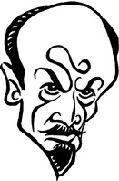

Lenin’s answer – The New Economic Policy
#2- Small factories (those employing less than 20 workers) were privatized. (capitalist
#3- However, all important industries, such as coal and steel remained nationalized (com)
#1-Peasants:
Peasants now had to supply amount of what they grew to the government
Any extra they were allowed to keep or even sell for profit!
#4 -New Rouble was introduced to end inflation.
Electricity added & expanded to rural areas

Slide 11
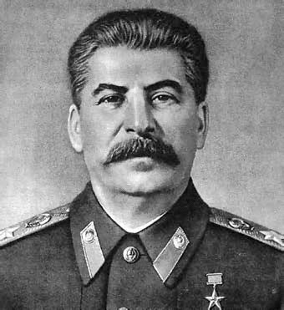
NEXT UP…STALIN
Lenin said about Stalin:
“Comrade Stalin…has concentrated enormous power in his hands, and I am not sure that he always knows how to use that power with sufficient caution.”
What do you think Stalin might do?

