Slide 1
ROMANTICISM:
The Artistic
Expression of
Liberalism
María Sanz

Slide 2
The Spirit of the Age (1790-1850)
A sense of a shared vision among the Romantics.
Early support of the French Revolution.
Rise of the individual
Dehumanization of industrialization.
Radical poetics / politics → an obsession
with violent change.

Slide 3
CHARACTERISTICS OF ROMANTICISM
Imagination was emphasized over “reason.”
This was a backlash against the rationalism characterized by the Neoclassical period or “Age of Reason.”
Imagination was considered necessary for creating all art.

Slide 4
CHARACTERISTICS OF ROMANTICISM
Romantics placed value on “intuition,” or feeling and instincts, over reason.
Emotions were important in Romantic art.

Slide 5
CHARACTERISTICS OF ROMANTICISM
Idealism is the concept that we can make the world a better place.
Idealism refers to any theory that emphasizes the spirit, the mind, or language over matter – thought has a crucial role in making the world the way it is.

Slide 6
CHARACTERISTICS OF ROMANTICISM
The Romantic artist, musician, or writer, is an “inspired creator” rather than a “technical master.”
What this means is “going with the moment” or being spontaneous, rather than “getting it precise.”

Slide 7
CHARACTERISTICS OF ROMANTICISM
Romantics celebrated the individual, THEY WERE INDIVIDUALISTS
During this time period, Women’s Rights and Abolitionism were taking root as major movements.

Slide 8
1. Emotions!
Passion!
Irrationality!

Slide 9
A Growing Distrust of Reason
Early
19c
Enlightenment
Romanticism
Society is good, curbing violent impulses!
Civilization corrupts!
The essence of human experience is subjective and emotional.
Human knowledge is a puny thing compared to other great historical forces.
“Individual rights” are dangerous efforts at selfishness → the community is more important.

Slide 10
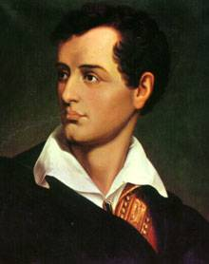
The Romantic Movement
Began in the 1790s and peaked in the 1820s.
Mostly in Northern Europe, especially in Britain and Germany.
A reaction against classicism.
The “Romantic Hero:”
  Greatest example was Lord
  Byron
  Tremendously popular among
  the European reading public.
  Youth imitated his rebelliousness.

Slide 11
Characteristics of Romanticism
The Engaged & Enraged Artist:
  The artist apart from society.
  The artist as social critic.
  The artist as genius.

Slide 12
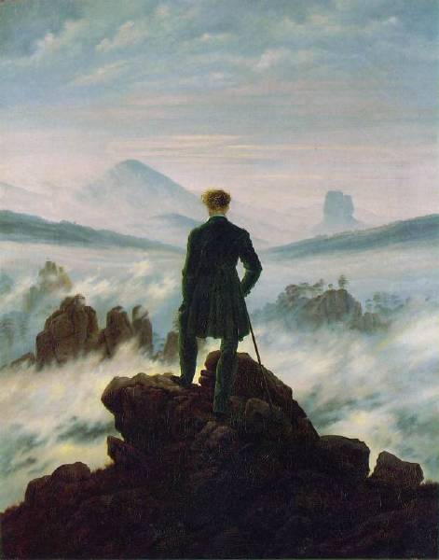
Wandering Above the Sea of Fog
Caspar David Friedrich,
1818

Slide 13
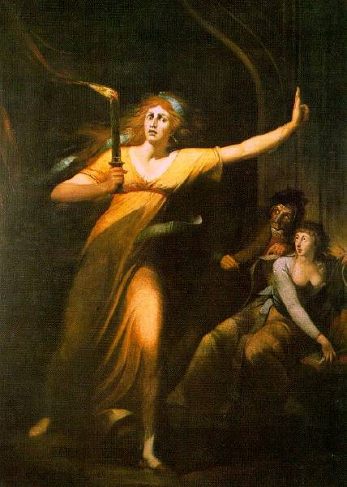
Lady Macbeth - Henry Fuseli, 1794

Slide 14
2. The
"Rugged"
Individual

Slide 15
Characteristics of Romanticism
The Individual/ The Dreamer:
  Individuals have unique, endless potential.
  Self-realization comes through art
      Artists are the true philosophers.

Slide 16
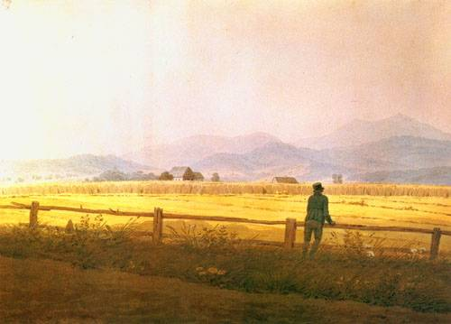
The Dreamer
Gaspar David Friedrich, 1835

Slide 17
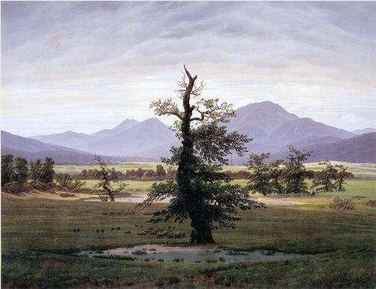
Solitary Tree
Caspar David Friedrich, 1823

Slide 18
3. The Power
& Fury
of Nature

Slide 19
Characteristics of Romanticism
Glorification of Nature:
  Peaceful, restorative qualities [an escape from industrialization and the dehumanization it creates].
  Awesome, powerful, horrifying aspects of nature.
    Indifferent to the fate of humans.
    Overwhelming power of nature.

Slide 20
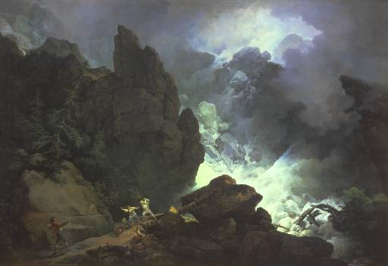
An Avalanche in the Alps
Philip James de Loutherbourg, 1803

Slide 21
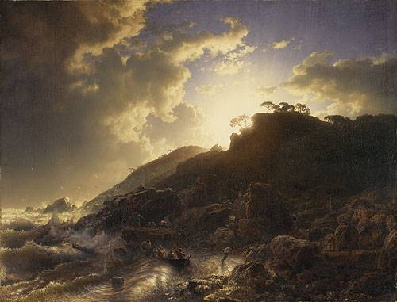
Sunset After a Storm On the Coast of Sicily – Andreas Achenbach, 1853

Slide 22
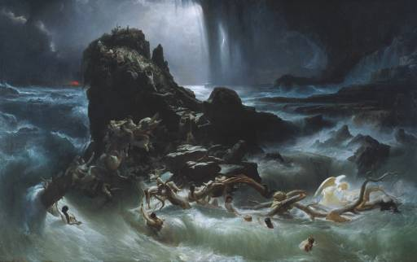
The Deluge
Francis Danby, 1840

Slide 23
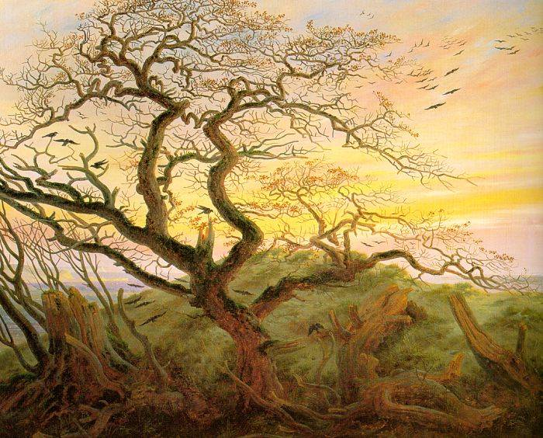
Tree of Crows
Caspar David Friedrich, 1822

Slide 24
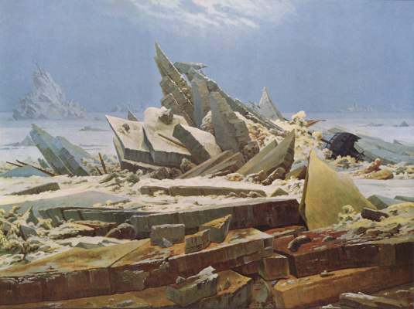
The Wreck of the Hope (aka The Sea of Ice)
Caspar David Friedrich, 1821

Slide 25
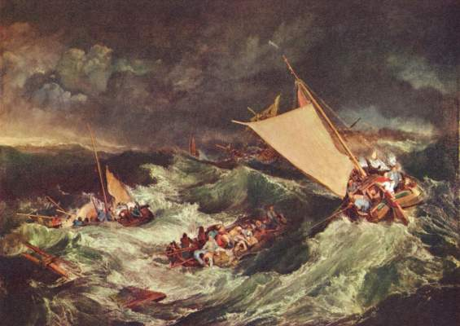
Shipwreck – Joseph Turner, 1805

Slide 26
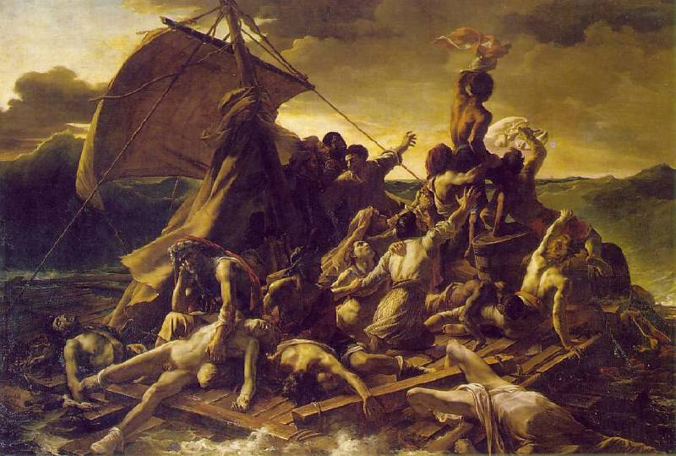
The Raft of the Medusa
Théodore Géricault, 1819

Slide 27
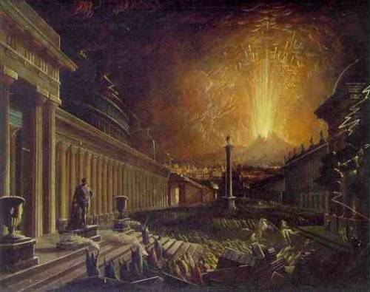
The Eruption of Vesuvius - John Martin

Slide 28
4. Science
Can Be
Dangerous!

Slide 29
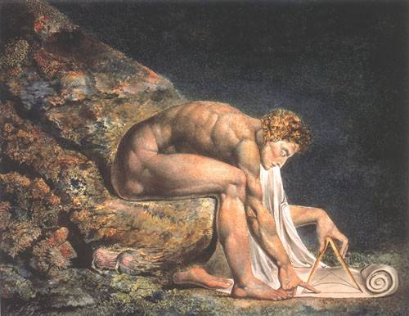
Isaac Newton – William Blake, 1795

Slide 30
5. The "New"
Technology
Is Dehumanizing

Slide 31
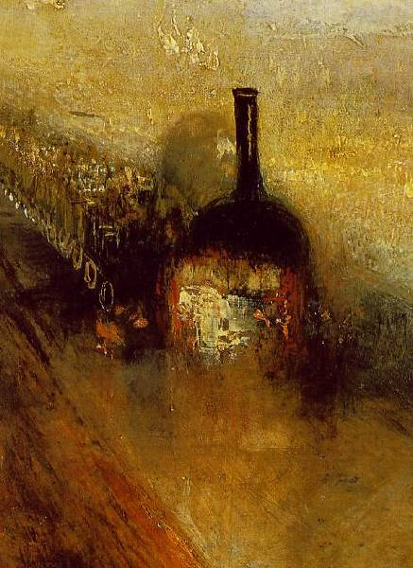
Rain, Steam, & Speed
(details)

Slide 32
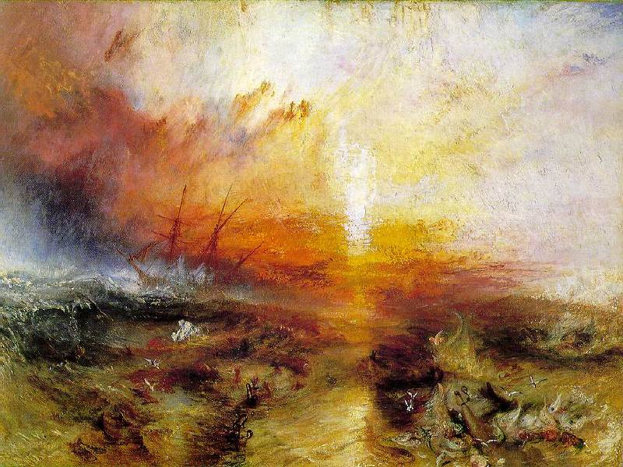
The Slave Ship
Joseph Mallord William Turner, 1842

Slide 33
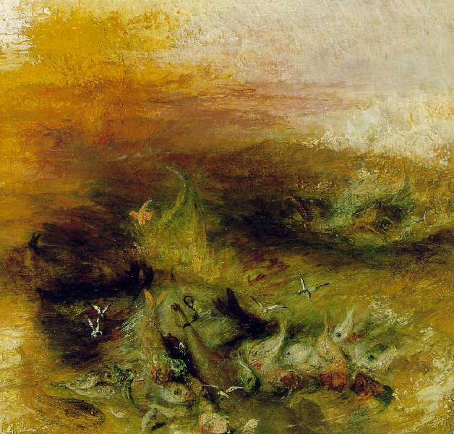
The Slave Ship
(details)

Slide 34
6. Romanticizing
Country Life

Slide 35
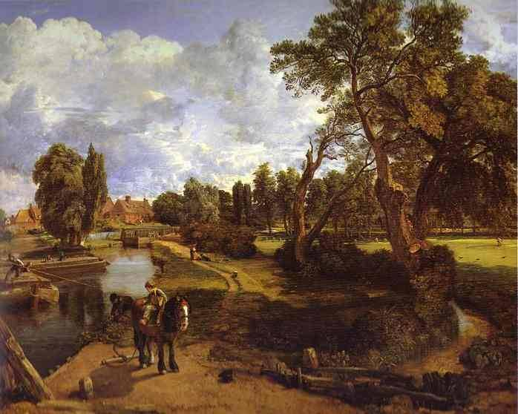
Flatford Mill – John Constable, 1817

Slide 36
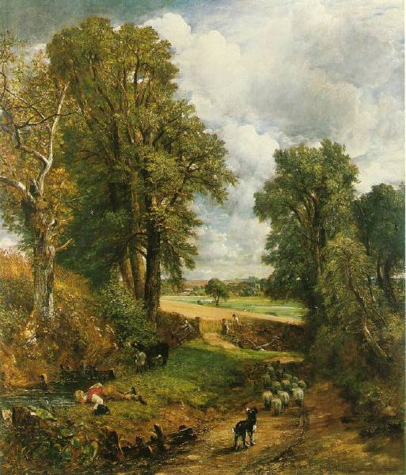
The Corn Field
John Constable,
1826

Slide 37
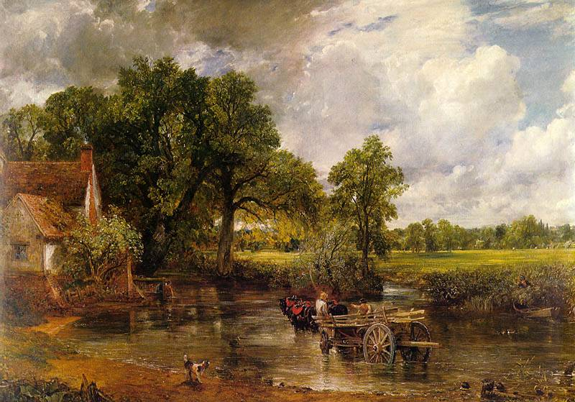
The Hay Wain - John Constable, 1821

Slide 38
7. The Gothic:
"Romanticizing"
the Middle Ages

Slide 39
Characteristics of Romanticism
Revival of Past Styles:
  Gothic & Romanesque revival.
  “Neo-Gothic” architectural style.
  Medieval ruins were a favorite theme for art and poetry.

Slide 40
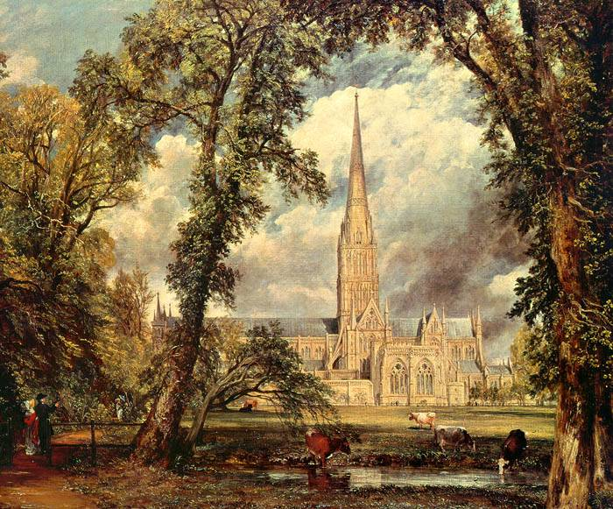
Salisbury Cathedral from the Bishop’s Ground
John Constable, 1825

Slide 41
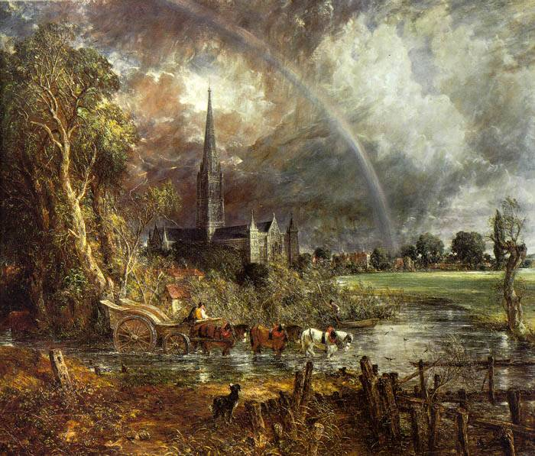
Salisbury Cathedral from the Meadows
John Constable, 1831

Slide 42
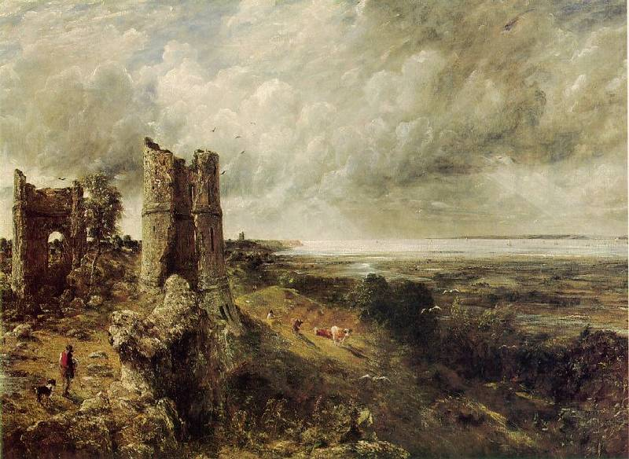
Hadleigh Castle - John Constable, 1829

Slide 43
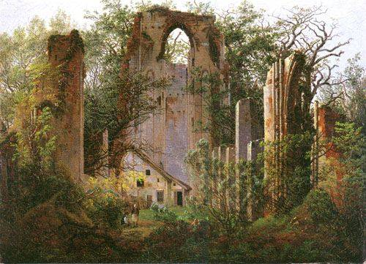
Eldena Ruin
Gaspar David Friedrich, 1825

Slide 44
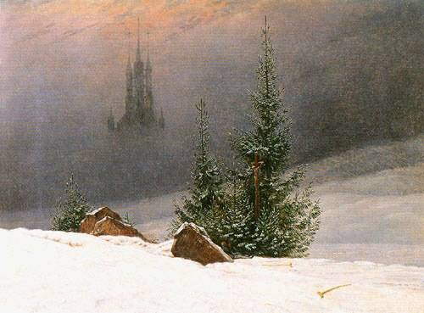
Winter Landscape with Church
Gaspar David Friedrich, 1811

Slide 45
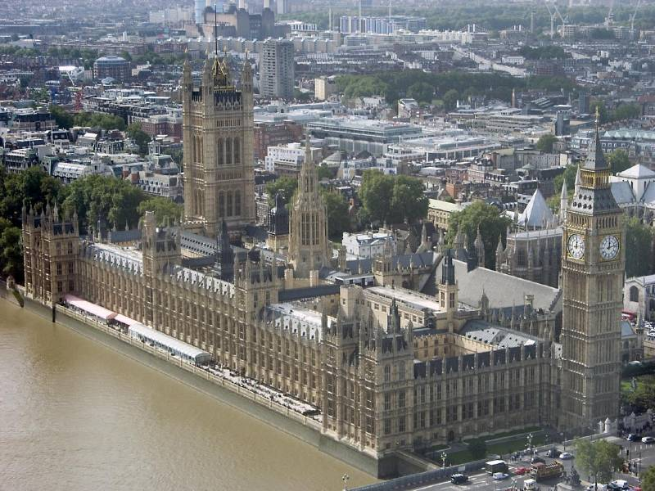
British Houses of Parliament
1840-1865

Slide 46
8. The Exotic,
the Occult,
and the Macabre!

Slide 47
Characteristics of Romanticism
The Supernatural:
  Ghosts, fairies, witches, demons.
  The shadows of the mind—dreams & madness.
  The romantics rejected materialism in pursuit of spiritual self-awareness.
  They yearned for the unknown and the unknowable.

Slide 48
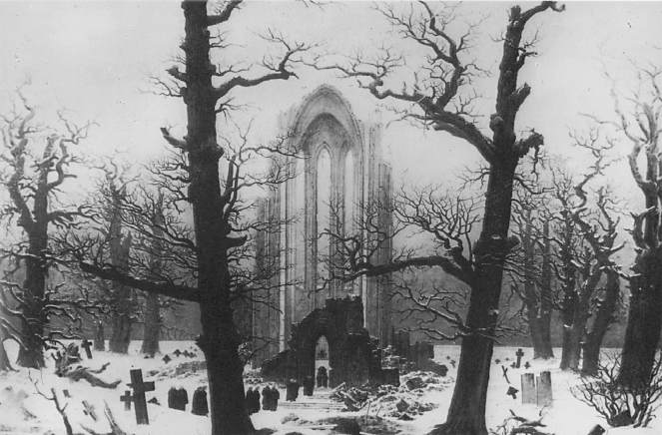
Cloister Cemetery in the Snow
Caspar David Friedrich, 1817-1819

Slide 49
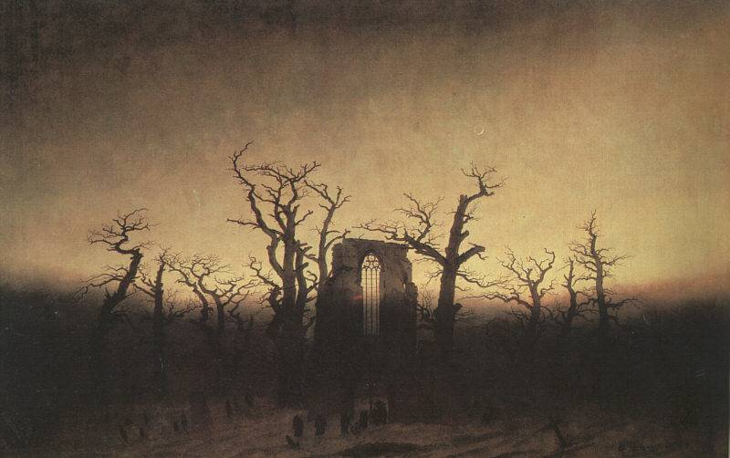
Abbey in an Oak Forest
Caspar David Friedrich, 1809-1810

Slide 50
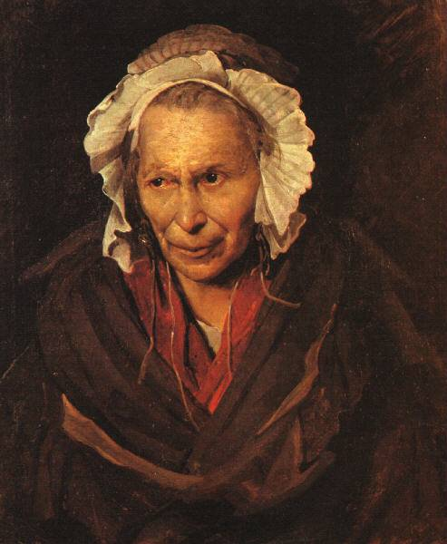
Mad Woman With a Mania
of Envy
Theodore
Gericault,
1822-1823

Slide 51
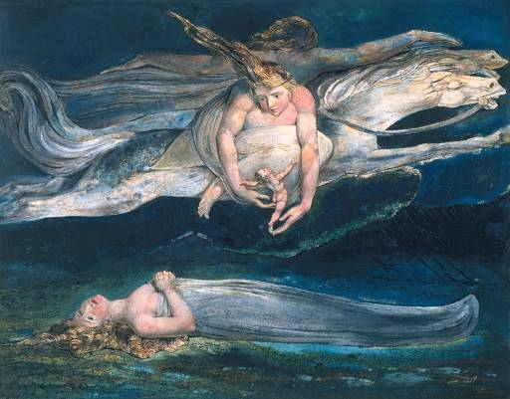
Pity - William Blake, 1795

Slide 52
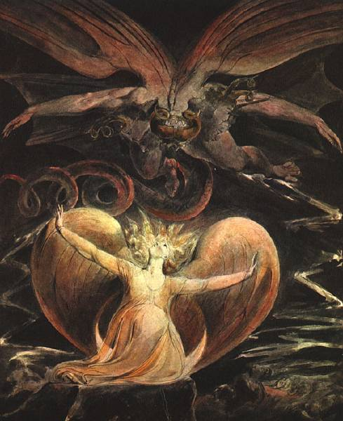
The Great Red
Dragon and the Woman Clothed
with the Sun
William Blake,
1808-1810

Slide 53
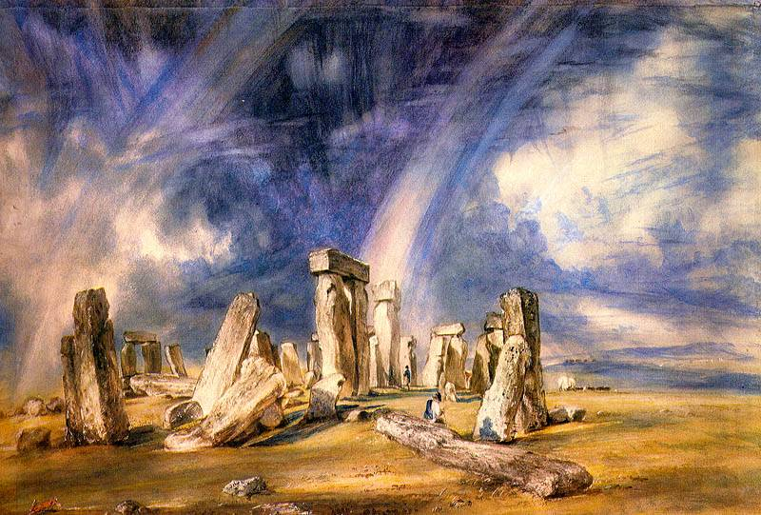
Stonehenge - John Constable, 1836

Slide 54
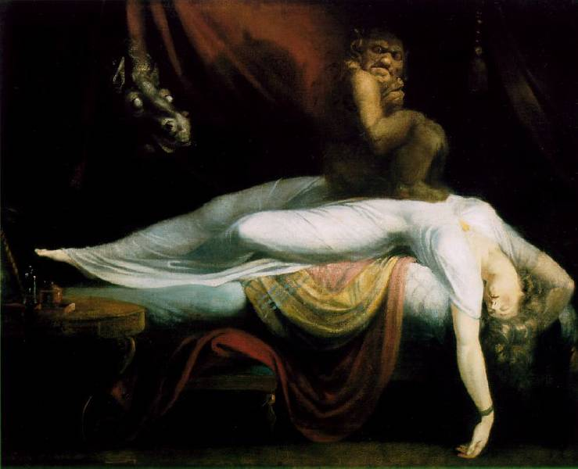
Nightmare (The Incubus)
Henry Fuseli, 1781

Slide 55
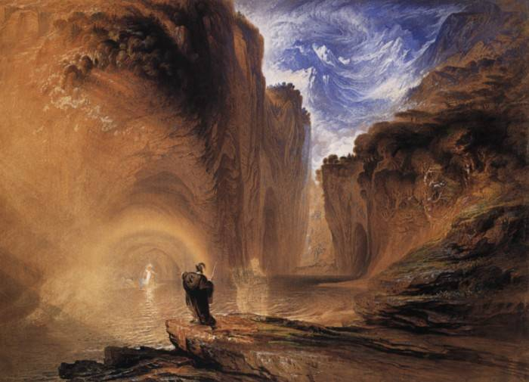
Manfred and the Witch of the Alps
John Martin - 1837

Slide 56
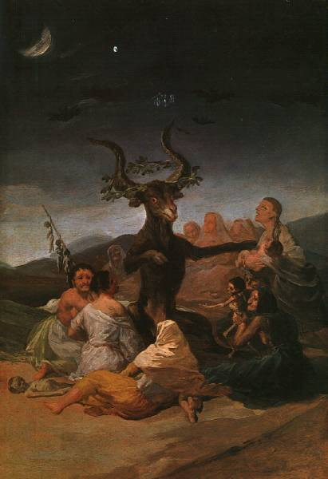
Witches
Sabbath
Francisco Goya,
1798

Slide 57
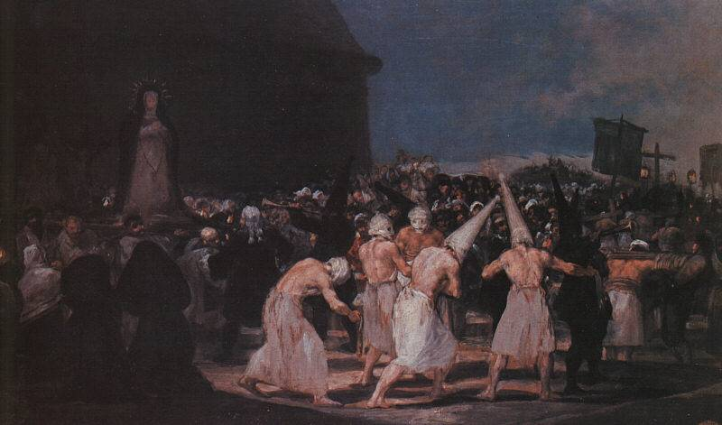
Procession of Flagellants on Good Friday
Francisco Goya, 1793

Slide 58
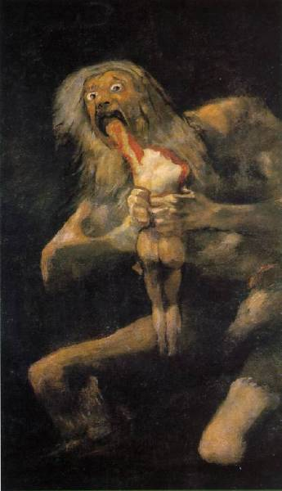
Saturn Devours
His Son
Francisco Goya,
1819-1823

Slide 59
9. Nationalism

Slide 60
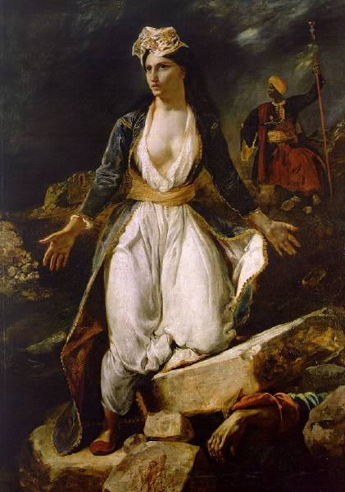
Greece on the Ruins of Missolonghi
Eugène Delacroix, 1827

Slide 61
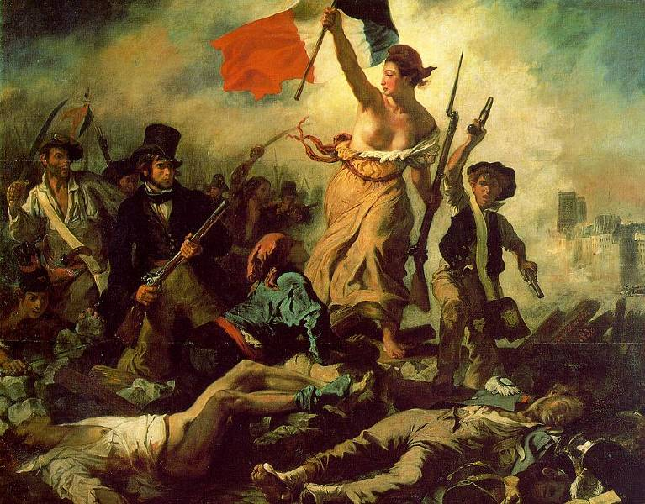
Liberty Leading the People
Eugène Delacroix, 1830

Slide 62
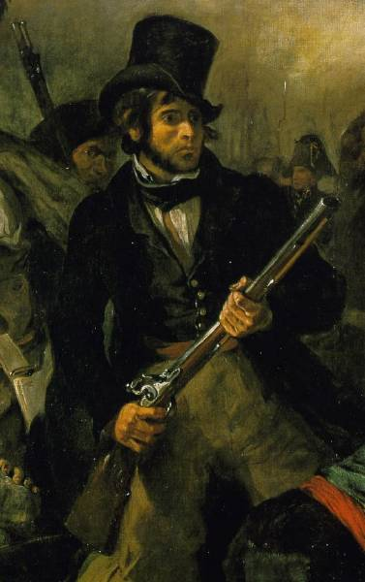
Detail of the
Musket Bearer
Delacoix, himself

Slide 63
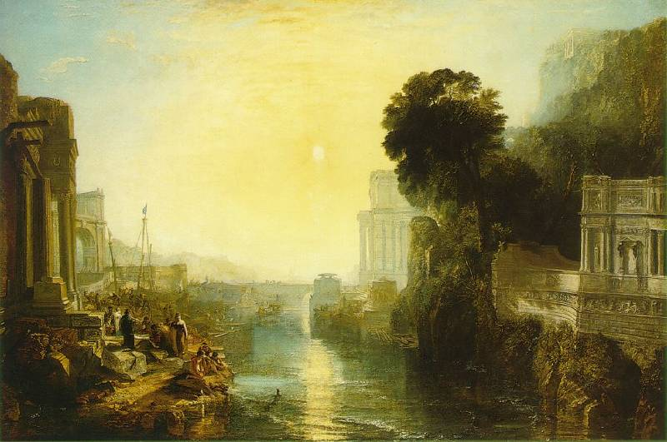
The Rise of the Cartheginian Empire
Joseph Turner, 1815

Slide 64
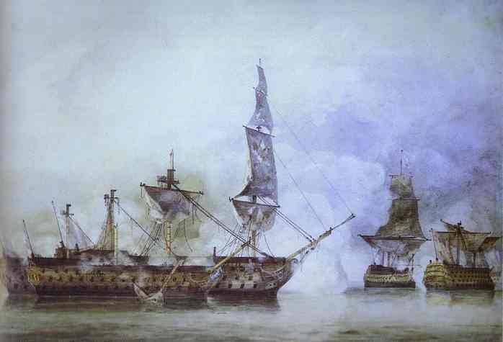
His Majesty’s Ship, “Victory”
(Trafalgar) - John Constable, 1806

Slide 65
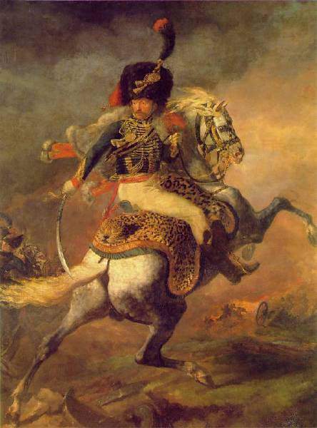
An Officer of the Imperial Horse Guard
Théodore Géricault, 1814

Slide 66
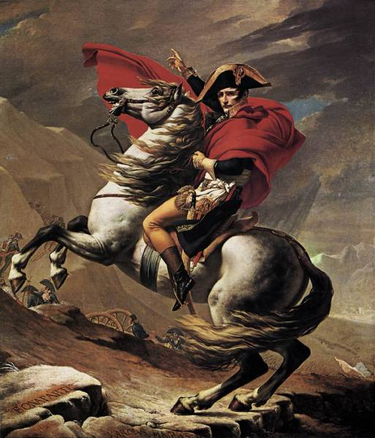
Napoleon
at the
St. Bernard
Pass
David,
1803

Slide 67
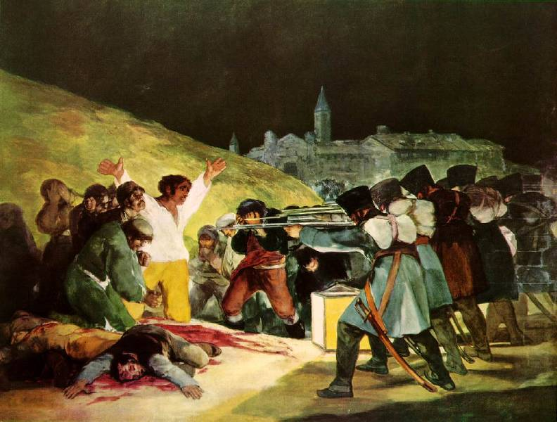
The Shooting of May 3, 1808
Francisco Goya, 1815

Slide 68
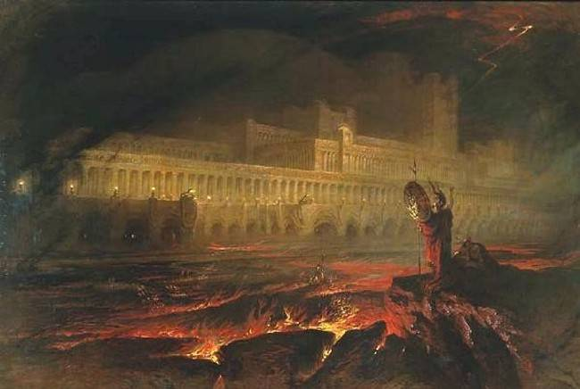
Pandemonium - John Martin, 1841

Slide 69
10. Interest in
Exotic
Foreign Lands

Slide 70
Characteristics of Romanticism
Exoticism:
  The sexy “other.”
  A sense of escape from reality.
  A psychological/moral justification of imperialism?

Slide 71
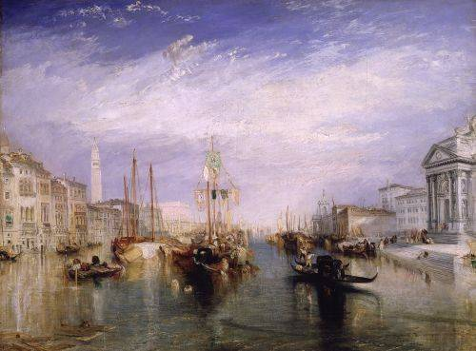
Grand Canal, Venice
Joseph Mallord William Turner, 1835

Slide 72
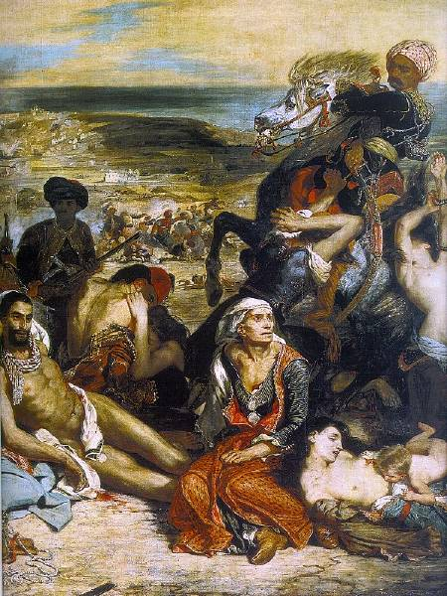
Massacre of Chios - Eugène Delacroix, 1824

Slide 73
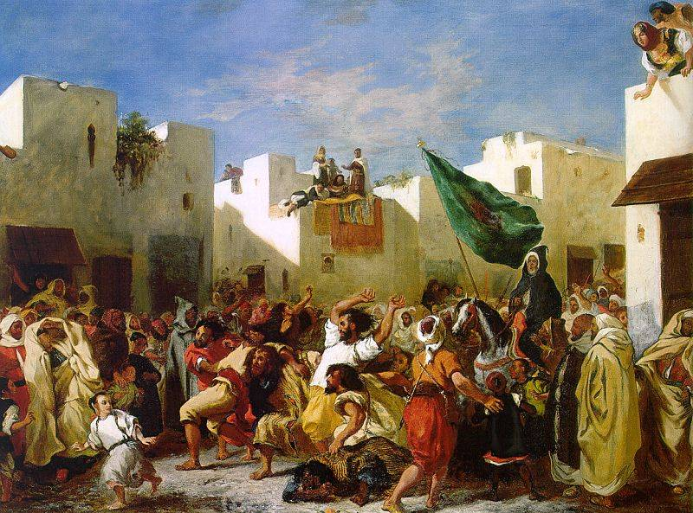
The Fanatics of Tangiers
Eugène Delacroix, 1837-1838

Slide 74
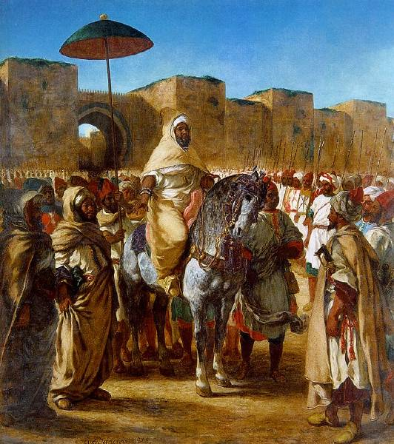
The Sultan of Morocco and His Entourage
Eugène Delacroix, 1845

Slide 75

Women of Algiers in Their Apartment
Eugène Delacroix, 1834

Slide 76

The Turkish Bath
Jean Auguste Ingres, 1852-1863

Slide 77

The Bullfight - Francisco Goya

Slide 78

Charge of the Mamelukes, May 2nd, 1808
Francisco Goya, 1814

Slide 79

The Royal Pavillion at Brighton
John Nash, 1815-1823

Slide 80
11. Return to
Christian
Mysteries

Slide 81

God as the Architect - William Blake, 1794

Slide 82

Elohim Creating Abraham
William Blake, 1805

Slide 83

Body of Abel Found by Adam and Eve
William Blake, 1825

Slide 84

Faust and Mephistopheles
Eugène Delacroix, 1826-1827

Slide 85

The Seventh Plague of Egypt
John Martin, 1823

Slide 86

The Cathedral
Gaspar David
Friedrich,
1818

Slide 87

The Cathedral
(details)
Gaspar David
Friedrich,
1818

Slide 88
The Great Age of the Novel
Gothic Novel:
Jane Eyre - Charlotte Bronte (1847)
Wuthering Heights - Emily Bronte (1847)
Historical Novel:
Ivanhoe - Sir Walter Scott (1819)
Les Miserables - Victor Hugo (1862)
The Three Musketeers – Alexander Dumas
(1844)

Slide 89
The Great Age of the Novel
Science Fiction Novel:
Frankenstein - Mary Shelley (1817)
Dracula – Bramm Stoker (1897)
Novel of Purpose:
Hugh Trevar - Thomas Holcroft (1794)

Slide 90








Slide 91


Other Romantic Writers
Jacob and Wilhelm Grimm
- Grimm’s Fairy Tales
(1814-1816)
Johann Wolfgang von Goethe
- Faust (1806-1832)

Slide 92
The Romantic Poets
Percy Byssche Shelley
Lord Byron (George Gordon)
Samuel Taylor Coleridge
William Wordsworth
John Keats
William Blake

Slide 93

George Gordon’s
(Lord Byron)
Poem
The
Prisoner
of Chillon

Slide 94

Mary
Shelley
Frankenstein

Slide 95


Sir
Walter
Scott
Ivanhoe

Slide 96

William
Wordsworth’s
Poem,
Tintern
Abbey

Slide 97

Samuel
Taylor
Coleridge’s
Poem,
The Rime
of the
Ancient
Mariner

Slide 98
Romanticism:
The Great
Paradox

