Slide 1
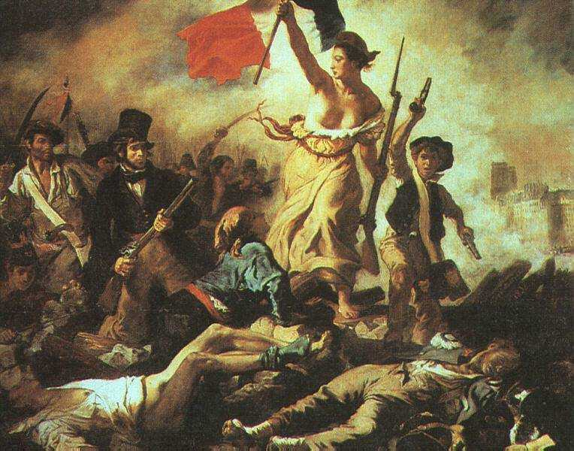
French Revolution
María Sanz

Slide 2
French Revolution Background
Causes
1. Inequality
2. Monarchy ineffective (Louis XV and XVI)
3.Bad Harvests
4.Financial Collapse
Three Estates
1.First clergy-130,000
owned 10% of land
2.Second- Nobility
120-350,000 owned 30 % of land
3. Third Commoners
75-80% owned 35%

Slide 3
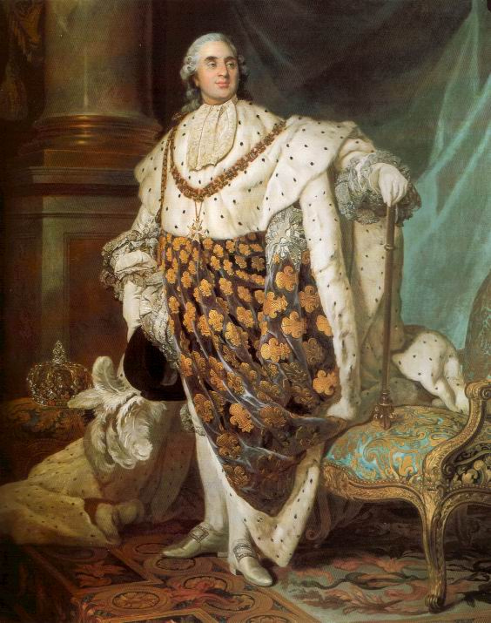
Causes of the French Revolution
The Enlightenment- a new way of thinking that stressed the idea that all people had common rights among those rights was freedom and equality
The American Revolution-Cost France a lot of money
French system’s lack of change
  Louis XVI clung to Absolute kinship or Absolutism (or absolute power)
  King’s response to the poor (heavy taxes)
  Poor starving on the streets
  First second and third estates cannot get along
  French Nobility bankrupts the treasury

Slide 4
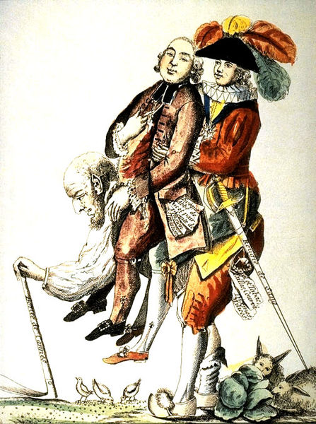
The 3rd Estate
Carries the 1st and
2nd Estate on
Their back.

Slide 5
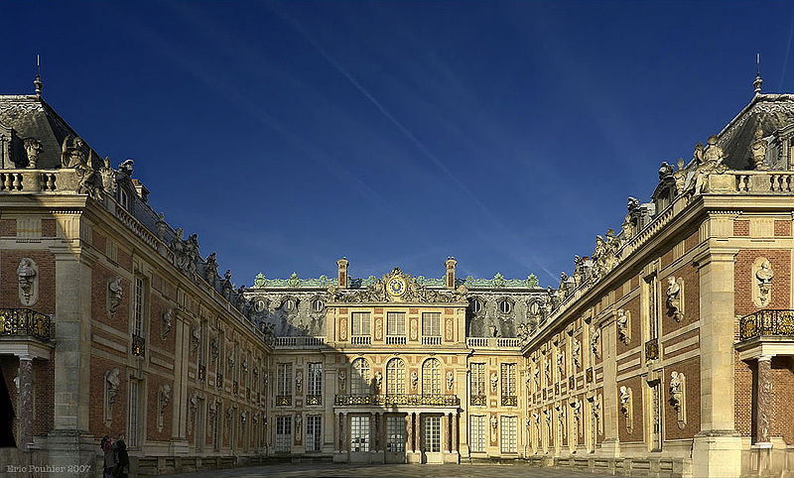
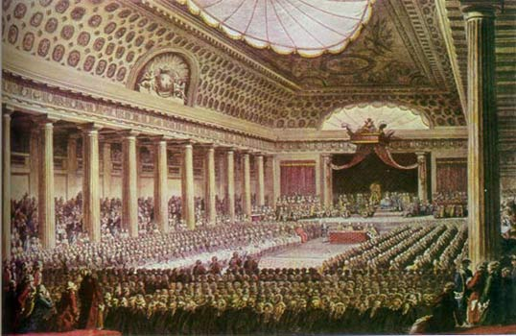
First Stage (1789-1793)
King desired new tax to stabilize economy
He needs the agreement of all three estates.
Estates General is called into assembly (3 estates)
  Not met for 150 years
  Needed to meet
Finally met in Spring 1789
  3rd Estate walked out angry that the nobility was asking for higher taxes when members of the 3rd estate were already starving.

Slide 6
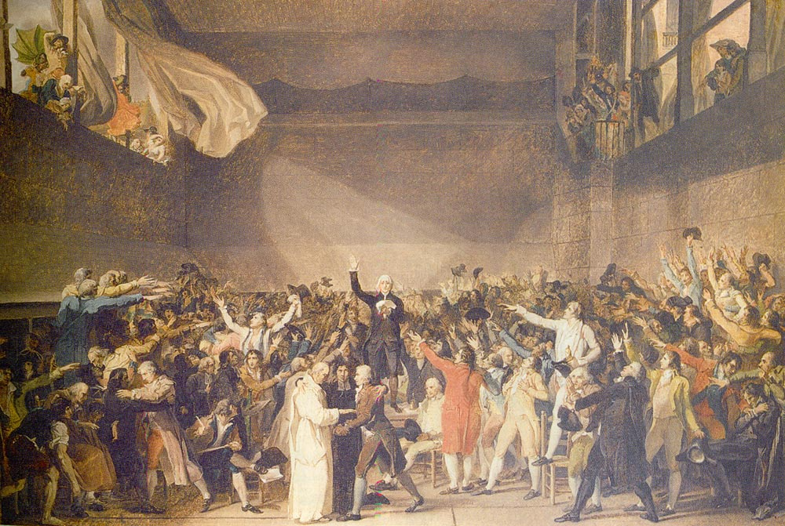
First Stage
National Assembly is created by the 3rd estate (1789-1793)
  3rd estate met in indoor tennis court (Tennis Court Oath)
  Resolved to stay in session until a constitution could be written
  3rd estate Formed a municipal (self) government and start making their own laws for France.

Slide 7
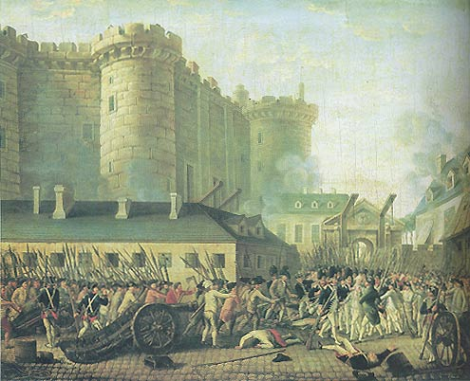
First Stage
Peasants storm the Bastille (Armory)
  July 14, 1789
  Municipal government trying to get arms for the Revolution
Revolts in the countryside

Slide 8
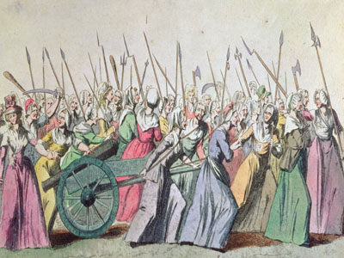
March of the Ladies
In October, 1789 a huge crowed of women march to the Versailles (King’s huge palace)
They take Louis XVI and his wife Marie Antoinette hostage.

Slide 9
Actions of the National Assembly
Declaration of the Rights of Man is written-
  Says what rights men have
  Leaves out rights of Women and Slaves
Secularization of the church (separation of church and state)
New constitution was passed in 1791 with separation of powers and France became a constitutional monarchy.

Slide 10
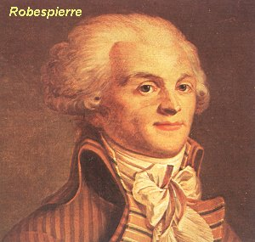
Second Stage
Great turmoil in France
France drawn into war with Europe (Austria)
Failure in wars (1st coalition, 1792-1797)
  Louis XVI and Marie try to run away to Austria (where Marie Antoinette is from)
  King and queen are arrested
Maximilien Robespierre takes control of
Government

Slide 11
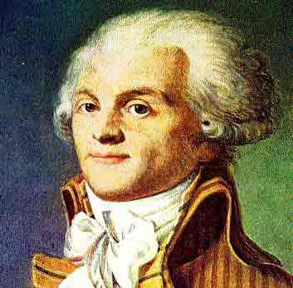
Maximilien Robespierre
Member of the 3rd estate
Well educated as a lawyer.
Had good intentions as a leader but becomes paranoid of political enemies.
Is remembered as one of the most blood thirsty tyrants ever.

Slide 12
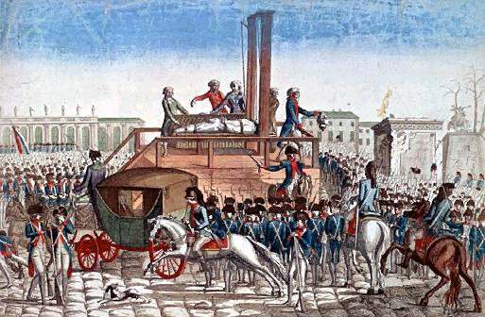
Second Stage
Reign of Terror (1793-1794)
Robespierre basically kills anyone of noble birth
This is called the Reign of Terror
Reforms
  Metric system
  New calendar
  Universal suffrage
  (or right to vote)
  Slavery eliminated
  Land redistribution
  Defaced churches
Guillotine
  20,000 die
  King and queen die

Slide 13
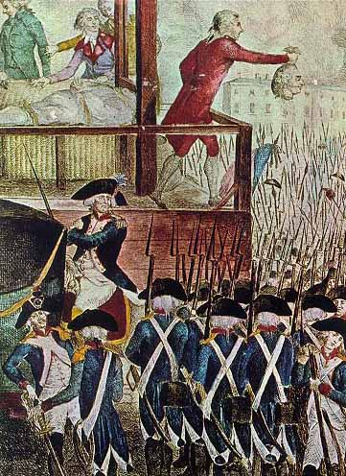
The King and Queen Executed
The New Government declared King Louis VI guilty of:
"conspiracy against the public liberty and the general safety“
He was sentence to death on the new invention called the Guillotine.

Slide 14
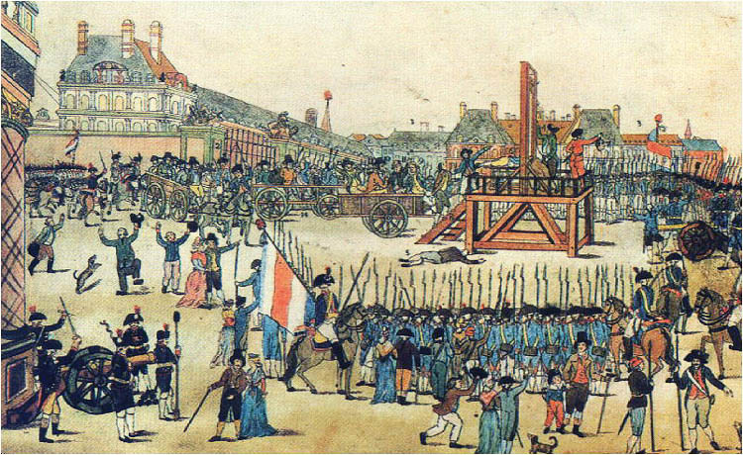
Third Stage—Return of the moderates (1794-1799)
Eventually the people have enough of Robespierre an have him executed
  Moderates gained control of National Convention
National Assembly re-elected
Adoption of new constitution

Slide 15
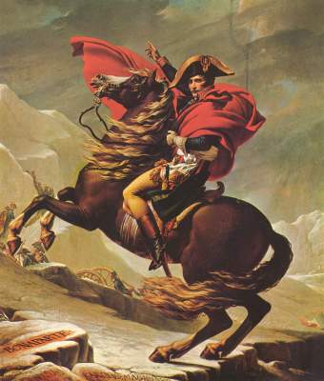
Third Stage—Return of the moderates
The New government is criticized for poor leadership
Some military successes in European wars (Napoleon)
desperate for a popular leader
  Napoleon invited to be consul
  Napoleon will become dictator of France

