Slide 1
Nationalism
What does it mean?
Please write a 3-5 sentence response to: What is nationalism?

Slide 2
Essential Question
How does analyzing multiple perspectives enhance understanding of history?

Slide 3

Nationalism?
For each image you see write the first word that comes to mind.
Does this image represent nationalism?
Why or why not?

Slide 4
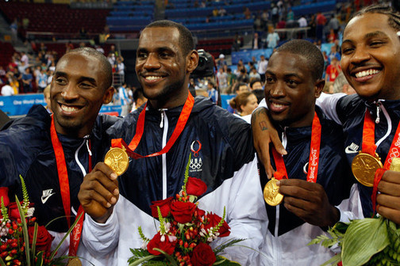
Nationalism
How about this one?
2008 Beijing

Slide 5

Nationalism
And this?

Slide 6
Were those examples of nationalism easy to relate to your definition?
Let’s mix it up a little…….

Slide 7
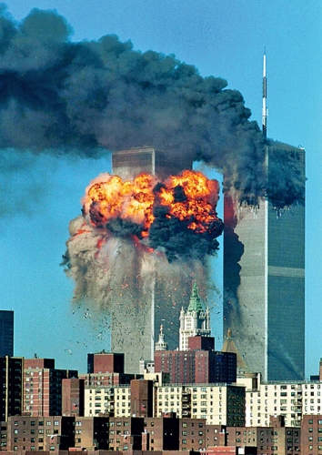
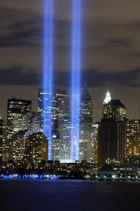
What inspires nationalism?
  Tragedy -Triumph

Slide 8
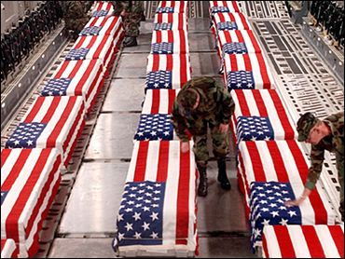
How do you interpret this one?
Does this image inspire nationalism? Please respond in 3-5 sentences.

Slide 9
Nationalism
Are there different perspectives on nationalism?
Is it a feeling?
Can individuals interpret the same images in different ways?
Let’s explore a little further….

Slide 10
Remember this picture?

Slide 11
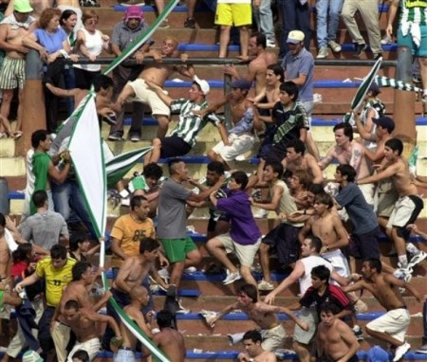
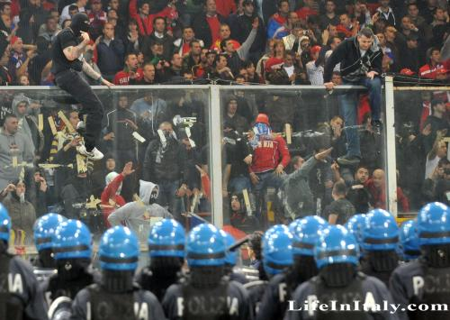
How does it relate to these pictures?

Slide 12
Remember this?

Slide 13
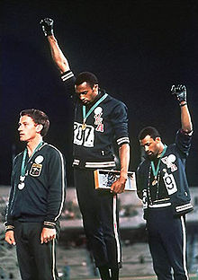
Add some perspective…
When "The Star-Spangled Banner" played, Smith and Carlos delivered the salute with heads bowed, a gesture which became front page news around the world. As they left the podium they were booed by the crowd. Smith later said "If I win, I am American, not a black American. But if I did something bad, then they would say I am a Negro. We are black and we are proud of being black. Black America will understand what we did tonight.” 1968

Slide 14
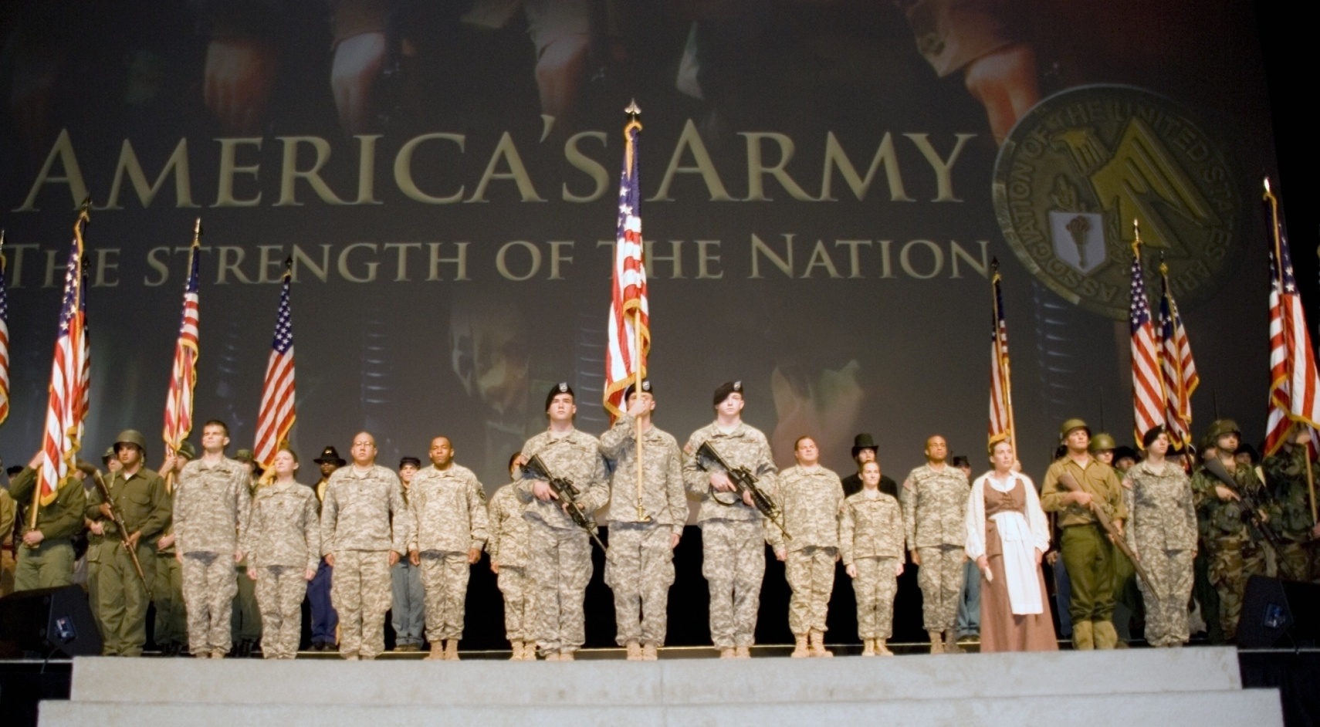
Is this example of nationalism different than…

Slide 15
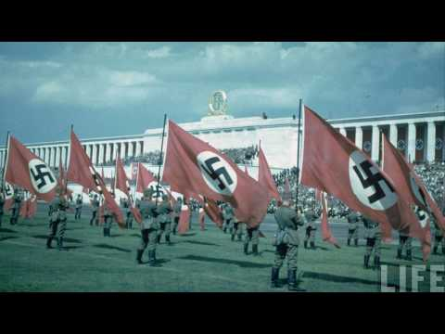
this? How so?

Slide 16
Taking it too far.
Xenophobia is defined as the "hatred or fear of foreigners or strangers or of their politics or culture".
xenophobia (n)
Synonyms: chauvinism, racial intolerance, racism, dislike of foreigners, nationalism, prejudice
Antonym: tolerance

Slide 17
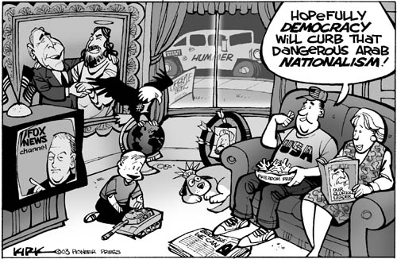
Positive or Negative?
Why?

Slide 18
Where are we going with this?
Student speculation
To Europe!
How does the concept of nationalism play out on the European continent with so many nations in close proximity?

