Slide 1
The Cuban Missile Crisis
13 days in October, 1962

Slide 2
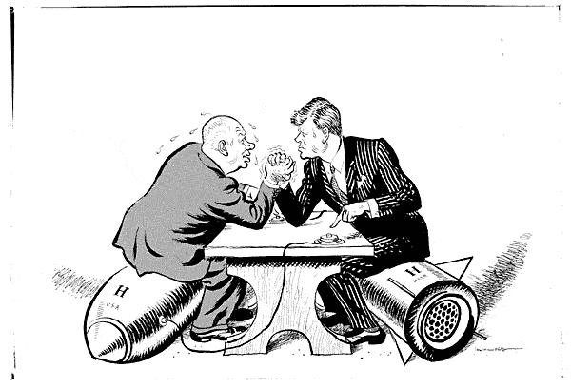
John F. Kennedy and Nikita Khrushchev

Slide 3
The Overthrow of Fulgencio Batista, 1959
The dictatorship of Fulgencio Batista was riddled with corruption and did not serve the interests of the Cuban people.
Many major Cuban industries, like sugar refineries, tobacco, oil, tourism, and gaming, were controlled by American interests and the Batista regime. Meanwhile, most Cubans struggled along in poverty.
In 1959, Fidel Castro, his brother Raul, and the Argentinean revolutionary Ernesto “Che” Guevara, led the successful military revolt which removed Batista from power in 1959.

Slide 4
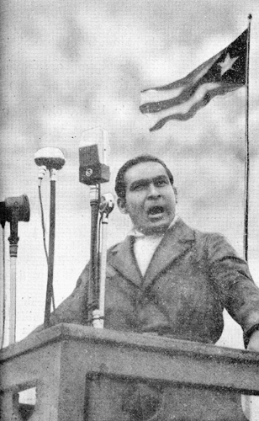
Fulgencio Batista

Slide 5
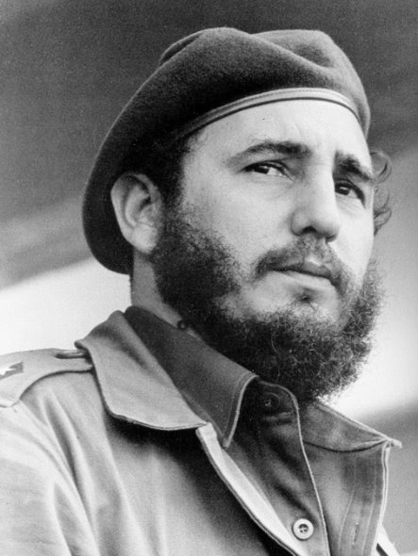
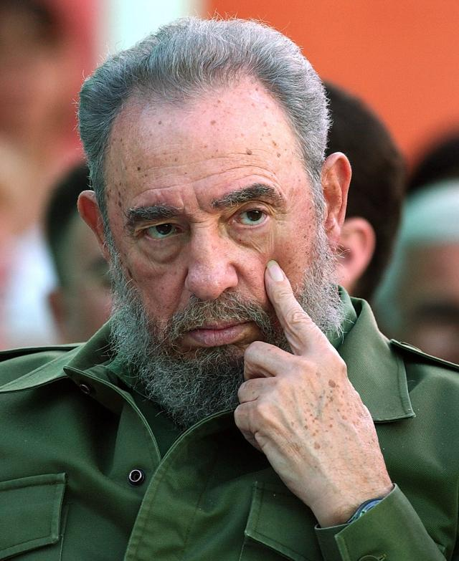
Fidel Castro
The Revolutionary, 1959
Castro, Fifty Years Later

Slide 6
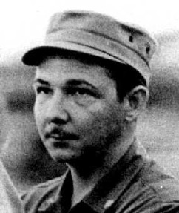
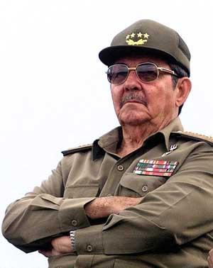
Raul Castro
Raul Castro, the Revolutionary
Raul Castro, the Current Leader of Cuba

Slide 7
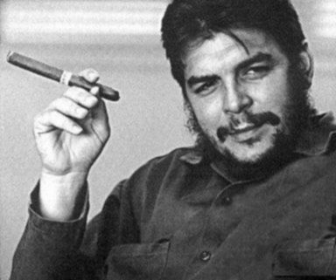
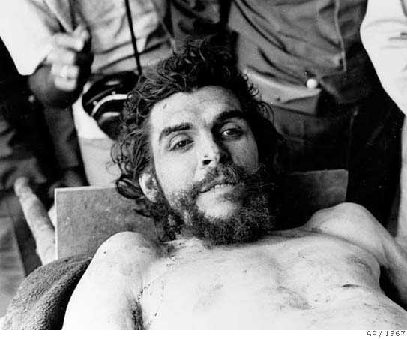
Ernesto “Che” Guevara
“Che” Revolutionary, 1959
Killed in Bolivia, 1967

Slide 8
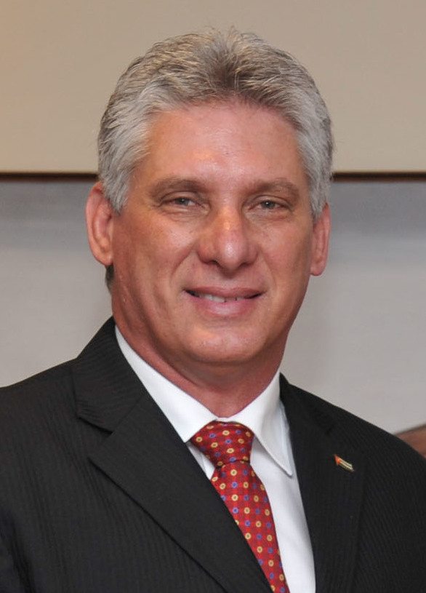
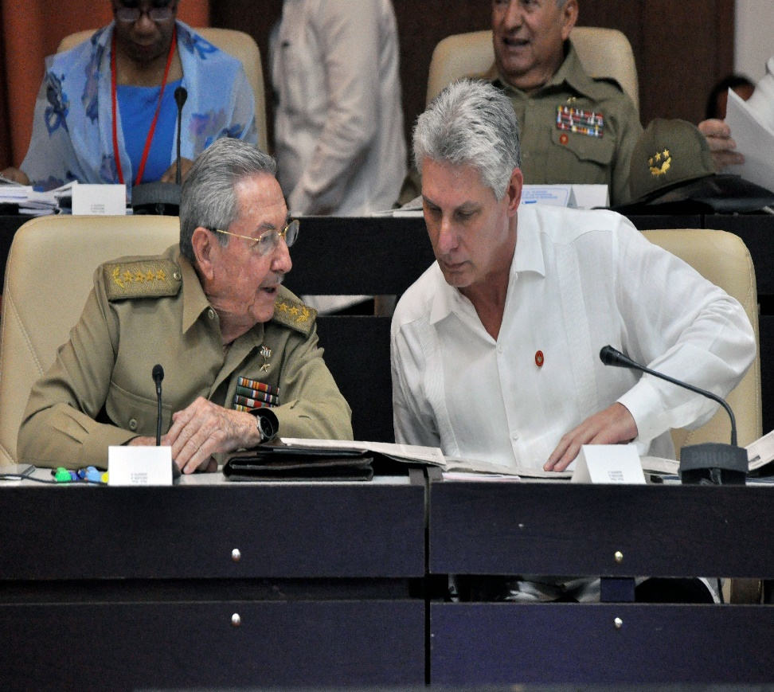
MIGUEL DÍAZ-CANEL

Slide 9
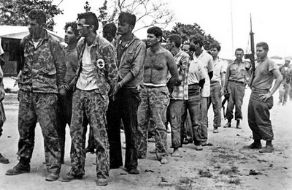
The Bay of Pigs Invasion, 1961
Under Dwight David Eisenhower, the CIA had begun training Cuban exiles and military forces for an invasion of Cuba, meant to reverse the Cuban Revolution, defeat Castro, and restore a government in Cuba which would be sympathetic to US interests. Carried out during the Presidency of John F. Kennedy, the invasion failed, miserably – Kennedy’s military background was less impressive than IKE’s.

Slide 10
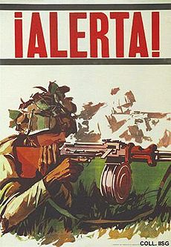
The Bay of Pigs Invasion, 1961
Cuban Quickly Responds
Kennedy Fails to Act
Kennedy committed several missteps during the Bay of Pigs invasion. In all likelihood, the invasion was not ready to procede when it did. JFK had promised to provide the American trained soldiers who stormed the southern shores of Cuba with air support – planes to bombard the enemy. But at the last moment, Kennedy lost his resolve, and the Bay of Pigs invasion was crushed.

Slide 11
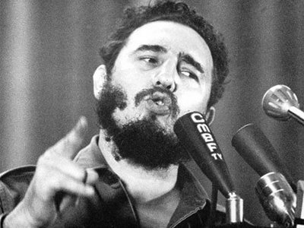
Fidel Castro Remains in Power
After Castro narrowly escaped several assassination attempts and was able to defeat American trained forces attempting to overthrow his government, he became more confident in his abilities and reached out to the Soviet Union for protection from the ever-present threat of United States aggression.

Slide 12
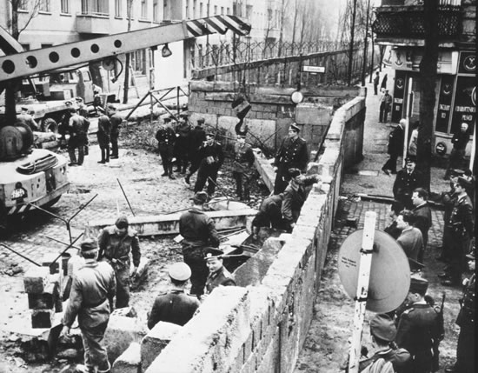
June, 1962: The Construction of the Berlin Wall
In June of 1962, Nikita Khrushchev retaliated against the United States by constructing the Berlin Wall. Millions of Eastern Europeans had flooded into West Berlin in an effort to emigrate to the capitalist democracies of the West. This exit route was blocked off indefinitely by the construction of the Berlin Wall, a symbol of Soviet oppression.

Slide 13
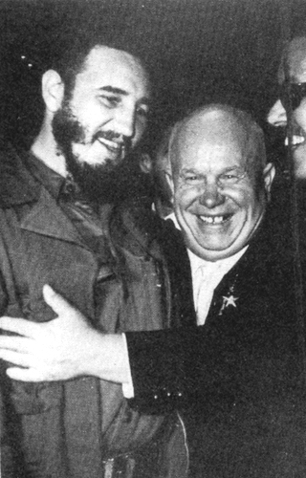
Castro asks Khrushchev for protection
Seeing the desire of Nikita Khrushchev to win a public victory over the United States, Fidel Castro reached out to the leaders of the Soviet Union’s Politburo. He asked for and received access to nuclear missles from the Soviet Union – he claimed, in order to defend himself against the threat of American invasions or assassination attempts.

Slide 14
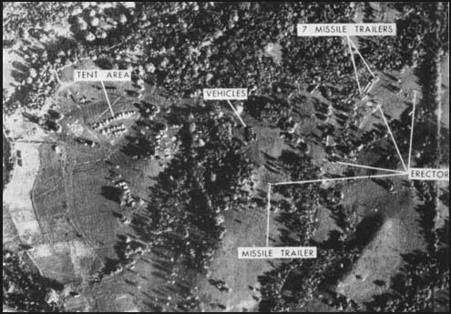
The United States Discovers Missile Silos In Cuba, October, 1962
Using U-2 spy planes, the United States was able to take aerial photographs of large areas in Cuba and around the world. In October of 1962, some of the surveillance photos brought back to Washington, D. C. suggested that Cuba was assembling missile launch pads which could threaten the Unite d States. The Kennedy Administration was faced with a crisis – the threat of nuclear war and ruin.

Slide 15
John Fitzgerald Kennedy
As the youngest president ever elected to the office, many Americans questioned his leadership skills. In a meeting with Nikita Khrushchev in Geneva in 1961, Kennedy had seemed nervous, intimidated, and weak.
After the embarrassment of the Bay of Pigs Invasion and the construction of the Berlin Wall, Kennedy appeared to be losing his grip.
Sadly, Kennedy was assassinated in November of 1963 during a visit to Dallas, TX.

Slide 16
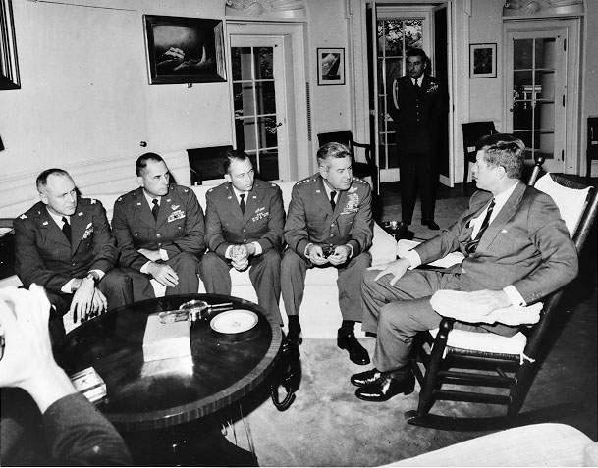
Kennedy’s Options
Kennedy’s first option was to bomb the missile sites in Cuba, and to invade the island. Many of his military advisors thought that this was the best plan available, and suggested that the Soviet Union would do nothing in response. Kennedy, however, did not concur. He feared that any American action in Cuba would be met by Soviet attacks.

Slide 17
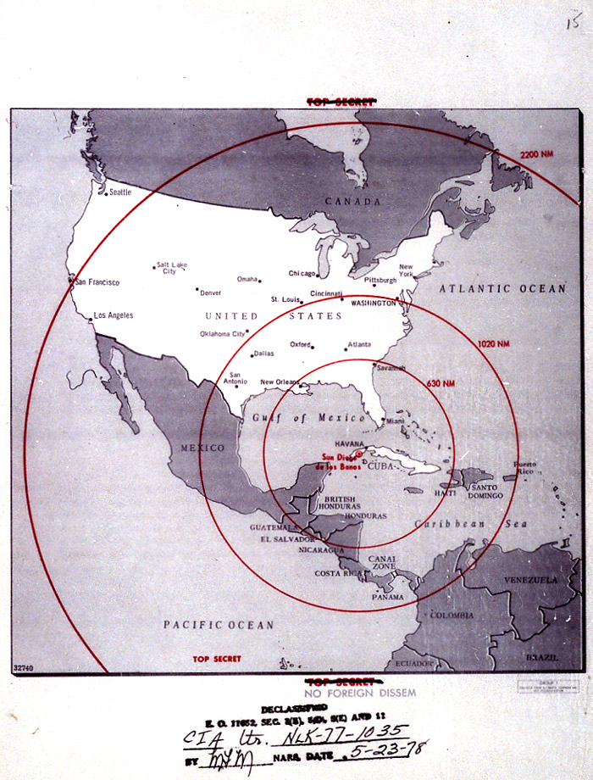
Kennedy’s Second Option
A second option, of course, would have been to do nothing at all. Allowing the Cubans to keep nuclear missiles within 100 miles of major United States cities would have changed the calculus of Cold War activities, but we had our own missiles near the USSR, and could have lived with the tension. Kennedy never really considered this option, though. He claimed, “The greatest danger of all would be to do nothing.”

Slide 18
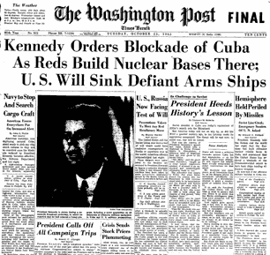
The Third Option: Quarantine
It is an act of war to blockade another nation and to prevent trade from taking place. So Kennedy didn’t call it a blockade – he called it a quarantine. Kennedy surrounded Cuba with American ships, and dared the Soviet Union to try to run the blockade. The world waited anxiously to see what the Soviet Union’s Navy would do.

Slide 19
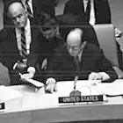
Adlai Stevenson Confronts the USSR in the UN
Former Presidential Candidate Adlai Stevenson, in the UN, asked the Soviet Rep. Zorin whether or not the USSR had place missiles in Cuba. When Zorin refused to answer, Stevenson famously replied: “All right, sir, let me ask you one simple question: Do you, Ambassador Zorin, deny that the USSR has placed and is placing medium- and intermediate-range missiles and sites in Cuba? Yes or no—don’t wait for the translation—yes or no?” Still no answer from Zorin. Stevenson continued: “ You can answer yes or no. You have denied they exist. I want to know if I understood you correctly. I am prepared to wait for my answer until hell freezes over, if that’s your decision.”

Slide 20
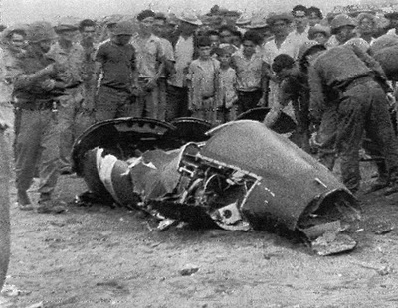
An American Spy Plane Was Shot Down Over Cuba During the Cuban Missile Crisis.
While Americans waited for a response, an American spy plane was shot down over Cuba. Once again, military leaders pressed Kennedy for an immediate and strong response – invasion, retaliatory bombing, or direct conflict with Soviet forces. But Kennedy refused to act in haste. The tension between the Soviet Union and the United States mounted. Kennedy went to the airwaves to speak to the American people on television.

Slide 21
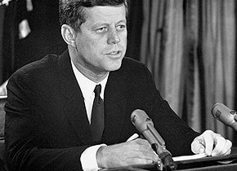
JFK Delivers His Most Famous Television Address on The Cuban Missile Crisis.
John F. Kennedy announced the blockade of Cuba to the United States and the world in a public television address in October of 1962. The Soviet Union, not wanting to heighten the tensions even more or to bring on conflict, chose to turn their ships around on the open seas. Eventually, Khrushchev and Kennedy would work out an agreement to resolve the crisis without any further anxiety.

Slide 22
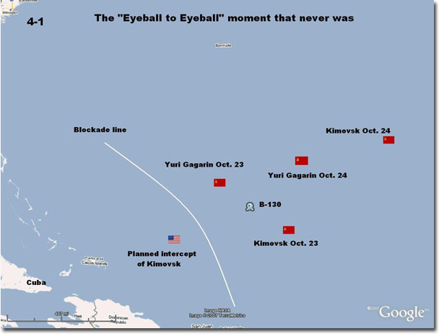
Nuclear Holocaust is Avoided
John F. Kennedy’s Secretary of State Dean Rusk claimed, “We were eyeball to eyeball and the other guy just blinked.” Two Soviet Naval Vessels – the Kimovsk and the Yuri Gagarin (named after the world’s first cosmonaut) changed course just before reaching the United States’ “quarantine line.”

Slide 23
Resolution to the Cuban Missile Crisis
The Soviet Union agreed to disassemble and remove all of its nuclear missiles and launch pads from Cuba.
The United States of America publicly pledged never to invade Cuba again. We have not done so since the Bay of Pigs Invasion.
Secretly, the United States made a promise to remove our own intermediate range missiles, which were easily within reach of the Soviet Union’s major cities from Turkey.
Kennedy, who appeared both confident and strong during the crisis, gained much popularity and a stronger reputation.
Khrushchev, who appeared to have backed down, lost power within the Soviet Union. By 1964, he had been replaced by Leonid Brezhnev.

