Slide 1
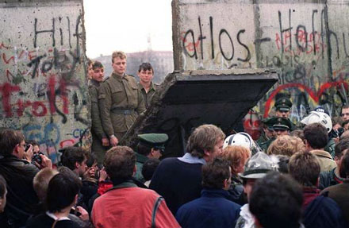
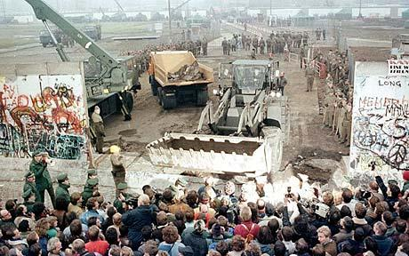
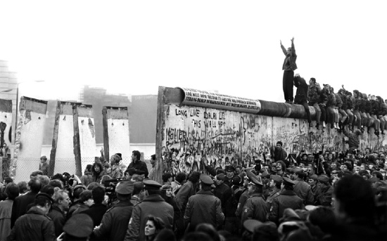
Study the images.
1. What is going on?
2. What does this suggest about the control of the Soviet Union?
3. Why might this have happened?

Slide 2
The End of the Cold War
Objective: To explain how the Cold War came to an end

Slide 3
Gorbachev’s Attitude to Eastern Europe
Dec 1988 – He announced that Russia’s communist ideology should play a smaller role in foreign affairs e.g. The USSR would no longer trade with Capitalist states over Communist States.
He wanted Eastern European states to embrace glasnost and perestroika.
He withdrew Soviet troops from Eastern Europe to cut costs.
He did not intend to weaken communist control there, he simply wanted to strengthen it through reform – however once reform had begun he could not contain it…

Slide 4
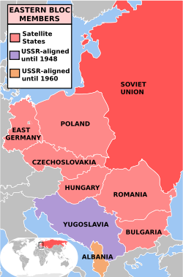
The Fall of the Eastern Bloc 1989-90
2. Hungary
Although in May 1989
Hungary opens its
borders with Austria,
the Communist government
is not defeated until early
1990.
1. Poland
1988 sees strikes throughout
the country & by June 1988
the communist government
is defeated in free elections.
5. Romania
(the most brutal
government in Eastern
Europe) Following huge
Demonstrations from
December 1989 & a
very violent response
from the secret police,
democratic elections are
eventually held in 1990.
What are the implications
of this for the USSR?
3. East Germany
In September 1989
thousands of East
Germans escape
through Hungary
to West Germany &
by November the
Berlin Wall comes
down. In 1991
Germany is reunited.
4. Czechoslovakia
Following huge
Demonstrations from
against communism,
the government resigns
in November & a
non-communist
becomes President
in December.
6. Bulgaria
Early 1990
democratic
elections are held
& the renamed
Communist
Party wins.

Slide 5
End of Warsaw Pact
- The pact had united the communist states of Eastern Europe against the capitalist states in the West.
- As the states rejected communism, the pact became null and void.
- Military co-operation between Eastern European states ended early 1990
- Formal dissolving of Warsaw Pact July 91

Slide 6
The Fall of the Soviet Union
Using pages 132-33, create a flowchart explaining the fall of the Soviet Union.
Gorbachev was widely
respected in the West
for his willingness
to reform and the fact
that his policies had led
to the break-up of
Eastern Europe.
Leading members of the
communist party believed
Gorbachev had severely
weakened communism.
They organised a coup on
19 August 1991 which
removed him from power.
Gorbachev was away from
the capital at the time
and was prevented from
returning. The new gvt
declared a state of
emergency and aimed to
restore the power of the
Soviet Union.
Gorbachev’s final
attempt to save
the Soviet Union was
a new constitution
which gave Soviet
republics greater
independence.
However the leaders
of these countries did
not accept as they
wanted full
independence.
As a result,
Gorbachev officially
announced the
dissolution of the
Soviet Union and
his resignation as
President on 25
December 1991.
21 Aug Gorbachev
returned and resumed
his position as
Soviet leader, and
announced it was
his goal to save
communism. But the
coup had damaged
his authority.
The new gvt
lasted 3 days.
Boris Yeltsin,
played a crucial
role in defeating
the coup. he
called upon the
people to resist
the new regime.

Slide 7
End of the Cold War
The dissolution of the USSR ended the superpower conflict.
The Cold War was over.
America was left as the world’s only superpower.

Slide 8
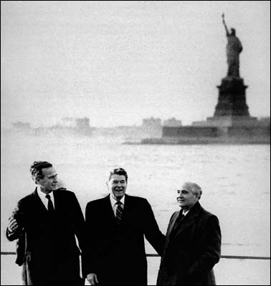
Exam Practise
Create a plan for the following question:
“Explain why relations between the Soviet Union and the USA changed in the years 1979-91”
(12 marks)

Slide 9
Exam Plan
Afghanistan War
- Link back to question - how did this change relations?
Briefly explain
End of détente
New Leaders
- Link back to question – how did this change relations?
Reagan and his attitude towards the USSR (evil empire, SDI)
Gorbachev and his attitude towards the US (reforms and better links with West)
3. Break up of Eastern Europe and End of Cold War
Link back to question – how did this change relations?
Breakaway states and end of Warsaw Pact
Fall of Soviet Union left America as only superpower

