Slide 1

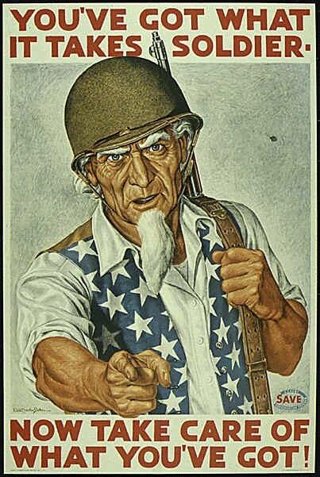


WORLD WAR
II…
SECOND WORLD WAR

Slide 2
Beginnings/ Fascism Rises in Europe
Most devastating war in human history
  55 million dead
  1 trillion dollar damage
Began in 1939 as strictly a European Conflict, ended in 1945.
  Widened to include most of the world
In response to political turmoil and economic crises, Italy, Germany, and Japan turn to totalitarian dictators.

Slide 3
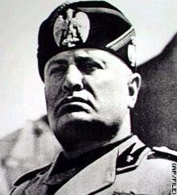
Fascism Rises
Fascism is a new, militant political movement
Extreme nationalism and loyalty to authoritarian leader
Italians want a leader who will take action
  Fascist leader, Benito Mussolini, promises to rescue Italy
  Italian king puts Mussolini in charge

Slide 4
Fascism Rises
Adolf Hitler—obscure political figure in 1920s Germany
Nazism—German brand of fascism 1923 BEER HALL PUTSCH
Hitler tries—but FAILS—to seize power from the democratically elected, but troubled, Weimar Government
MEIN KAMPF (My Struggle) : written in jail, Hitler’s book outlines his plan for a Nazi Germany

Slide 5
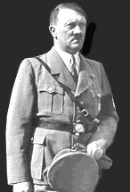
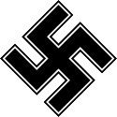
Rise to Power
Adolf Hitler

Slide 6
Background
Father may have been Jewish – Alois Shickelgruber Hitler. He dies when Adolf is 14. Mother dies when he is 18.
Moves to Vienna
  Originally wants to be an artist but fails to get in to Vienna Fine Arts Academy
  Hears many anti-Semitic speeches by Vienna mayor. Ultimately enlists in German army for WWI.
Becomes interested in Conservative German Workers Party in Munich after war. Joins and becomes popular after he gives speeches about his experiences in the war.

Slide 7
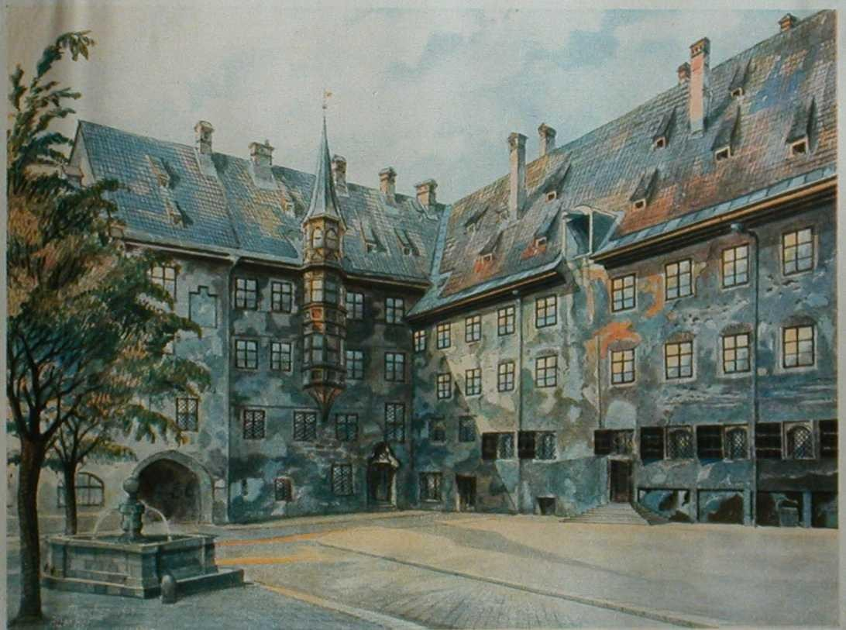
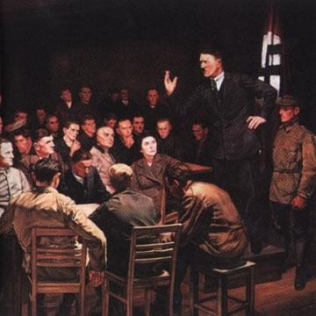
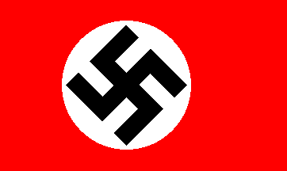
1
2
3
Painting
Speaking in Munich
Swastika – Nazi Party Flag. Nazi is NSDAP or National Socialist German Workers Party.

Slide 8
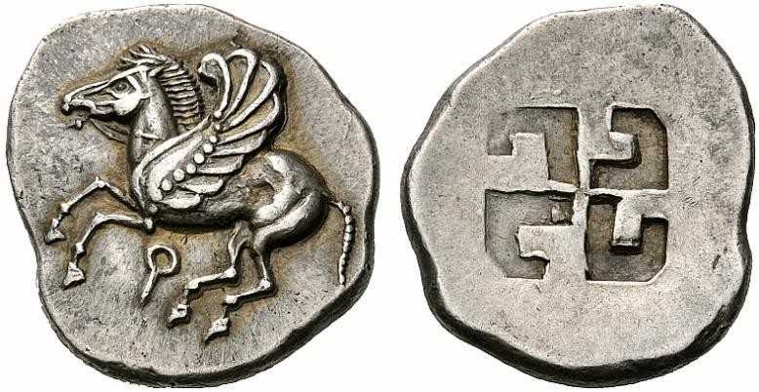
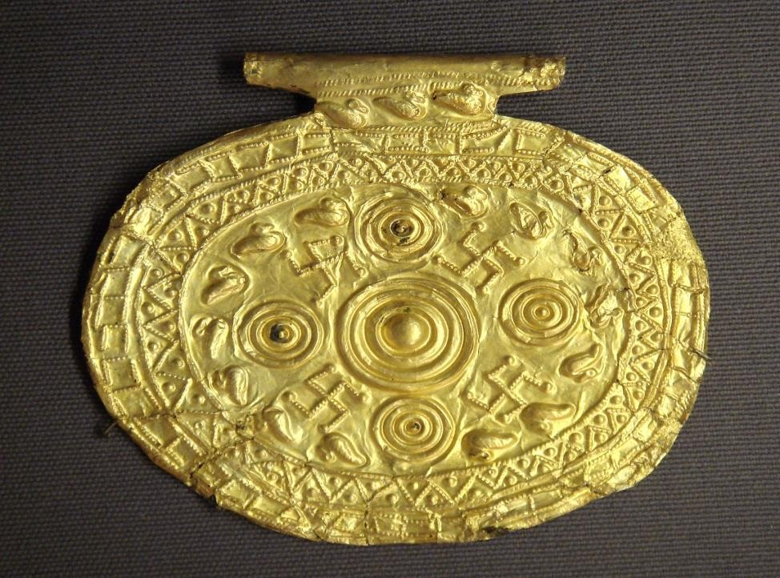
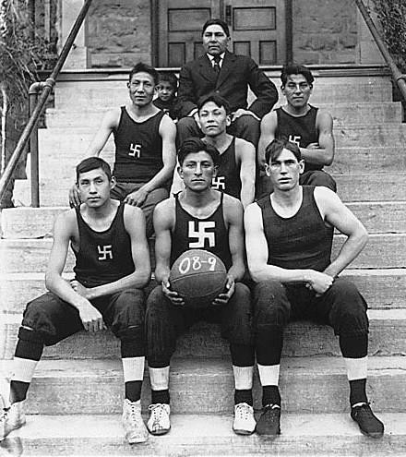

Slide 9
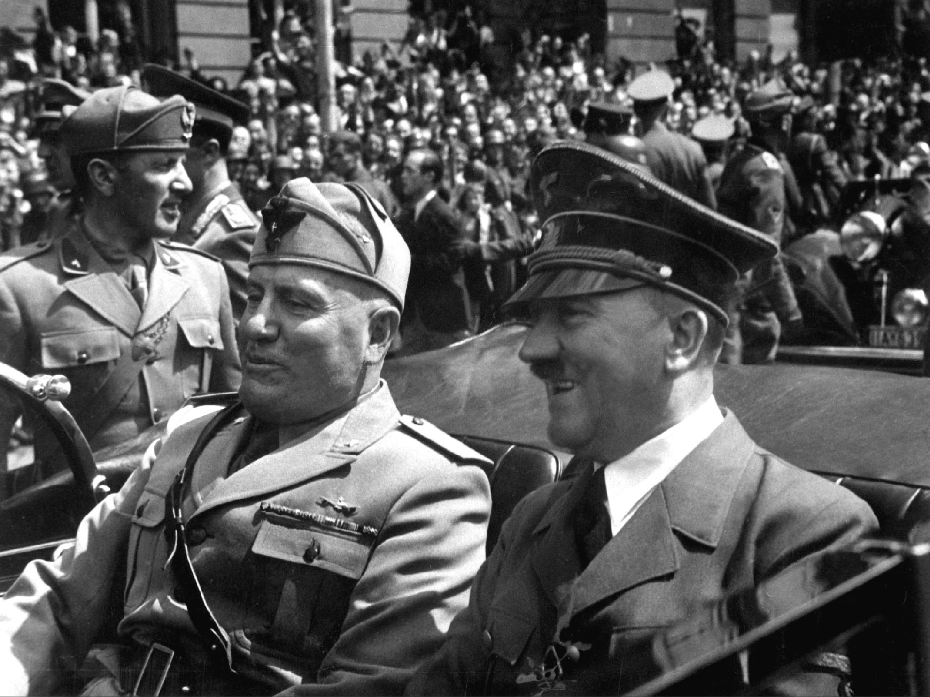

Slide 10
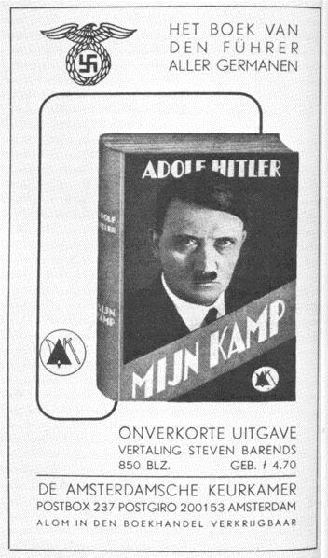
MEIN KAMPF
Superiority of German (Aryan) race; all others inferior
Jews were the reason for all of Germany’s problems (also Communists)
Treaty of Versailles must be overturned
Lebensraum: Germany needed “Living Space” for its people; room to EXPAND

Slide 11
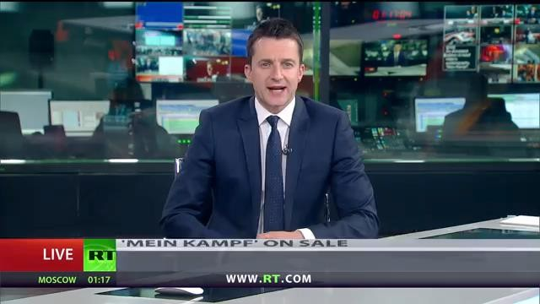
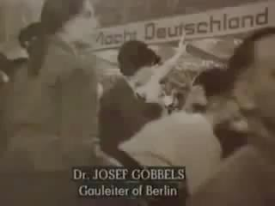
MEIN KAMPF
5. FURHER Principal: One leader should have supreme power and rule Connector: Do you believe Mein
Kampf should be sold in Germany today?
Results:
Bad economic conditions get Nazi Party elected in growing #’s
1933 Ger. President appoints Hitler Chancellor
Burning of Reichstag gives Nazis majority in elections

Slide 12
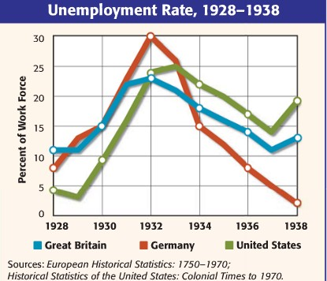
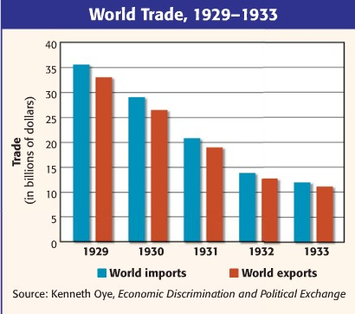
Postwar Europe
Unstable New Democracies
German Inflation
American Great Depression has worldwide impact
Worldwide Unemployment

Slide 13
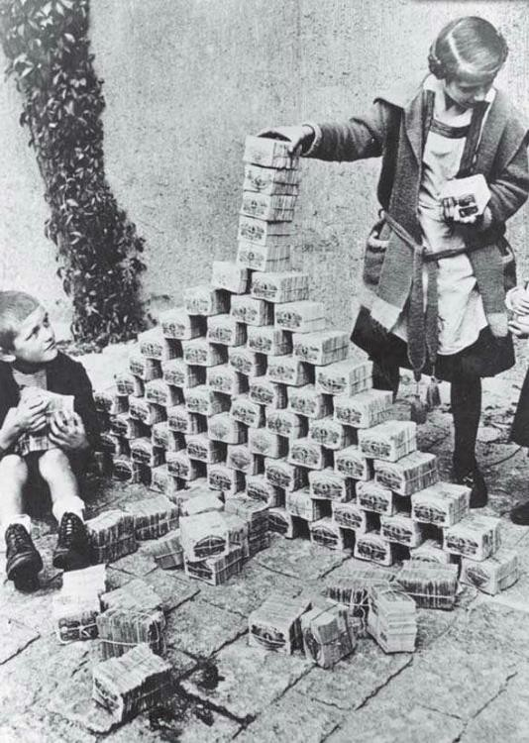
(don’t write this down)
Children using bundles of German marks as blocks →
During and after WWI, Germany just printed more money to pay for the war and reparations. This lead to severe inflation.
In 1923, a loaf of bread cost 200 billion marks!

Slide 14
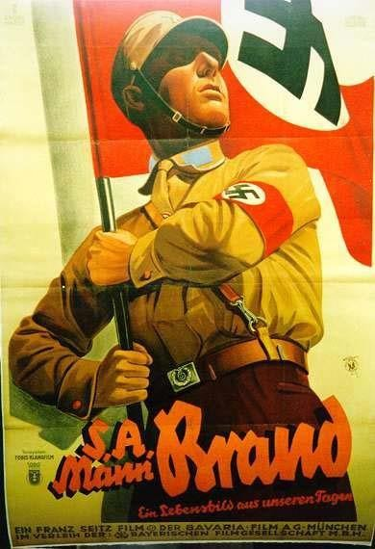
Brownshirts
Q. How did Adolf Hitler accomplish such popularity or hardly any resistance?
Fear – Brownshirts Or SA –
Stormtroopers
  Threatened and beat up Jews and
anti-Nazi voters (Comm, democrats)
–Numbered almost 400,000 by 1932
Propaganda by Joseph Goebbels
  Ph.D. in Literature
Economic crisis and need for strong leadership
Indoctrination and education of young – Hitler Youth

Slide 15
Comparing Fascism to Communism
 | COMMUNISM | FASCISM
Ruled by: | STRICT GOV’T | DICTATOR
Political Parties | ONE | ONE
Individual Rights | Denied | Denied
Societal Classes | None! (A classless society) | Many Aristocrats Industrialist Military Lower middle class Workers
World View | Internationalism -unite workers world- wide | National issues take precedence

Slide 16
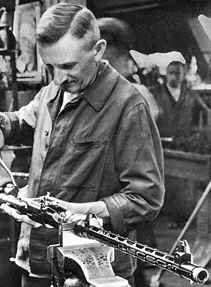
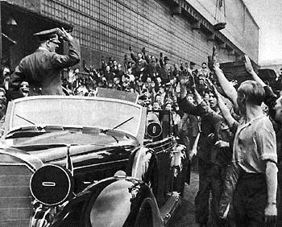
Hitler orders a program of rearming Germany in Secret
Germans grateful
Violation
Factories designed as schools

Slide 17
Aggressors Invade Nations
Germany, Italy, and Japan conquer other countries; the rest of the world does nothing to stop them. Why?
They don’t want to risk World War II

Slide 18
Aggressors March (1933-1936)
Japan invades Manchuria (NE China), later takes major cities like Beijing.
  Chinese Nationalists and Communists fight back (remember…?)
Mussolini (Italy) takes Ethiopia. Why?
Hitler (Ger) takes Rhineland (border land between FR and GER)

Slide 19
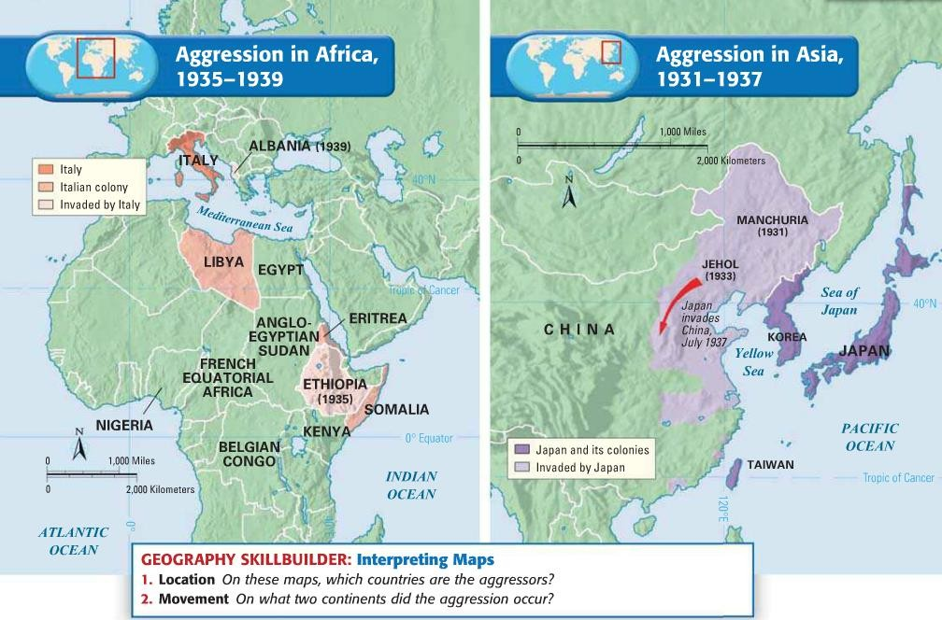

Slide 20
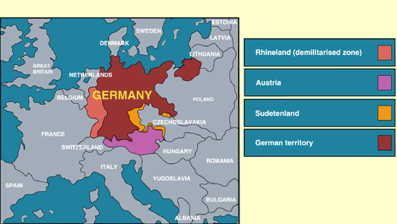
Major Violations of Versailles (R.A.S.C.P.)
1
3
4
2

Slide 21
Taking Sides
Britain and France follow appeasement, a policy of giving in to aggression to keep peace elsewhere
Germany, Italy, and Japan—the Axis Powers— form an alliance
United States follows an isolationist policy (political ties with other countries should be avoided)

Slide 22
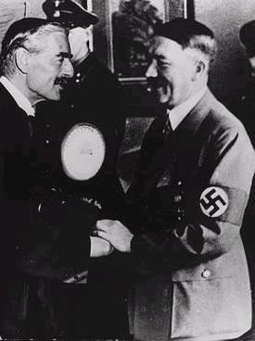
Finally…Chamberlain meets
Hitler to talk appeasement
"If ever that silly old man comes interfering here again with his umbrella, I'll kick him downstairs and
jump on his stomach in front of the photographers".
--Adolf Hitler to
Neville
Chamberlain

Slide 23
Axis Aggression
Hitler takes Sudetenland (Czech-Ger border), and later rest of Czechoslovakia
  GB and FR give in; think Hitler will be satisfied
Mussolini takes Albania; Hitler demands part of Poland
  GB and FR continue appeasement
Nazis and Soviets secretly sign Nonaggression Pact
  Stalin and Hitler pledge never to attack one another
  Germans get Western Poland; Soviets get Eastern Poland and spheres –Estonia, Latvia, and Lithuania

Slide 24
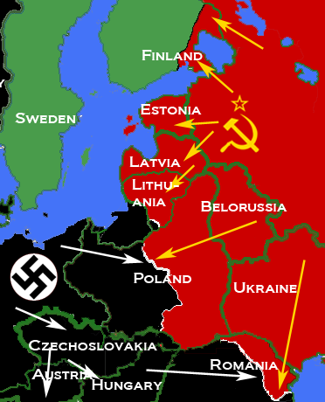
Nazi-Soviet Pact (Molotov-Ribbentrop Pact_

Slide 25
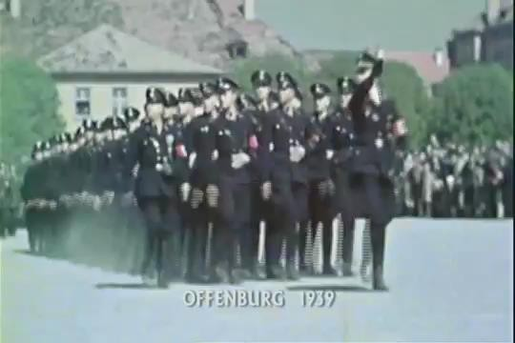

War!
Germany uses blitzkrieg, a new military strategy using airplanes, tanks, and MASSIVE infantry forces to SURPRISE and OVERWHELM the enemy.
  Takes west Poland, Denmark, Norway
Stalin expands the USSR
  Takes Lithuania, Latvia, Estonia, and eventually Finland

Slide 26
France Falls
May 1940, Germany moved quickly into Belgium and France
  Cornered Allied BR troops (had to be rescued by boat)
  Captured Paris by June 14
  FR surrenders a week later
  GER controls northern FR, sets up a “puppet gov’t” in Vichy for southern FR
Charles de Gaulle, FR general, leads the resistance from exile in London

Slide 27
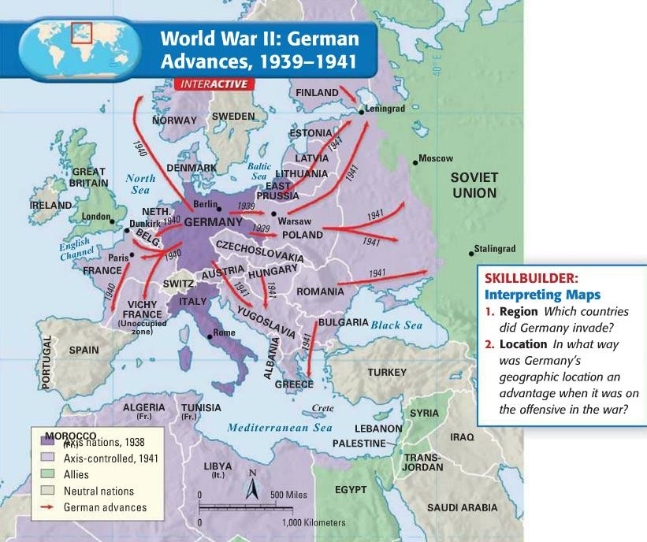

Slide 28
Battle of Britain
German air force (Luftwaffe) bombarded British cities, especially London
RAF (Royal Air Force) fights back
  They have radar and a German decoders!
  Better dogfighters; 3:1 kill ratio
  Germany switches to night raids and blitzes (bombs) London at night
Germany eventually backs out of England
  Considered a British victory!

Slide 29
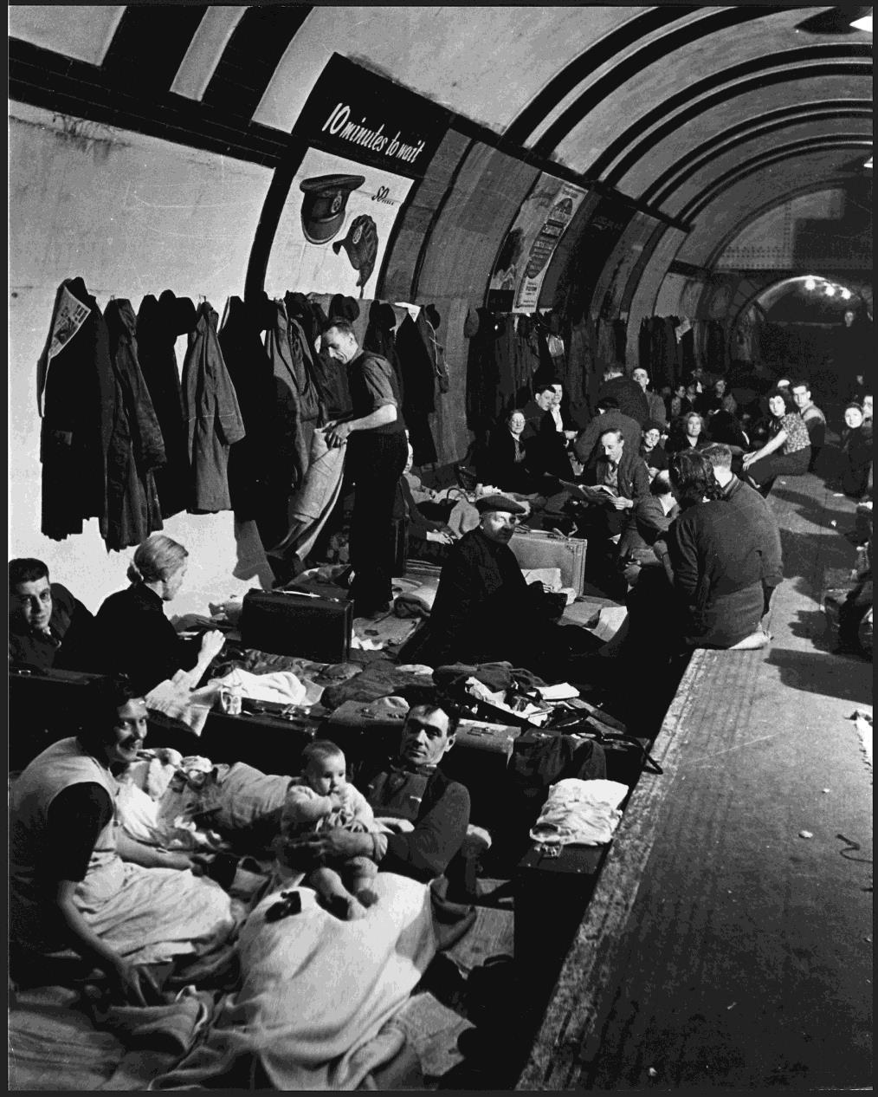
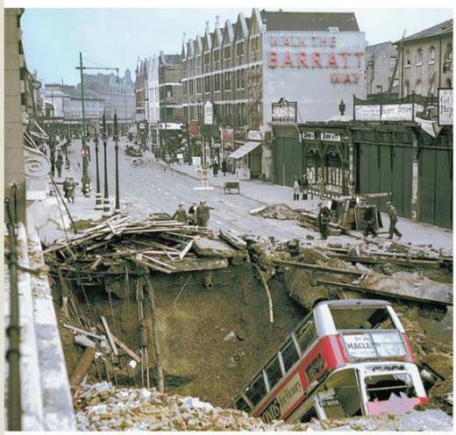
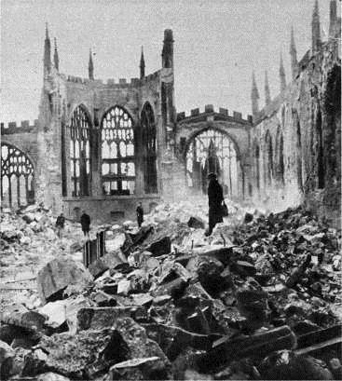


Slide 30
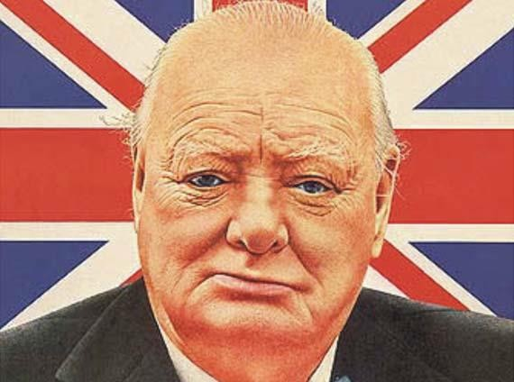
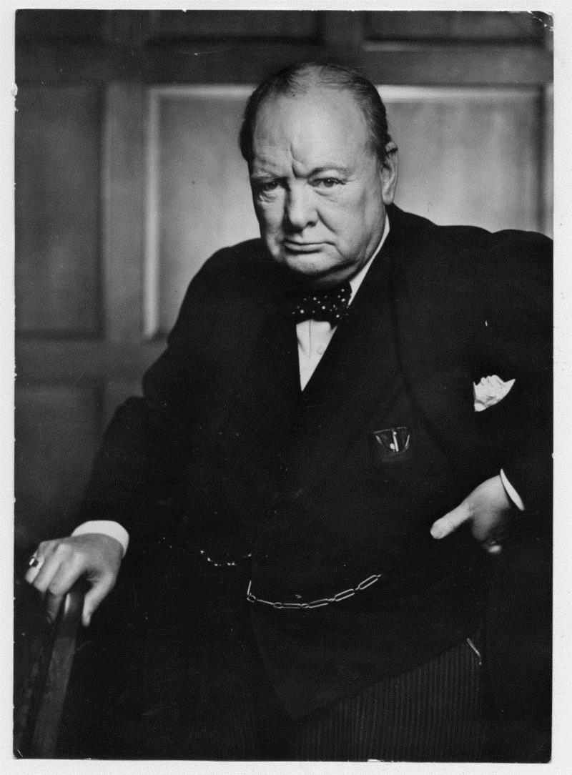
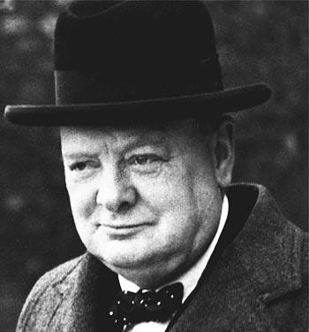
“…We shall never surrender”
Winston Churchill

Slide 31


Other fronts…
Africa
Italy and BR armies compete for oil-rich land
Fights go back and forth for years; GER has advantage
Eastern Europe
Hitler attacks and controls Balkans
SURPRISE! In June 1941, Hitler invades the Soviet Union
Soviet troops retreat!
GER wants Leningrad and Moscow—spends 2 winters trying…

Slide 32
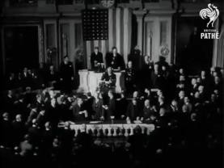
Pacific Front
America stays isolationist until early 1941—then sells arms to the Allies
Japan is gaining land for empire and has its eyes on the Philippines – an American island
Roosevelt makes decision to embargo (not trade) oil, steel, and rubber to Japanese.
  Reasoning is because Japan is an island nation and must import oil.
December 7, 1941—Japan attacks the American naval base at Pearl Harbor
  Significant damage and loss of life
  America declares war on Japan and its allies
Japan attacks other BR and AM colonies at the same time or soon after
  Guam, Hong Kong, Philippines

Slide 33
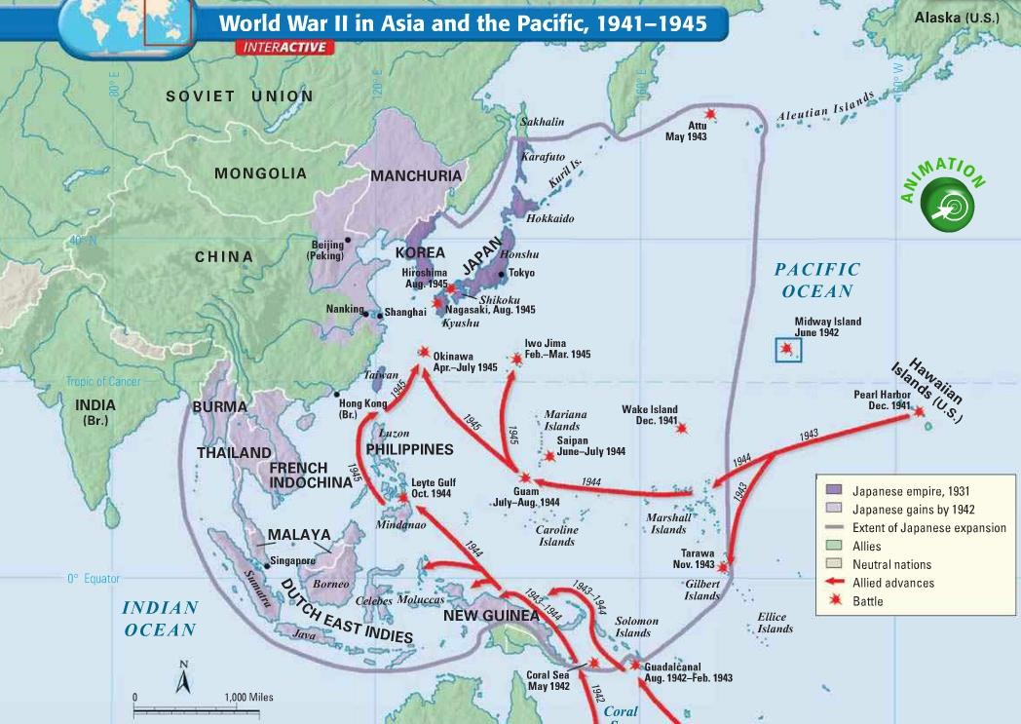

Slide 34
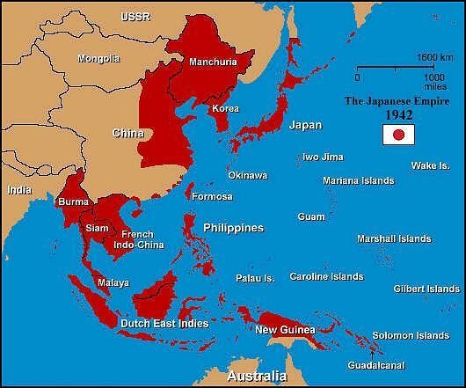


“East Asia for the Asiatics”
not a term to be used now—used in the 1940’s to generally mean people from Asia
Japan wants to convince the 150 million people they conquered that Asia should be ruled by other Asians, NOT COLONIALISTS
Takes control of over 1 million square miles of land
Often treats prisoners with extreme cruelty
Japanese culture: shameful to surrender.

Slide 35
Prisoner of War
“…They took me outside and I was forced to watch as they buried six of my Scouts alive. They made the men dig their own graves, and then had them kneel down in a pit. The guards hit them over the head with shovels to stun them
and piled earth on top.”

Slide 36
Allies Fight Back by Sea
Beginning: Doolittle Raid on Tokyo
  Not too damaging, but inspiring to Americans!
  Upsetting to dominant Japanese!
High point: Battle of Midway
  AM code breakers know where Japan is headed. US Navy waits to attack at JUST the right time. It works!
Savvy move: Island hopping
  AM and AUS forces target important islands instead of fighting for every single one
  Want go get closer to Japan

Slide 37
Battle of Guadalcanal (Japan-controlled
Pacific Island that AM and AUS forces attacked)
“Hell was red furry spiders as big as your fist,…enormous rats and bats
everywhere, and rivers with waiting crocodiles. Hell was the sour, foul smell of the squishy jungle, humidity that rotted a body within hours…Hell was an enemy…so fanatic that it used its own dead as booby traps.”

Slide 38
Holocaust
A mass genocide of races Hitler considered inferior
  Jews were targeted at the greatest rate (remember Mein Kampf)
  Roma, disabled, homosexuals, incurably ill, and others were also targeted
Hitler called it the Final Solution
over six million killed, most in concentration camps

Slide 39
Turning Points
North Africa
Stalingrad
Germans in control after earlier victories
Allies send in two different forces (planned by Dwight D. Eisenhower) to trap the Germans
GER forces in Africa defeated in May 1943
Major industrial city in the Caucus Mtns area of USSR
Hitler wanted total control
Both leaders (Hitler and Stalin) refuse to back down
Enormous loss of life on both
sides (over 1 million Soviets!)
Begins Aug 1942, GER surrenders in Feb 1943

Slide 40
D-Day Invasion
Allies from GB, invade at Normandy in Northern France on June 6, 1944
Largest land and sea (amphibious) attack in history
Allies take heavy losses but push on
Over one million troops land in one month
By September, France, Belgium, and Luxembourg are liberated

Slide 41
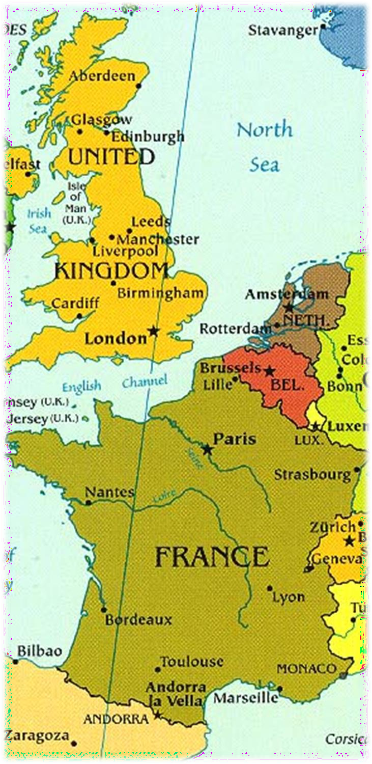
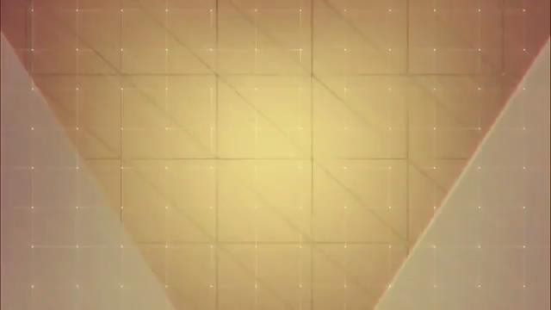
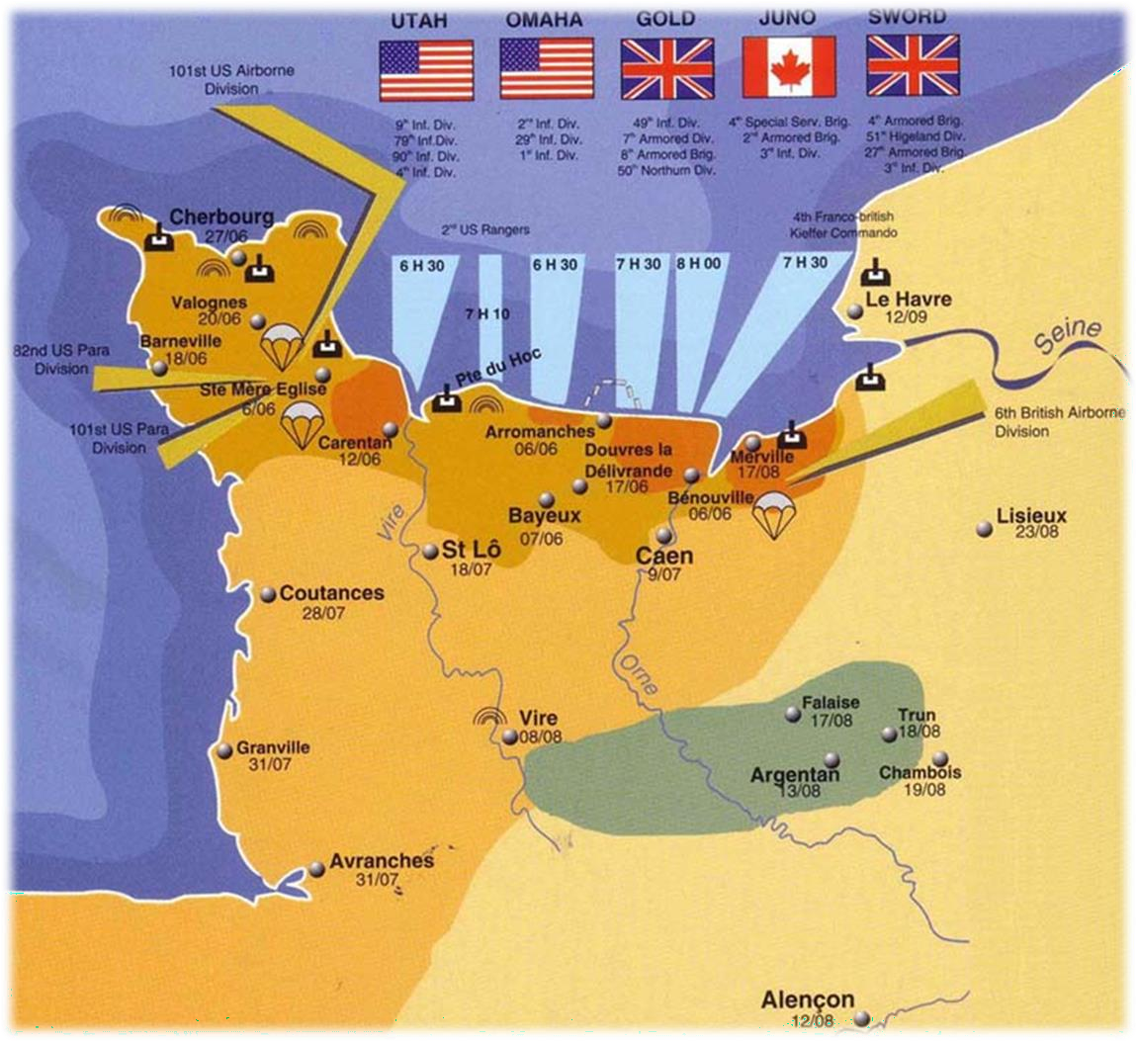

Slide 42
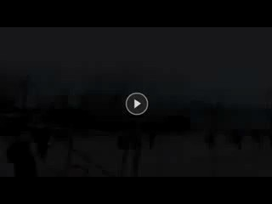
End of War in Europe
Battle of the Bulge—December 1944—Germans break through weak American lines but are eventually forced to retreat
April 1945—Allies invade Germany from East (Soviets) and West (AM, BR, others). Surround Berlin.
April 1945—Hitler and his new wife take their own lives
April and May 1945—Concentration camps are liberated
May 7, 1945—General Eisenhower accepts the unconditional surrender of the Third Reich. Victory in Europe!

Slide 43
Victory in the Pacific
Guadalcanal had stopped any other Japanese advances; now retreating
Battle of Leyte Gulf—October 1944—Allies take back the Philippines and destroy the Japanese naval fleet
More successful (but bloody) island hopping
  Iwo Jima, Okinawa, others. Thousands die.

Slide 44
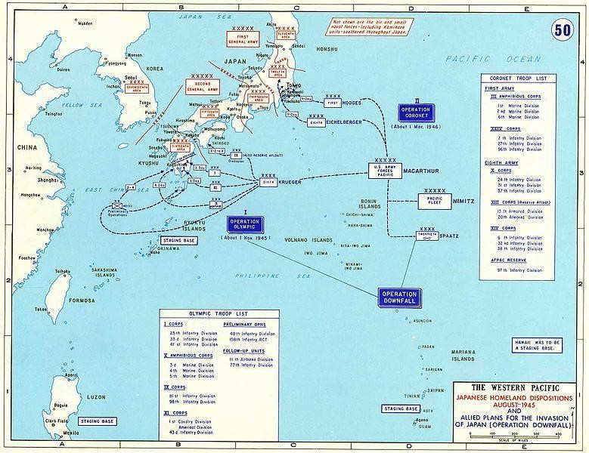
Japanese Surrender
Possible invasion
  Could cost million Allied lives or more
  Could take 10 years
  POW’s and treatment is horrible
Atomic Bombs
first tested July 16, 1945. Japan was warned.
August 6, atomic bomb dropped on Hiroshima
August 9, bomb dropped on Nagasaki
Over 140,000 killed immediately, more of radiation
September 2, 1945—Japan surrenders

Slide 45
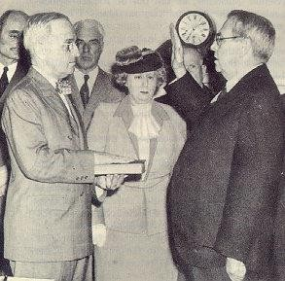

Harry S Truman taking the oath of office after the death of Franklin
D. Roosevelt, April 12, 1945. The following day, Truman spoke to reporters and said, "...I don't know whether you fellows ever had a load of hay fall on you, but when they told me yesterday what had happened, I felt like the moon, the stars, and all the planets had fallen on me."

Slide 46
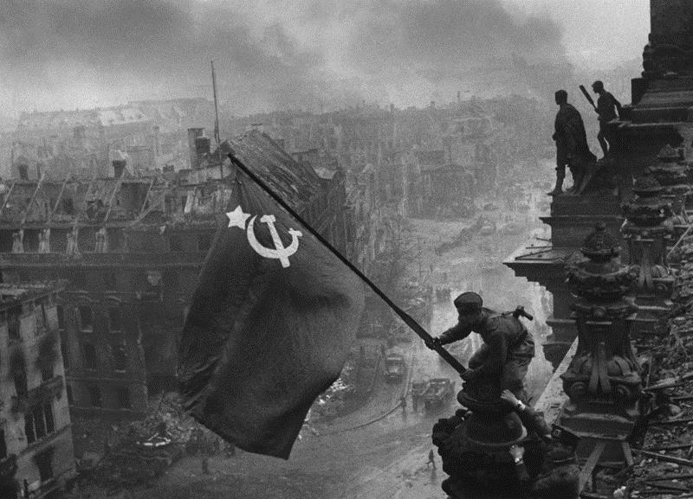
Red army soldiers raising the Soviet flag on the roof of the Reichstag (German Parliament) in Berlin, Germany.

Slide 47
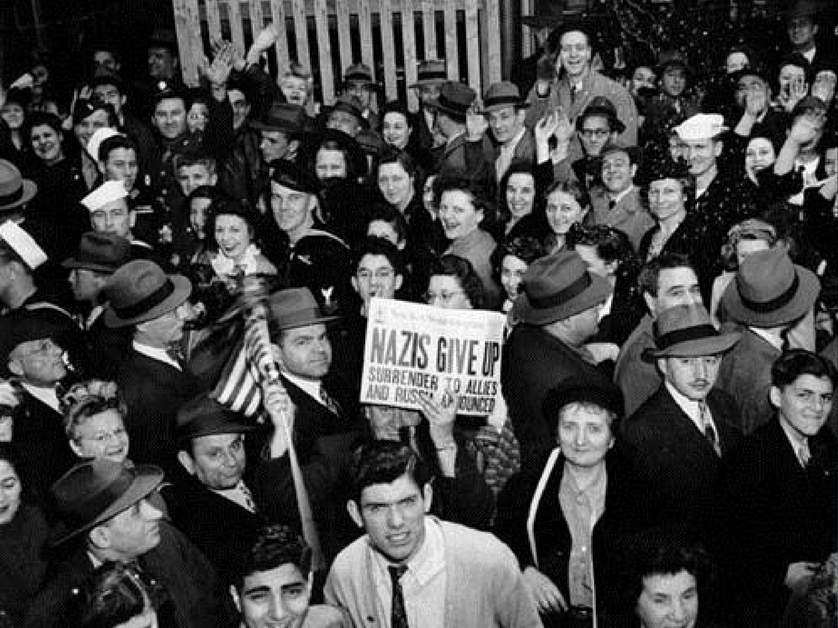
V-E Day Celebrations in New York City, May 8, 1945.

Slide 48
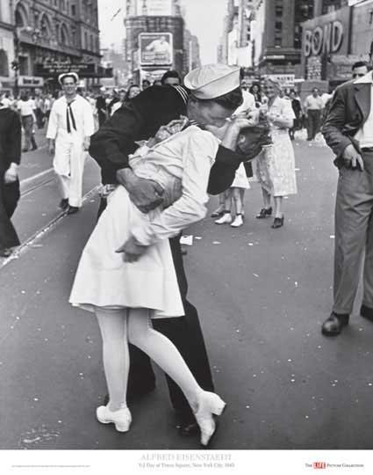
For millions of Americans, Alfred Eisenstaedt's 1945 LIFE photograph of a sailor stamping a masterly kiss on a nurse symbolized the cathartic joy of V-J Day.

Slide 49
Atomic Bomb Reading
In your opinion, did the American generals and the President make the right decision?
  Think about those who were affected (use the reading!) and those who may have been affected if a different decision was made.

Slide 50


Post-War Changes
GOAL: Avoid future wars!
Cities and farms ruined
Governments struggle
Nuremberg Trials—Nazi leaders were charged with crimes. Many were sentenced to prison time or death.
Japan was demilitarized—disbanded the army
  Could fight only if attacked
Japan became a constitutional monarchy
  Constitution written mostly by Americans

