Slide 1
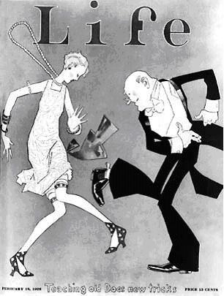



1920’S ENTERTAINMENT:
MUSIC

Slide 2


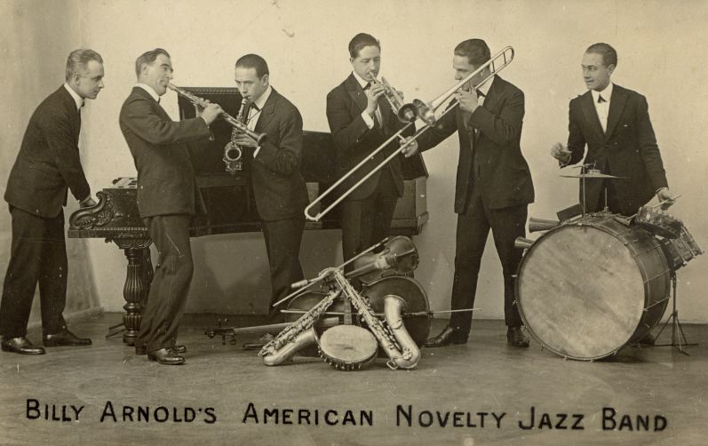
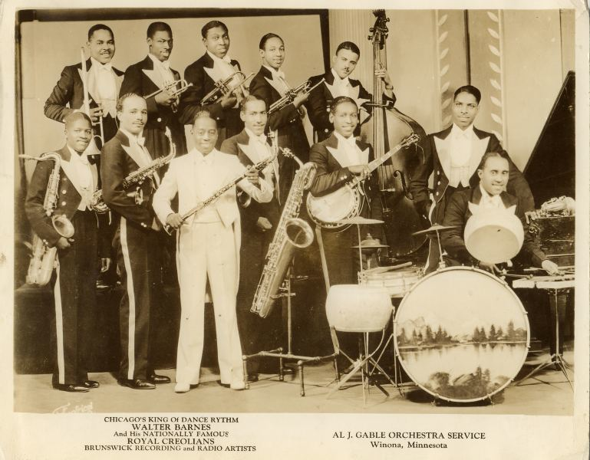
JAZZ BABY, JAZZ!
The Jazz Age saw a new change in music

Slide 3
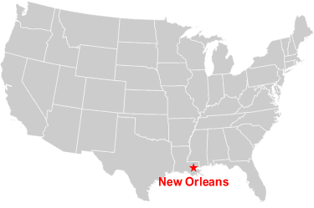
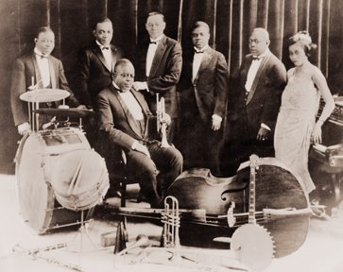
Jazz Music
Jazz grew out of the southern USA (New Orleans), moved north and flourished
Created by African-American communities
Jazz music was the popular style of music (Big Band era)

Slide 4
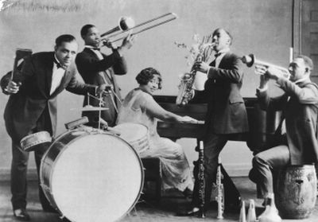
Edythe Turnham and Her Band
(Photo courtesy Black Heritage Society of Washington State, Inc.; Dorothy Hilbert Collection.)

Slide 5
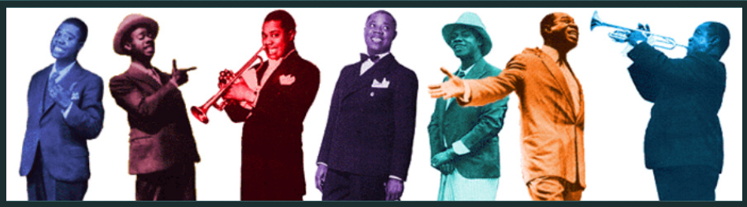
Jazz Music was …
New and exciting
Popular with the young rebel group (speakeasies)
Made more available through the radio and records
Upbeat
Had the reputation of being “immoral” with older parents (racist reasons)
Centers on the use of improvisation

Slide 6



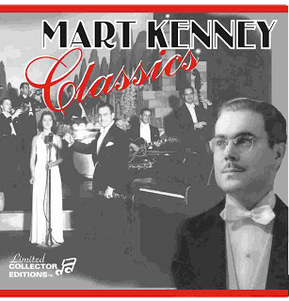
Canadian Radio
What was important, though Canadians probably did not realize it at the time, was the emphasis that the CRBC, which became the Canadian Broadcasting Corporation in 1936, put on home grown talent.
The Mart Kenney band, broadcasting from Vancouver, became known from coast to coast in the thirties.

Slide 7
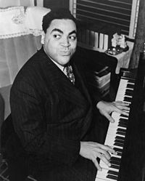
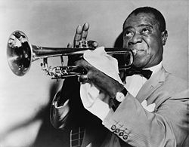
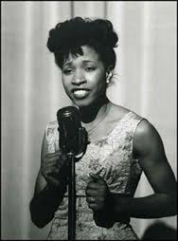
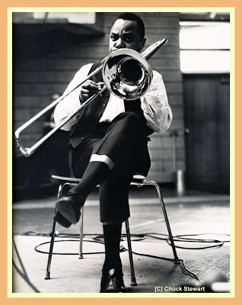
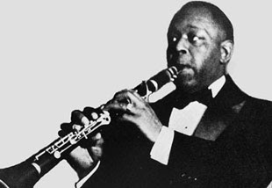
The Jazz Band
Louis Armstrong
Trumpet,
Clarinet,
Trombone,
Piano,
Singer, and
Banjo
Fats Waller

Slide 8
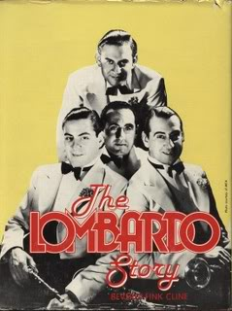
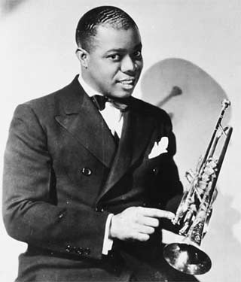
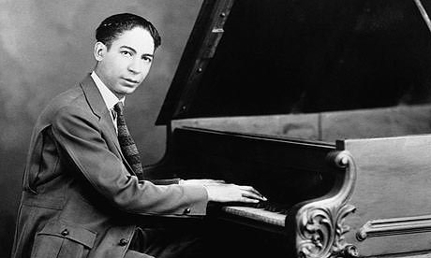
The
Soloist
Louis “Satchmo” Armstrong
Lombardo Brothers
Ferdinand “Jelly Roll” Morton
“King” Oliver

Slide 9
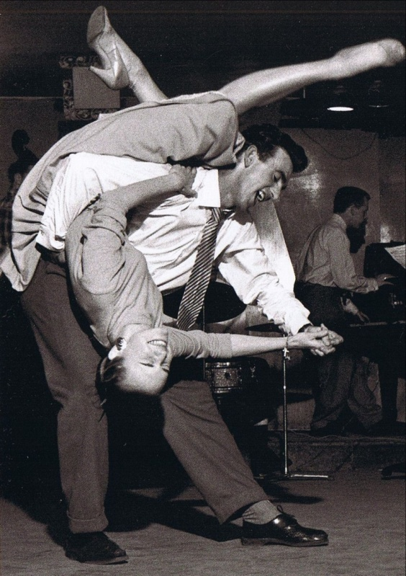
Swing Music
Swing music develops from jazz music in the mid 1930’s
Swing was a dance form of jazz
It was simple, lack of string instruments, and included lots of improvisation

Slide 10
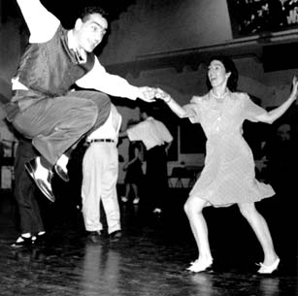

Slide 11
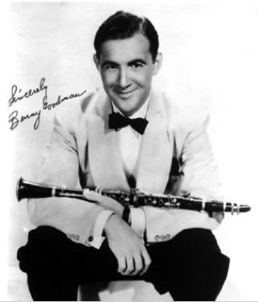
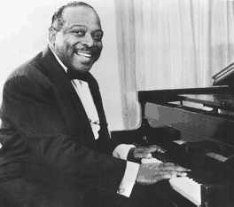
Swing Kings
Benny Goodman
Count Basie

Slide 12
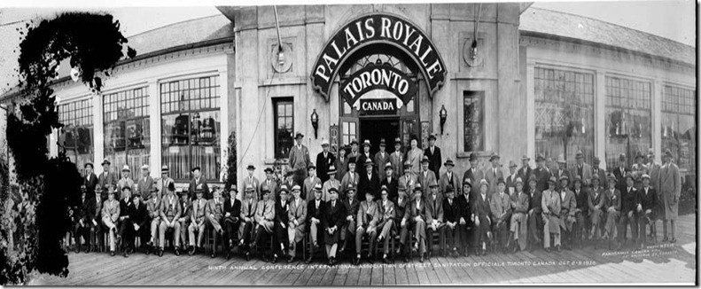
Live Music was King!
The 1920s and 1930s was the era of live music
People swarmed to the dance halls

Slide 13
Live Music was King!
There was many famous Canadian Dance Bands who regularly performed at the same dance hall
Harry Bedlington and His Whispering Orchestra - The Savann, Toronto
Fred Culley - Royal York Hotel, Toronto
Trump Davison - Club Esquire
Glenn Gray - Casa Loma, Toronto
Nelson Hatch - The Old Mill, Toronto
Mart Kenney and His Western Gentlemen - All of Western Canada
Horace Lapp - Royal Muskoka Hotel
Ferde Mowrie - Club Embassy, Toronto
Bert Niosi - Palais Royale, Toronto
Dal Richards - Panorama Roof Gardens, Hotel Vancouver
Don Romanelli - Royal York Hotel, Toronto
Luigi Romanelli - King Edward Hotel, Toronto
Ozzi Williams - Club Kingsway, Toronto

Slide 14

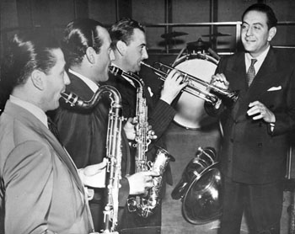
Guy Lombardo and his Royal Canadians
CDN
He was the most popular band leader on the American music scene at the time
Guy Lombardo was born in London, Ontario
His band, the Royal Canadians, sold at least 100 million records
Between 1929 and 1952, there wasn’t a single year that his record didn’t chart (21 of them were at #1)

Slide 15
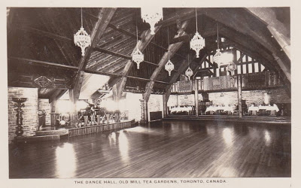
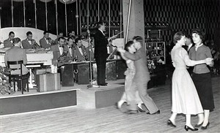
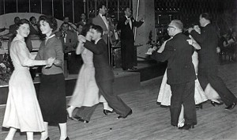
Photograph of the Syd Dean band in full swing
Photograph of dancers at the Regent Ballroom

