Slide 1
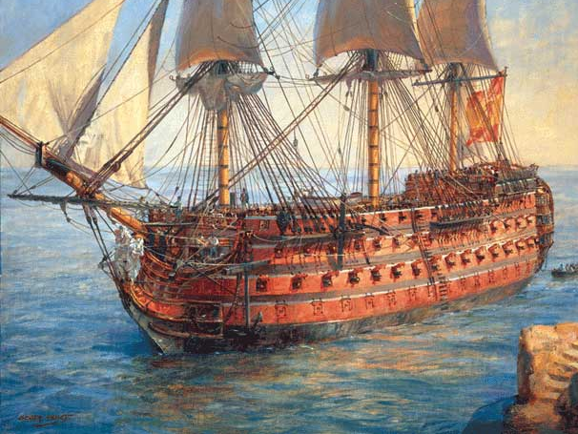
SPAIN IN THE 18th CENTURY

Slide 2
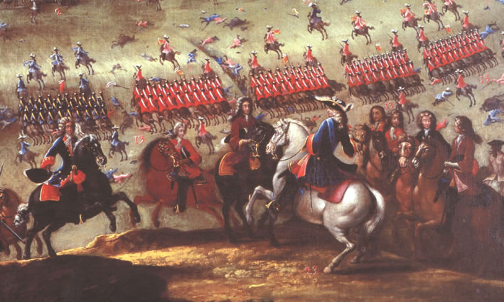
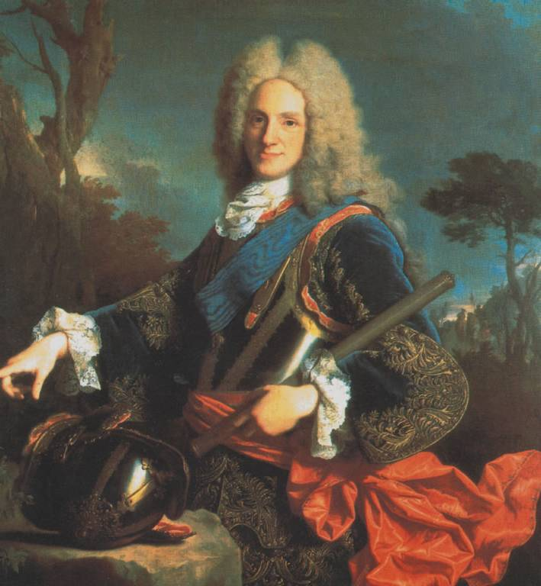
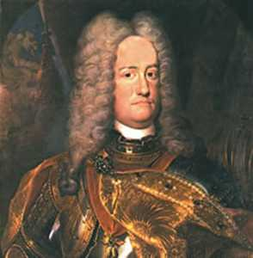
War of the Spanish Succession (1701-1714)
In 1700, Charles II of Spain died childless, leaving his possessions to Philip, duc d'Anjou, grandson of King Louis XIV of France. Philip became Philip V of Spaiin.
The War of the Spanish Succession (1701-1714) was fought among several European powers (mainly the German Empire, Great Britain, the Dutch Republic, Portugal and the Duchy of Savoy), against the Kingdoms of France and Spain, over a possible unification of the Kingdoms of Spain and France under a single Bourbon monarch.
It resulted in the recognition of Philip V as King of Spain while requiring him to renounce any claim to the French throne and to cede the Spanish possessions in Europe.
The war concluded with the treaties of Utrecht (1713) and Rastatt (1714). As a result, Philip V remained King of Spain but was removed from the French succession. The Austrians gained most of the Spanish territories in Italy and the Netherlands.
With regard to the political organization of their kingdoms, Philip issued the Nueva Planta Decrees, following the centralizing approach of the Bourbons in France, ending the political autonomy of the kingdoms; territories in Spain that had supported the Archduke Charles lost their charts and institutions. The Kingdom of Navarre and the Basque Provinces did not lose their autonomy and retained their traditional differentiated institutions and laws (fueros).
Almansa battle
Philip V
Archduke Charles

Slide 3
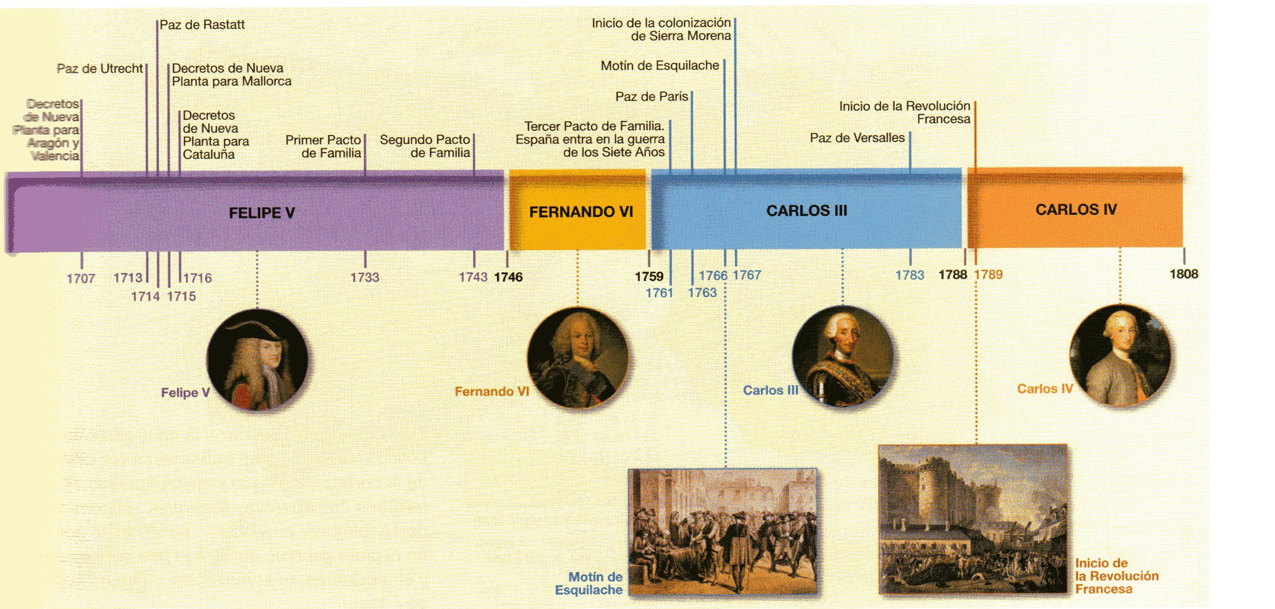
Timeline

Slide 4
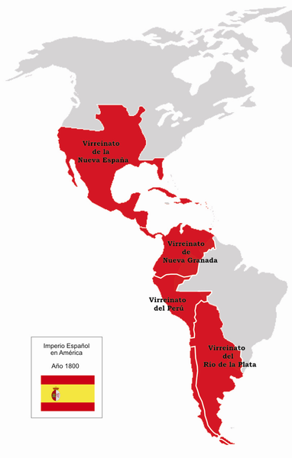
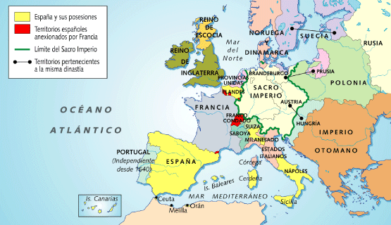
LOST EUROPEAN TERRITORIES
AMERICAN VICEROYALTIES

Slide 5

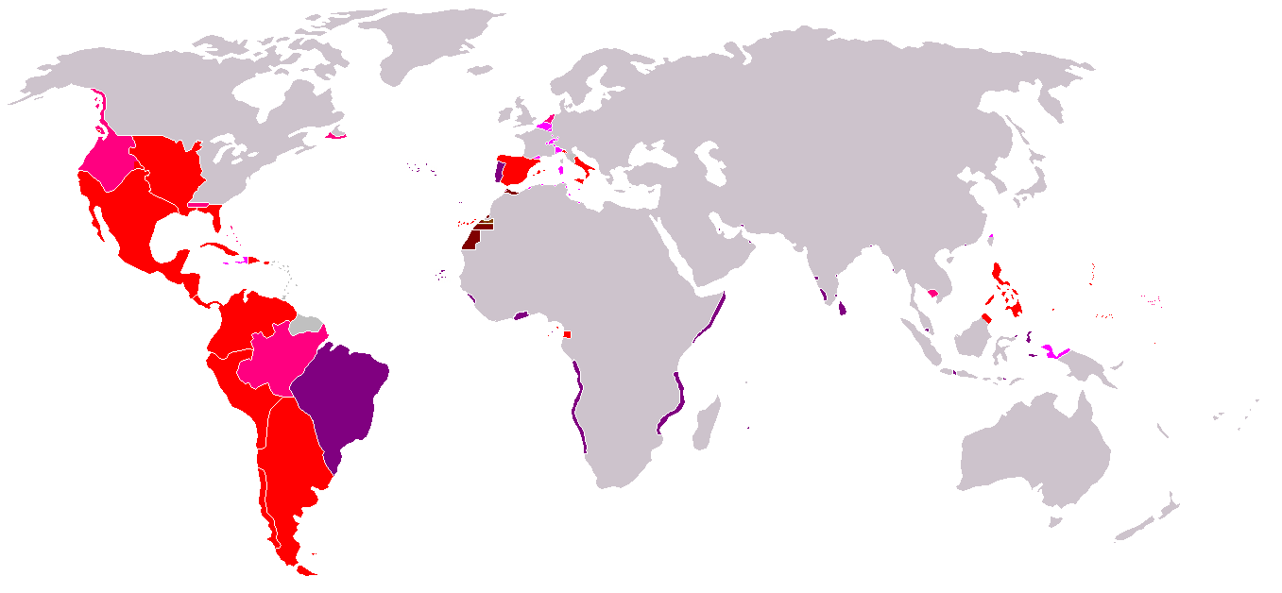
TERRITORIAL HEIGHT OF
SPANISH EMPIRE
The old flag of
Spanish Empire

Slide 6
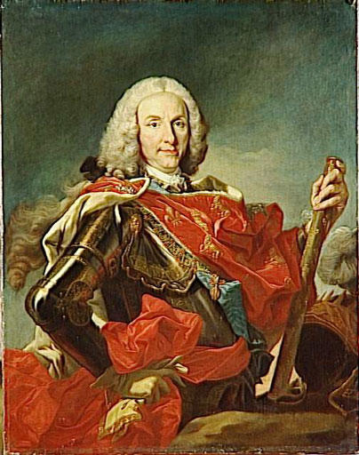
Philip V (1700-1746)
1707/1716: NUEVA PLANTA DECREES for Aragonese Crown countries. Aftermath: a centralized government following Castilian model, a real state without customs inside. Spain is divided into provinces.
Ruled as an absolute monarch so Parliament (Cortes) was not summoned.
In 1724, a short reign of Louis I, his son.
The king ruled with ministers: Most important one was Patiño reorganized a powerful navy.
Foreing policy: Spain lost its remaining European dominions in 1714. Spain reconquered some of its Italian possessions from the Austrians in the 18th century, placing Bourbon princes on the thrones of Parma, Naples, and Sicily. However, these were not incorporated again into the Spanish Crown.
Two Family Compacts with France against England were signed.

Slide 7
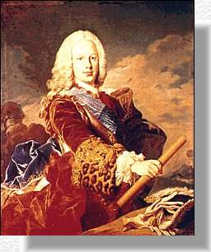
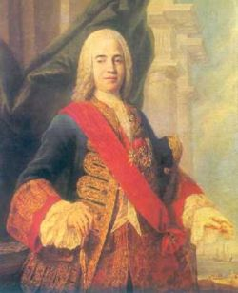
Ferdinand VI (1746-1759)
Educated and clever.
The Marquis of Ensenada, his more important minister, made a lot of public works and reorganized the Treasury to get more taxes. He strengthened the navy, called foreing technicians and scientists and he also ordered to make the famous cadastre (Catastro), a general report about the wealth of the country and the taxpayers.
He ended Spanish participation in international conflicts and foreign policy was based on neutrality.
The King
Ensenada

Slide 8
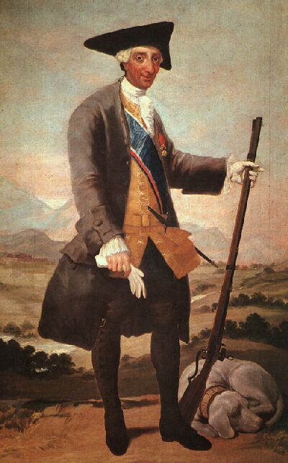
Charles III (1759-1788)
A good King and major for Madrid, surrounded by good ministers: Aranda, Floridablanca, Campomanes.
Former king of Naples and Sicily.
Third Family’s Pact with France (England is already a serious threat for the Empire): as a result of the Seven Years’ War, France lost Canada and Spain, Florida. As a compensation, France gave Louisiana to Spain.
France and Spain supported Americans against British (War of Independence): 1783, Peace of Versailles, Spain recovered Florida and Menorca.
INSIDE REFORMS (Enlightened despotism):
  Sierra Morena colonization
  Royal manufactures (silk, crystal, tapestries, china) and cotton mills (Catalonia)
  Free trade among Spanish and American ports, big shipping companies
  New roads and bridges
  Canals, as Castile or Imperial ones
  New clothes (shorter capes, three point hats). This thing and the wheat’s high cost caused a rebellion against the minister Esquilache (1766)
  Jesuits’ expulsion (Indian missions in Paraguay will be abandoned)

Slide 9
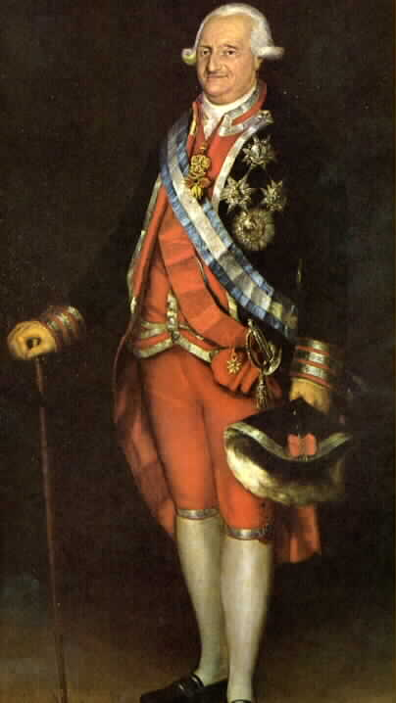
Charles IV (1788-1808)
No interest, no competence.
The government, in Prime Minister Manuel Godoy (Queen’s favourite) hands.
Spain follows French foreign policy.
Reforms will be stopped because of the fear for French Revolution.
Moreover, reforms will be failed because bourgeoisie is a weak minority, people have a conservative and religious closed mind and ancient nobility and clergy were very powerful.

