Slide 1
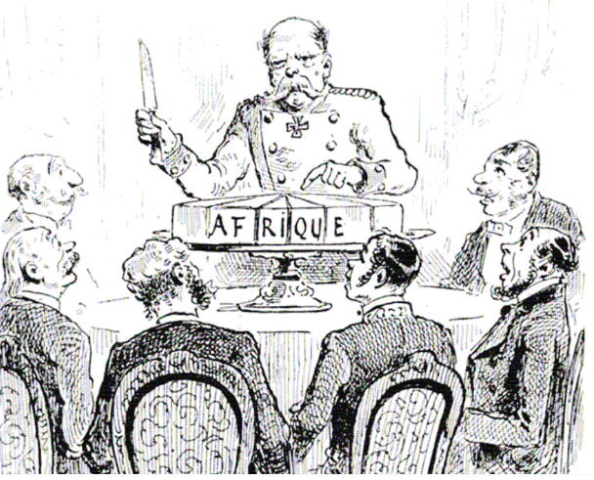
THE SCRAMBLE FOR AFRICA

Slide 2
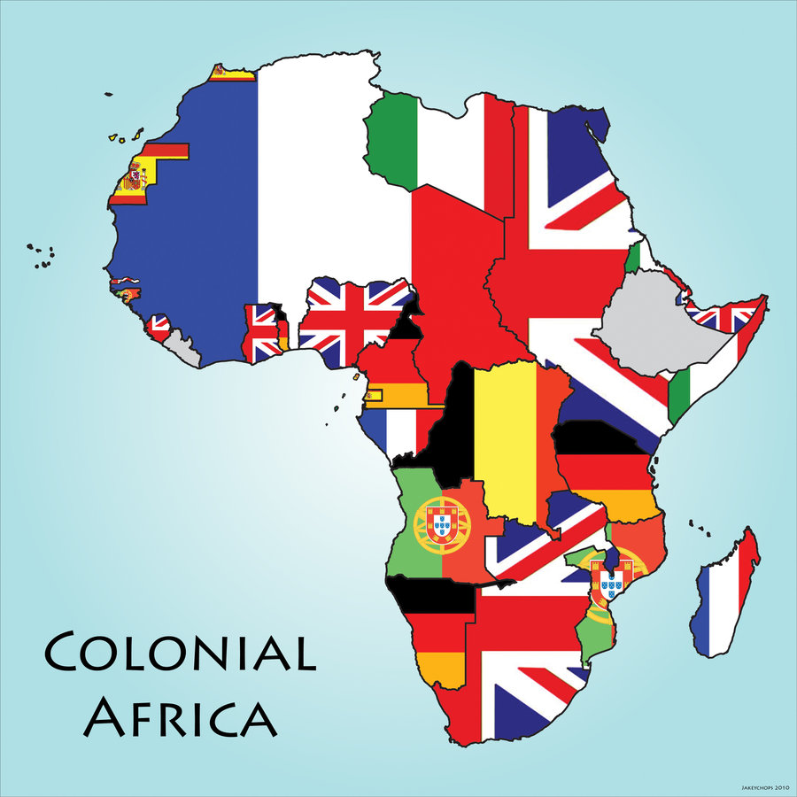

Slide 3
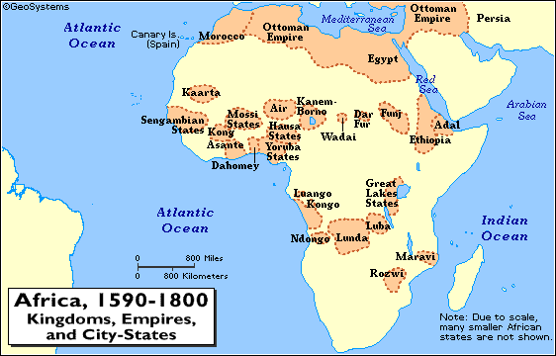
At the beginning of the 19th century…
Africa was home to great empires and rich cultures.
By that century’s end Africa was a place of European colonial powers and oppression.
European governments controlled much of the continent, the continent hasn’t been the same since.
Much of the poverty and violence of the 20th century is a direct result of colonialism

Slide 4
Colonizing the Continent
During the 15th century Portuguese ships, looking for trade routes to Asia, landed in Africa.
Soon other countries established coastal trading stations there.
Europeans were initially timid about going to the interior- “the white man’s grave.”

Slide 5
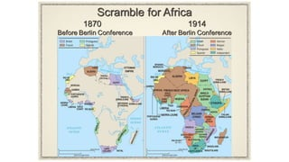
COLONIZING THE CONTINENT
By mid-1800s, the Europeans were aware of the rich resources in Africa, and wanted to use them to fuel their developing industrial economies.
Advances in science and technology made the trip into the interior more attractive:
* Conquest driven by the desire for territory, resources, and European nationalism.

Slide 6
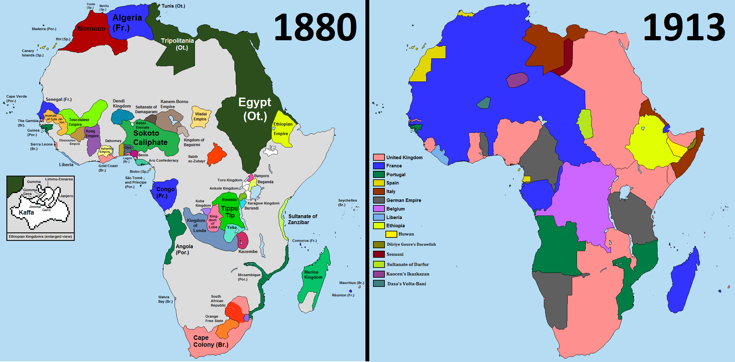
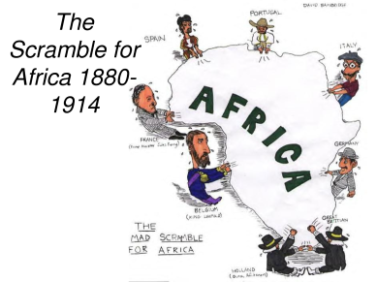

Slide 7
King Leopold II
King of Belgium
Interest in Congo after exploration in the 1870s
Wanted to open trade along the Congo River
Controlled the area by 1884, paving the way for the Berlin Conference and the “Scramble for Africa.”
Forced labor in the extraction of rubber, palm oil, ivory etc.

Slide 8
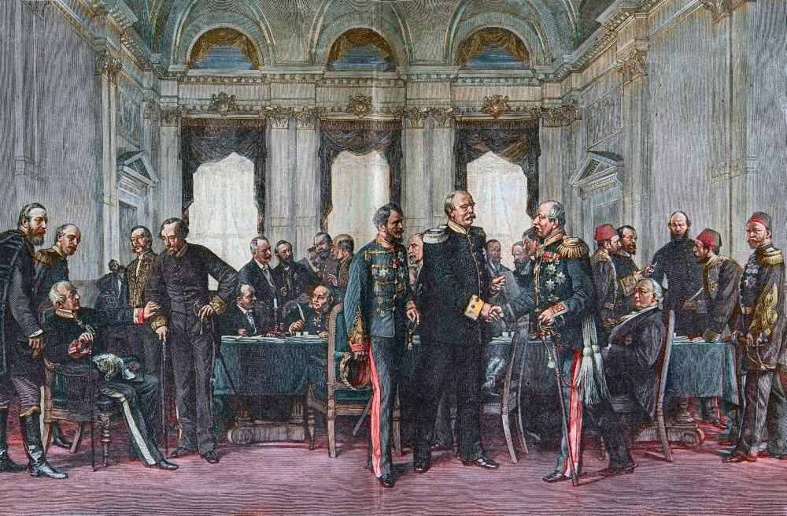
To prevent wars between the European powers, 14 nations convened at the Berlin Conference- 1884-1885, to lay down rules for dividing Africa (no Africans invited)
Essentially, any nation could claim land by telling other nations and demonstrating they could control the area.
Continent was divided without regard for where ethnic and linguistic groups lived
Set boundaries that combined people who were traditional enemies, dividing those that weren’t

Slide 9
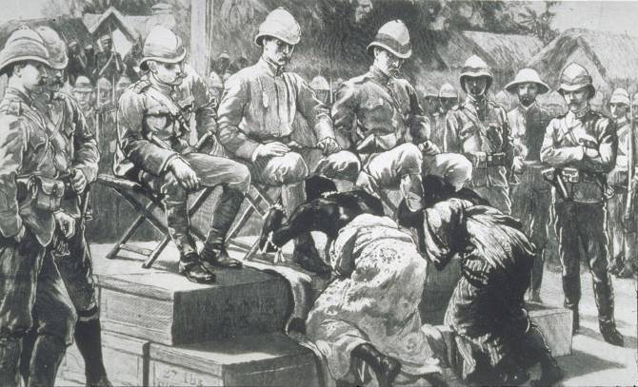
Ideology for Conquest
Conquest needed to be presented in legitimate terms, not just purely economic
Rudyard Kipling’s “White Man’s Burden”-1899
Argues for t
he obligation that Europeans have to civilize the African continent
Non-christenized and childlike, be their savior

