Slide 1






The Agricultural Revolution
Britain 1750–1900
Icons key:
For more detailed instructions, see the Getting Started presentation
Flash activity. These activities are not editable.
Teacher’s notes included in the Notes Page
Web addresses
Accompanying worksheet
Sound
1 of 22
© Boardworks Ltd 2006

Slide 2



Learning objectives
What was farming like before the Agricultural Revolution?
How did the Agricultural Revolution change farming in Britain?
Did everything really change during the Agricultural Revolution?
Learning objectives
2 of 22
© Boardworks Ltd 2007
Notes:
Worksheet One accompanies the whole presentation.

Slide 3
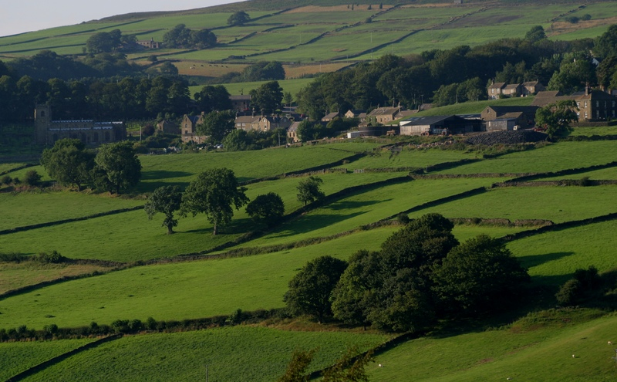
Enclosure
By 1700, only about half of the farmland in England still used the Open-Field System. The rest had been enclosed by acts of parliament.
Enclosure meant that the common land, meadow, and the three fields were reorganized and redistributed. A farmer’s land was now all in one area and he could enclose his fields with fences and hedges.
Each farmer could choose which crops to grow, try out new crops and ideas and control selective breeding. Farming became altogether more efficient and more productive.
What were the benefits of enclosure?
Notes:
Photo © 2007 Jupiterimages Corporation

Slide 4
The effects of enclosure

Slide 5
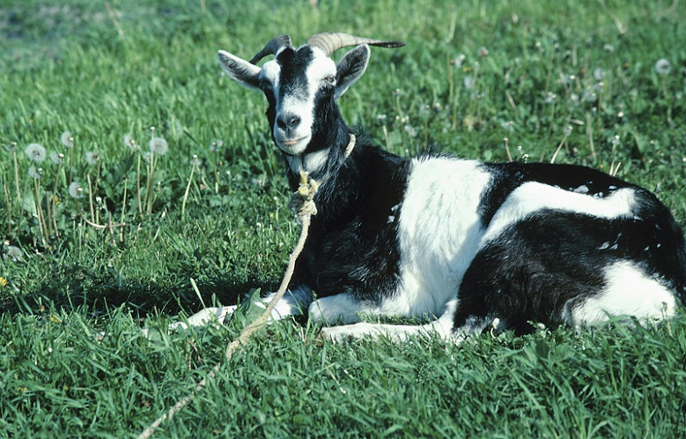
The effects of enclosure
Enclosure might have increased the efficiency of farming in England, but it wasn’t good news for everyone who lived in the countryside.
What type of farmland was lost during enclosure?
How might this have made life more difficult for some villagers?
Many poorer people relied on the common land to supplement their tiny incomes. After enclosure, there was nowhere for them to graze a few animals, collect tinder or pick berries.
Notes:
Photo © 2007 Jupiterimages Corporation

Slide 6
Crops – what changed?
Many farmers sought to improve their crop yields. To do this, they improved the soil by muck spreading, adding lime or planting crops which put nitrogen back into the ground.
Fodder crops, such as turnips and clover, were grown. These helped restore the soil’s fertility, so there was no longer any need to leave the land fallow.
Year 1
Year 2
Wheat
Turnips
These new crops could be fed to livestock, allowing animals to be kept over the winter, rather than being slaughtered in the autumn.
Clover
Barley
Year 3
Year 4

Slide 7
Crops – what changed?
Notes:
Image © 2007 Jupiterimages Corporation

Slide 8
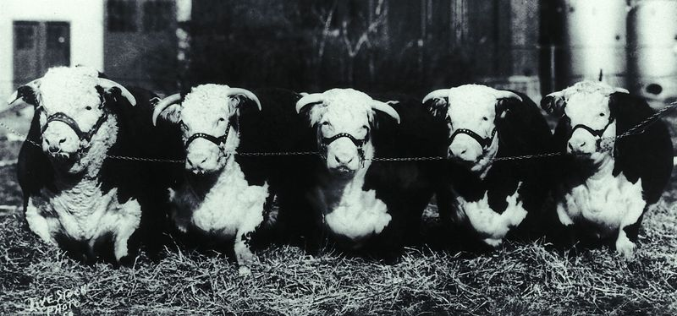
How did the farmers produce more meat?
Enclosure allowed farmers to control the breeding of their livestock because the animals could be separated into different fields.
The farmer could then select the best individuals to breed from in order to produce the biggest, healthiest offspring.
This is known as selective breeding.
The new fodder crops also helped farmers produce more meat, as they could now keep most of their animals through the winter, instead of slaughtering many at a young age.
Notes:
Photo © 2007 Jupiterimages Corporation

Slide 9
How did the farmers produce more meat?
As a result, cattle more than doubled in weight and sheep more than tripled between 1710 and 1795.
Enclosure also prevented the spread of disease from one herd to another.

Slide 10
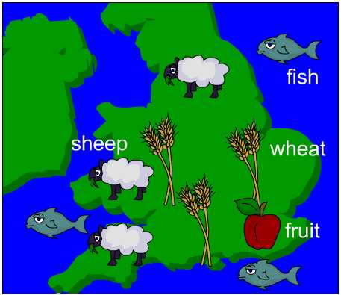
Specialization
Before 1750, most people were subsistence farmers. This means that they produced only what they needed to survive. Across Britain, families each grew a little corn, some root vegetables and kept a few animals.
Enclosure allowed farmers to specialize in the crops or animals best suited to their local climate, soil and terrain.
For example, the flat fertile land in East Anglia was ideal for wheat; fruit trees flourished best in Kent, while the hills of Wales were great for sheep farming.
Farming was far more productive if the conditions were ideal.
Farmers became experts in their specialist produce.

Slide 11
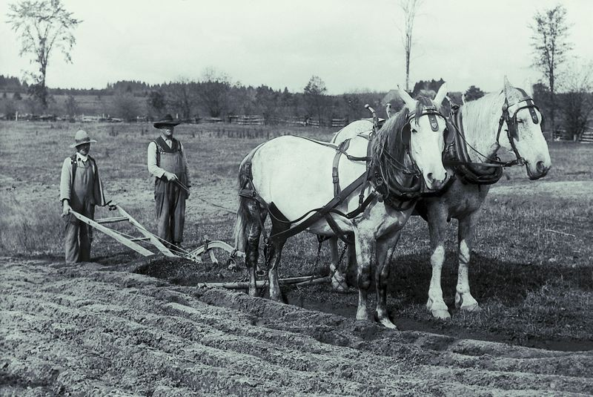
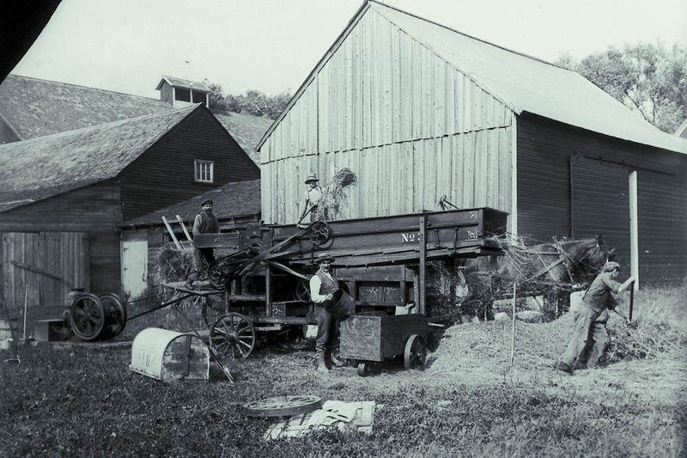
New machinery
Before 1750, farming was done by hand, with horses pulling ploughs and carts.
With the growth of the iron industry, new, heavy duty tools could be mass produced.
New machines were invented for activities such as threshing corn.
Notes:
Photos © 2007 Jupiterimages Corporation

Slide 12
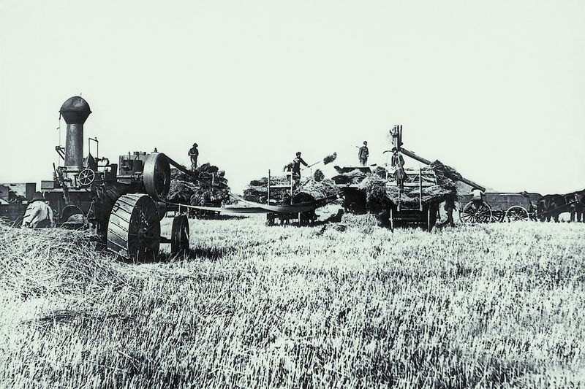
New machinery
Many machines were still horse-powered, but by the 1850s there were steam-powered traction engines which powered ploughs, chaff-cutters and other machines.
These new machines transformed work in the countryside. One or two men could operate a steam tractor which would do the work of ten men.
Notes:
Photo © 2007 Jupiterimages Corporation

Slide 13
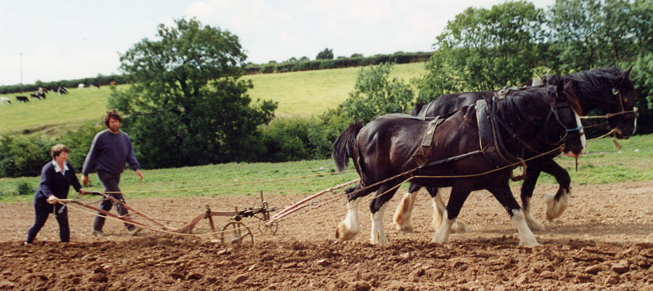
Horse power
Horses were usually a farmers most valuable possession in 1750, as they were the only alternative to hand-power.

Slide 14
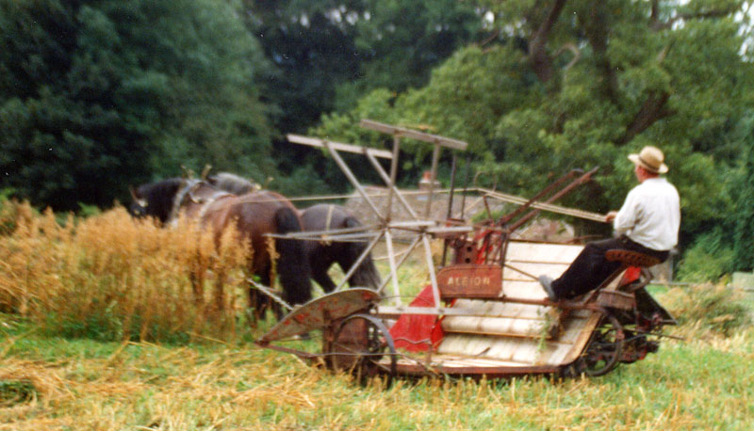
Horse power
During the 19th century, machinery was designed that could do the work of several men, but was often still horse-powered.

Slide 15

Effects of the Agricultural Revolution
Notes:
Correct answers:
Greater efficiency and mechanization meant that… much more food could be produced.
Fewer workers were needed to… produce the food so it became cheaper.
Fewer agricultural jobs caused the rural population to… decline in many areas with migration to the towns.
The percentage of the population living and working… in the countryside fell from 80% in 1750 to just 20% in 1900.
Better nutrition resulted… in an increased population.
A larger workforce enabled… new industries to start up.
Photo © 2007 Jupiterimages Corporation

Slide 16
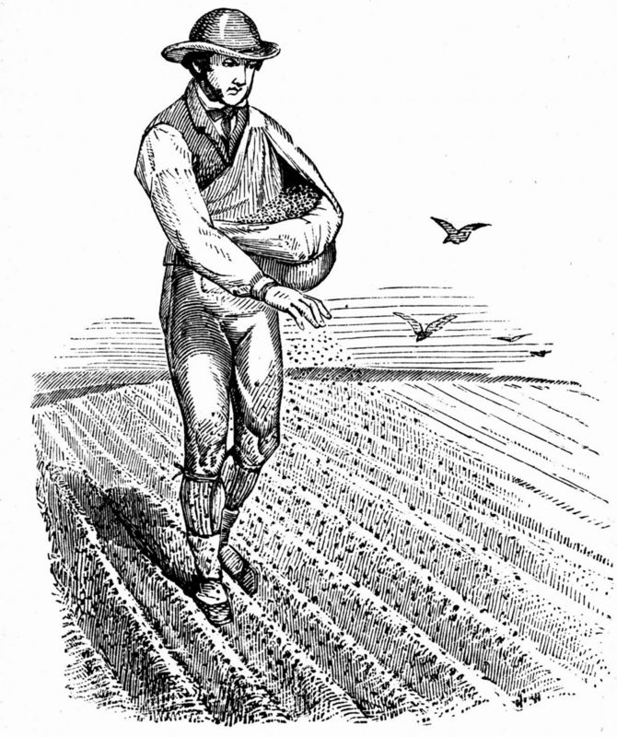
Effects of the Agricultural Revolution
Life in the countryside changed dramatically
during the Agricultural Revolution.
Without access to common land, those who
had very small farms, or no land at all, found
it difficult to get by. Mechanization meant that
fewer labourers were needed.
Many people in the countryside found themselves out of work. The only help these people had was poor relief.
Those who could not support themselves went into workhouses, paid for by the wealthier people in society.
Others left the countryside to find work. These people met with other difficulties in the new industrial towns.
Notes:
Image © 2007 Jupiterimages Corporation

Slide 17
The Agricultural Revolution
Notes:
Photo © 2007 Jupiterimages Corporation

Slide 18

Activities
Why was the Agricultural Revolution so important?
(Clue: think about what might have happened if
production had not increased.)
Imagine it is 1900. You have been asked to organize an exhibition showing the changes in farming over the last 150 years.
Choose either 2 or 3:
Write a report detailing the main themes you will be including: something about each of animals, crops, land and machinery. What exhibits would you show?
Design a brochure or poster to advertise the exhibition.

