Slide 1
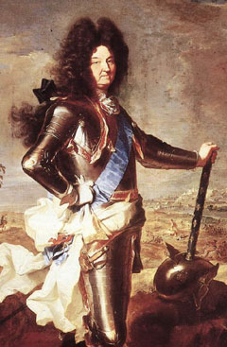
Highlights from the War of Spanish Succession
1702-1713
Louis XIV’s last war.

Slide 2
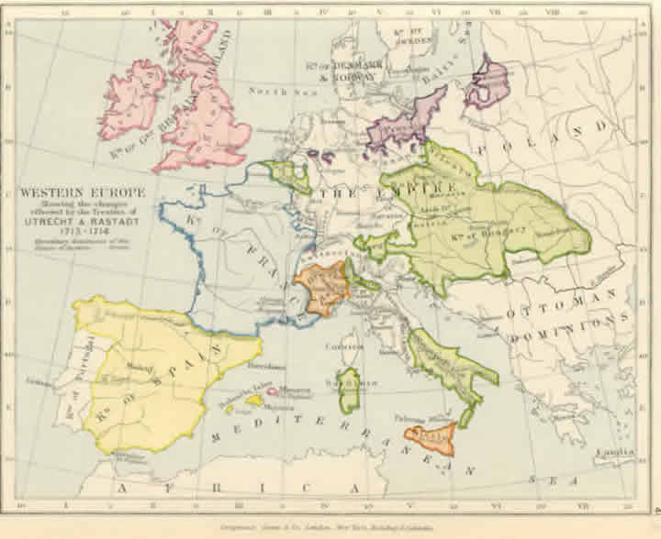
For thirty years, France and England had tried to maintain a balance of power in Europe. This was done through war and alliances
Many smaller states also placed themselves in this mess through diplomatic maneuvering.

Slide 3
While France and England dominated European Politics, Spain declined…
In Spain, the last Hapsburg monarch, Charles II was a product of years of inbreeding.
He was mentally deficient, drooling, hunchbacked.

Slide 4
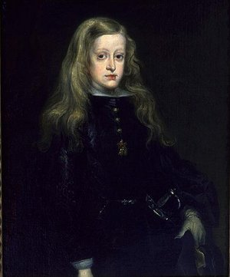
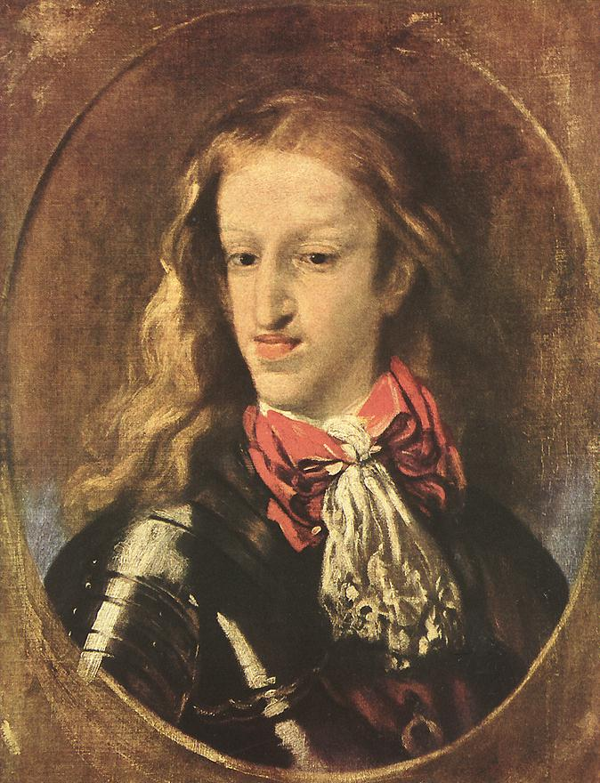
He should have died in his youth, but he didn’t!! (God’s intervention??)
Was likely impotent

Slide 5
The Dutch (newly independent of Spain) and France did not want the Hapsburg empire to be united as it had been under Charles V (HRE)
With no heir…Who would take control of Spain?
3 claimants
  Louis XIV’s grandson
  Leopold I (HRE)’s son
  Joseph Ferdinand of Bavaria (neither Bourbon nor Hapsburg!) related by marriage

Slide 6
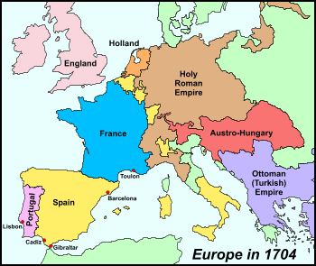

Slide 7
As Charles weakened William III and Louis agree that the Hapsburg domains should be split between France and Austria. (1698)
All this was done while Charles II was still alive!
When Charles II found out about this. He was so angry that he changed his will leaving everything to Joseph Ferdinand.
1699 JF dies!

Slide 8
Louis and William negotiate partition treaty again dividing Spanish possessions in Europe.
Charles changes his will to favor Bourbon claim (Philip, second grandson)

Slide 9
Louis accepted the throne on behalf of his Grandson Philip, causing a huge uproar among the powers. This meant that a Bourbon would now sit on the throne of Spain AND France.

Slide 10
One diplomat even cried out that
“The Pyrenees are no more!”

Slide 11
The fight was really a French Austrian issue, but nothing in Europe is ever that simple…
Alarmed by France's ambitious demands, England and Holland enter the fray in 1702 in support of the Austrian emperor.
  (2 protestant nations fighting for the HRE)

Slide 12
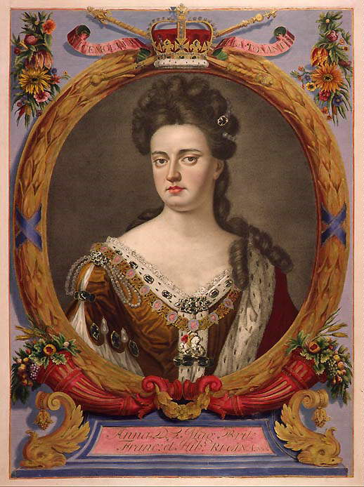
This alliance was called the Grand Alliance. William died two years later, in 1703. His sister in law (Mary’s sister) Anne inherited the throne. The Grand Alliance held… and Anne took up her brother- in- law’s war.

Slide 13
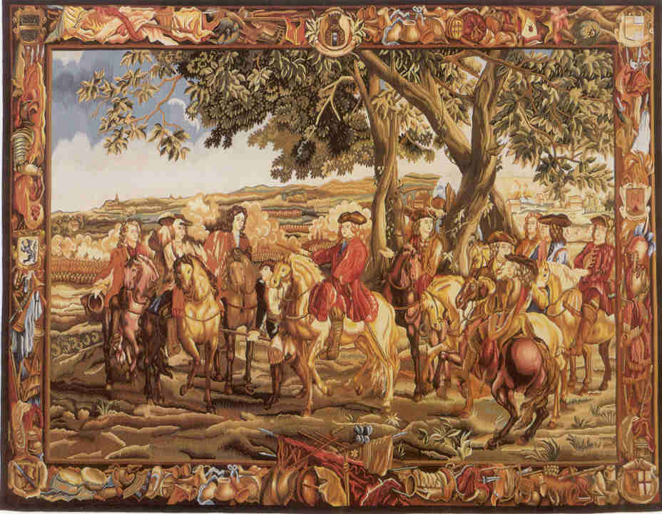
Battle of Blenheim (1704)…

Slide 14
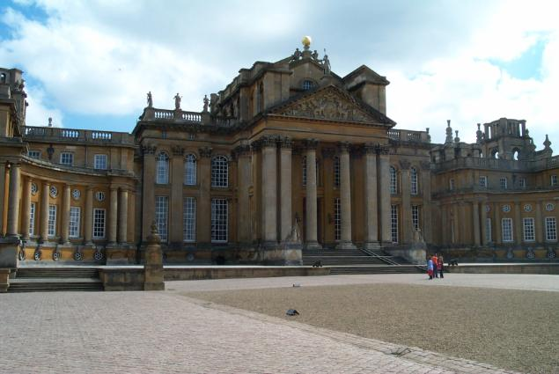

Slide 15
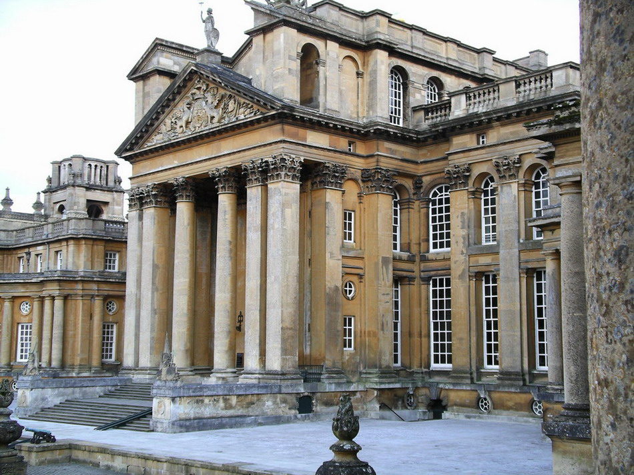

Slide 16
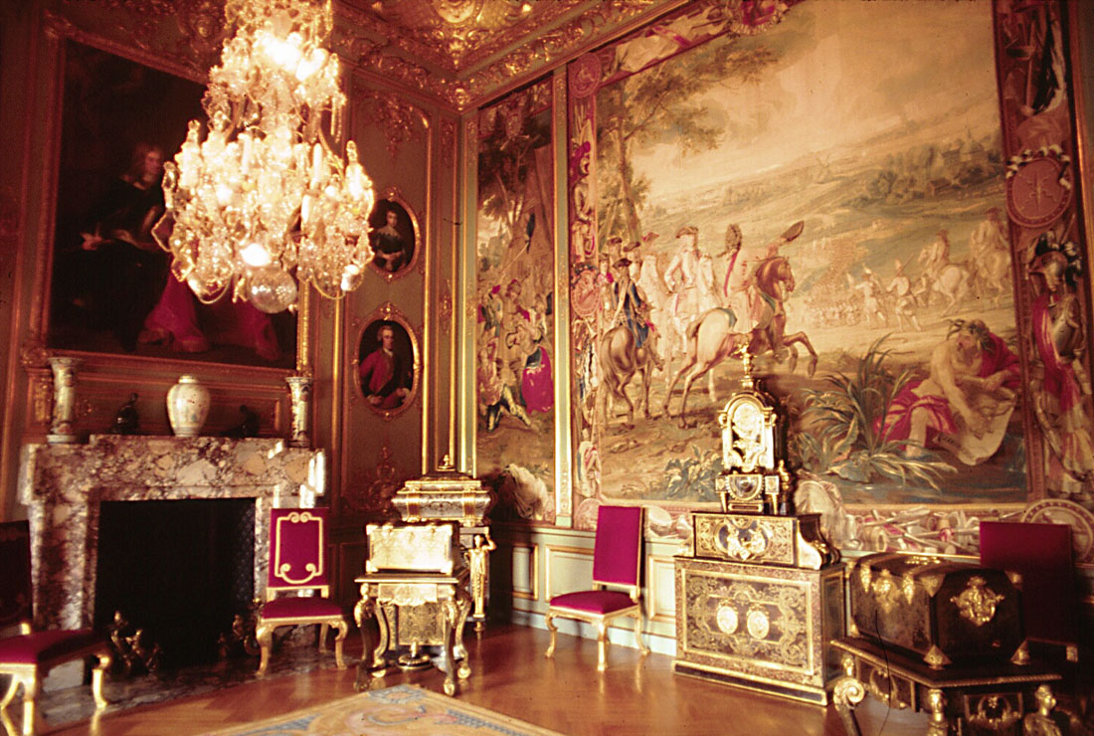

Slide 17
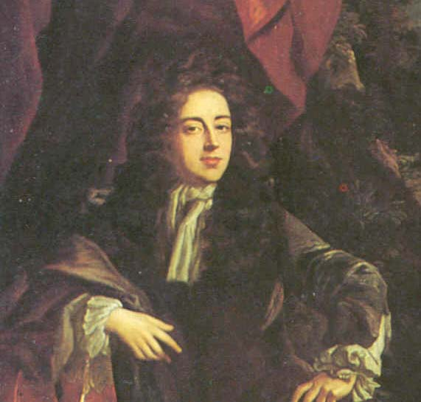
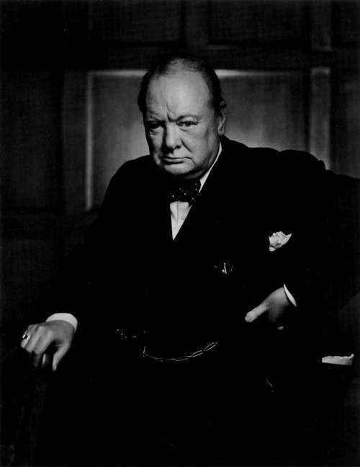
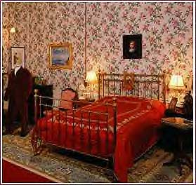

Slide 18
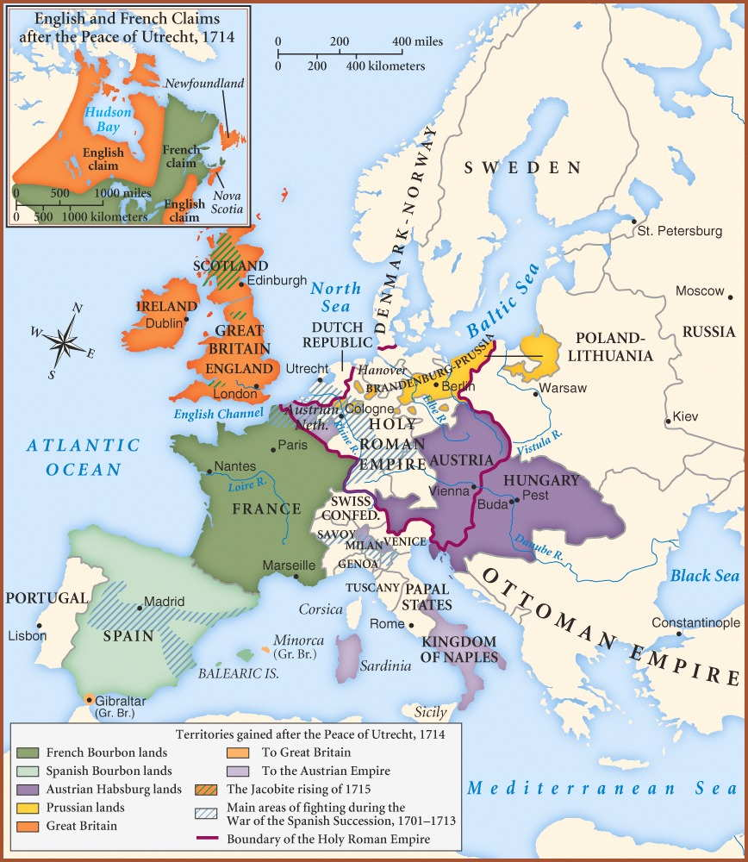
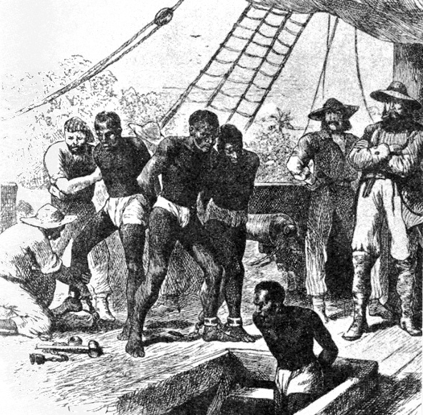
Treaties of Utrecht 1713
Philip V is King of Spain but relinquishes all rights to the throne of France
Spanish Netherlands ceded to Austria
Brandenburg is renamed Prussia and has a King!
  Alsace is ceded back to France
Britain and Netherlands gain slaving rights to Spanish colonies

Slide 19
The English emerge as the clear victors.
They gain Gibraltar and control the mouth of the Mediterranean
They gain territory in the New World from France (Canada)
France repudiates the claims of the Stuart ancestors of James II and accepts the line of Protestant rulers.

Slide 20
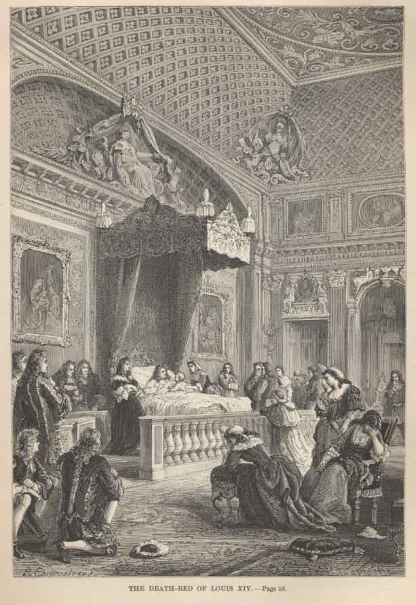
Louis dies September 1, 1715.
In Paris, people cheer his death.
He out livcs many of his heirs.
He spent too much and fought too many wars. France is broken, but still great.

